Slide 1

Introduction to the CASU Concept
Review of Phase I

Slide 2

The Facilitating Our Future Series
September 16, 2020: An Introduction to the CASU Concept and Review of Phase 1.
October 14, 2020: Exploring Community Aspirations as a Foundation for Implementing the CASU Model.
November 11, 2020: Creating an Entrepreneurial Ecosystem as a Structural Imperative for the CASU Model.
January 13, 2021: Crafting the Community Model Canvas as a Tool for Creating a Competitive Advantage.
February 10, 2021: Engaging the TEAM Concept and Talent Connect to Accelerate New Entrepreneurial Opportunities.
March 10, 2021: Visualizing the Long-term Goals of Rockport as a Start UP Community.

Slide 3
The Facilitating Our Future Series
StartUP enterprises and small businesses are at the core of the economic vitality of the Coastal Bend Region of Texas.
The “Communities As Start UP” (CASU) effort is an energy, activity, and innovation project that is designed to assist Rockport-Fulton as the community continues to emerge from Hurricane Harvey and the Covid-19 pandemic.
The core of the CASU program is to provide the community (as a whole) with the support to promote a robust entrepreneurial ecosystem.

Slide 4
The Facilitating Our Future Series
February 2020:
In the aftermath of Hurricane Harvey, the Coastal Bend Business Innovation Center partnered with IC2 from the University of Texas work to assist Rockport-Fulton to diversify and strengthen its economic base and to help the community to create a path forward to a sustainable economic future.
March 2020:
The national economy is ordered “Shut Down” as a result of the Covid-19 Pandemic.

Slide 5
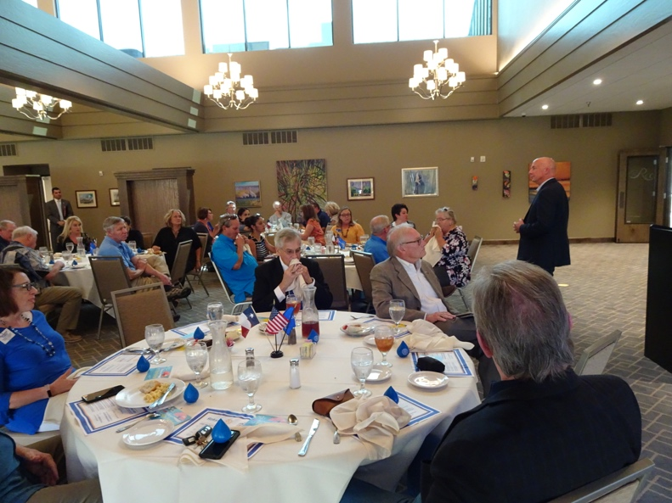
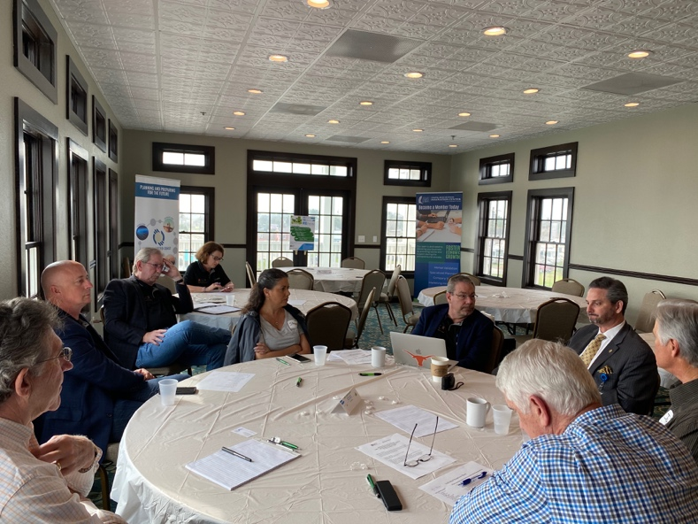
The Facilitating Our Future Series
Review of Phase 1: An Intensive Three-Day Discussion
Key meetings with community leadership.
Engagement in civic events.
Broad community-wide stakeholders engaged including:
  Mayor;
  County Judge;
  County Commissioners;
  Navigation District Manager;
  EDC Chairman;
  Art Center leadership; and
  Chamber of Commerce members;
Young Chamber members;
Tourism leadership;
Local small businesses owners;
School Superintendent;
Housing experts;
Builders;
Service providers in stores and restaurants; and
Retirees in the region and other residents.

Slide 6
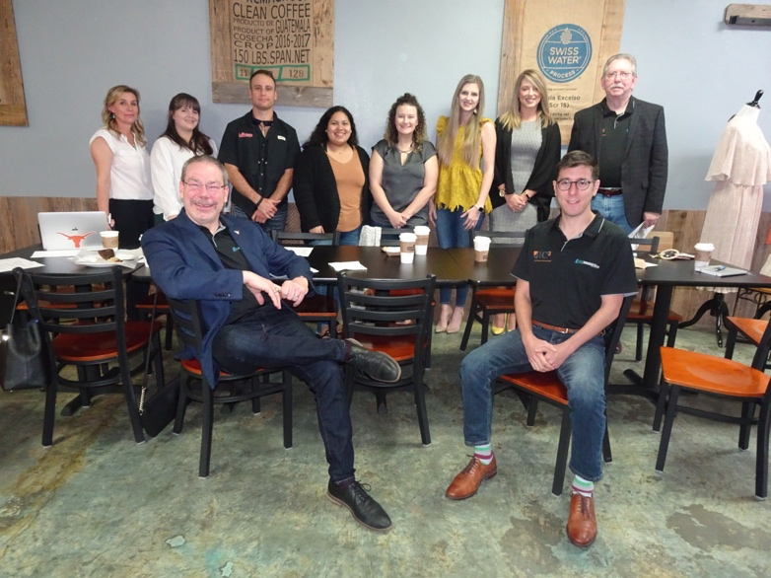
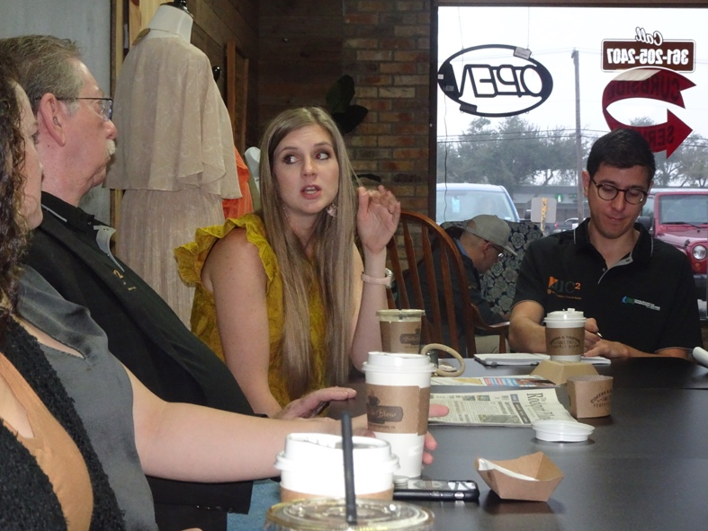
The Facilitating Our Future Series
Key Findings from Discussions:
  Lack of comprehensive economic development strategy.
  Collaboration very strong after Hurricane Harvey.
  Strategies for downtown rejuvenation are not integrative of synergistic.
  Community development between Rockport and Fulton “feel” quite distinct and separate.
  Maintaining pristine coastline, wildlife access, and coastal culture essential value.
  How to build and grow Rockport-Fulton unclear.
  Certain industry options like heavy manufacturing and “smokestack” industries are not desirable.
  Funding access is needed by community, schools, and businesses

Slide 7
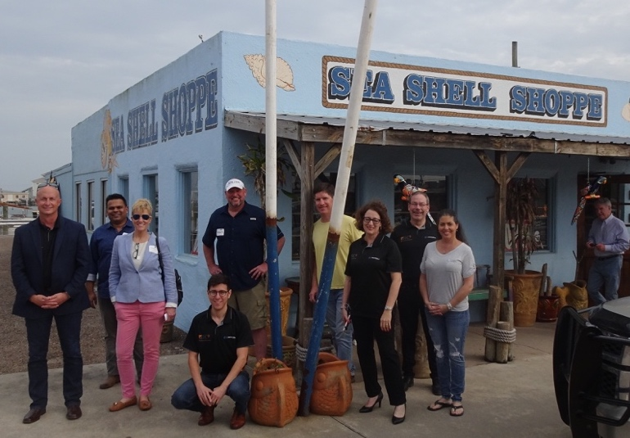
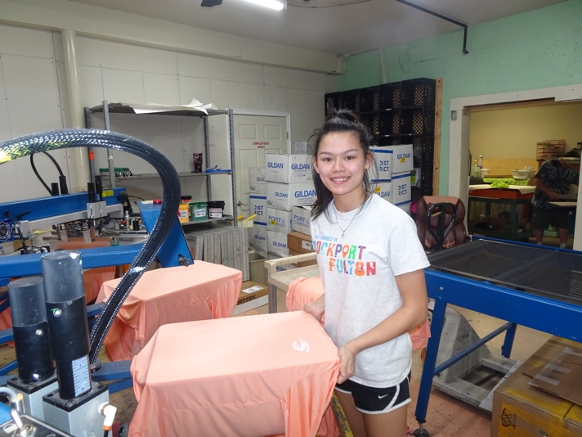
The Facilitating Our Future Series
Key Findings from Discussions (Cont.):
  Greater integration and impact of local schools and workforce development is desired.
  Residents see a need for skilled and hourly workforce and the availability of affordable housing and lack of high-paying jobs.
  Youth, young families, and entrepreneurs are difficult to recruit and retain.
  Healthcare access will be critical to support both retiree community and the targeted growth among young families.
  The tourism market, while not saturated, is discrete and imaginative actions to enhance this industry are needed.
  The value of Rockport-Fulton is not well known outside of the region.
  Infrastructure of roads, broadband, and water access have limited capacity.
  Highly competitive, not cooperative, relationship with other Coastal Bend communities for business, tourism, and workforce.

Slide 8
The Facilitating Our Future Series
Key Strategies for the Future:
1. Stabilize population to create flexibility in local investment funds:
Rockport-Fulton can establish the community as destinations for young families.
Promotion of relocation opportunities focusing on the “live well” and “commute-there” lifestyle.
Consistent tax and other revenues can be used to seed new initiatives for renewal, start new programs and market the community.

Slide 9
The Facilitating Our Future Series
Key Strategies for the Future (cont.):
2. Segment and target tourism and visitor market outreach:
The tourism and hospitality industries will continue to dominate the Rockport/Fulton economic base.
Improvement in strategy, approach, and focus in marketing of the community assets should enhance local economic activity.

Slide 10
The Facilitating Our Future Series
Key Strategies for the Future (cont.):
3. Remove local barriers for business creation and aspirational economic goals:
Leveraging new and soon-to-come downtown investments will improve the perception of both communities.
For maximal effectiveness, under-used downtown spaces need to be rapidly repurposed.

Slide 11
The Facilitating Our Future Series
Key Strategies for the Future (cont.):
4. Develop a strategy to introduce fitted light industry into the community:
Local businesses are focused on selling goods and services largely to residents and/or to tourists and visitors. With the expectation of a downturn in tourism due to the COVID-19 pandemic, there will be a need to bring new capital into the community.
The new Economic Development Corporation (EDC) must engage rapidly to conduct specific outreach to compatible industries to consider location in Rockport/Fulton.
Community collaboration with the EDC can offer incentives and expertise (Talent Connect Project) to support new businesses.

Slide 12
The Facilitating Our Future Series
Challenge 1:
Distance
Distance refers to physical, social or collaboration separation experienced by inter- and intra-regional stakeholders. Often, distance is expressed through the following:
“End of the road” location limits types of businesses fitting into region;
Infrastructure status limits online, road, trail and inter-community mixing and access;
Medical care quality and access;
Inadequate collaboration and communication between local stakeholders in each community and between the two communities;
Lack of engagement with diverse, minority, and lower socio-economic segments of the local population; and
Lack of effective reach to new tourism market segments.

Slide 13
The Facilitating Our Future Series
Challenge 2:
Dilution
Dilution describes the lack of critical mass surrounding planning, financial, technical and human resources in a region and is expressed by the following:
Lack of fitted workforce for service industry and advanced industry growth areas;
Lack of a clear innovative culture – “business as usual” is comfortable and common;
Too many general, and not specific, areas for economic development focus;
Small business owners lack mentorship, financial tools, and integrated marketing solutions to enhance business growth and sustainability.

Slide 14
The Facilitating Our Future Series
Challenge 3:
Demand
Demand highlights the combined needs for ready availability of quality company deal flow, investment or loan capital, talent, and attractive regional amenities to support new business creation or recruitment. It is expressed as
Perceived lack of housing access to accommodate hourly and higher salaried workers from the San Patricio region;
Funds lacking for many development goals – resistance to taxation, public debt or other instruments;
Need for source of off-season tourism access to smooth economic peaks and valleys; and
Need to create “easy” access and presentation of tourism assets to visitors

Slide 15
The Facilitating Our Future Series
Challenge 4:
Draw-In and Engage
Regions need to draw established or anchor companies and universities into their innovation or entrepreneurial plans and engage each organization to provide talent, market access, and financial resources necessary for in-region growth. The need is expressed through the following:
Engagement of San Patricio and Corpus Christi industry is poor – no systematic way to engage workers with Rockport/Fulton for living or visiting options or support of local programs;
ISD engagement in workforce development needs to grow with students being engaged in community building as well as enhanced trade training;
Retention of students and young talent is challenging; and
Need greater engagement with talent and experience in retirement community to enhance economic development and local business.

Slide 16
The Facilitating Our Future Series
The Rockport-Fulton Value Proposition:
Rockport/Fulton is poised to offer visitors and residents an elevated coastal experience. By highlighting the access to Rockport/Fulton’s pristine environment, active arts community, abundant seaside activities, and family-friendly atmosphere, Rockport/Fulton can attract the people, investment, and resources it will need to build the economy for its future.

Slide 17
The Facilitating Our Future Series
Consideration Points:
Take the value proposition statement and tailor messages to target markets using appropriate channels.
Rockport/Fulton should consider the intersection of tourism with local family needs to create experiences and attractions meeting the needs of children from both segments.

Slide 18
The Facilitating Our Future Series
Consideration Points (cont.):
Consider modern, flexible and low-cost options to insert food, beverage and “cool” to use derelict lands and enhance the use and visibility of downtown.
The need to maintain the pristine environment and unfettered access to water and natural resources limits some opportunities, but some businesses show excellent fit.

Slide 19
The Facilitating Our Future Series
Consideration Points (cont.):
Community engagement with small businesses is critical for new companies to start here, scale here, and grow here.
Engage the Economic Development Corporation (EDC) to drive strategy and implementation around business relocation to Rockport/Fulton in conjunction with the Chamber.

Slide 20
The Facilitating Our Future Series
Consideration Points (cont.):
Community leadership needs to be entrepreneurial to set the standards and illustrate the value of start up business.
Talent Connect will draw upon the experience, mentorship, coaching, and advise that is available in abundance in Rockport-Fulton.
Everyone on the Rockport-Fulton community has a role and a responsibility to play in the economic prosperity of the region.

Slide 21
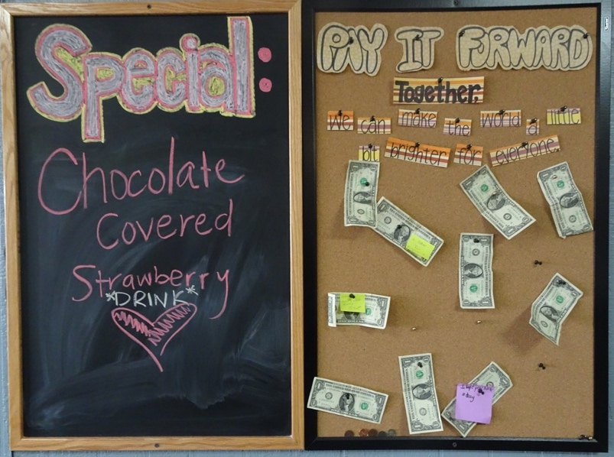
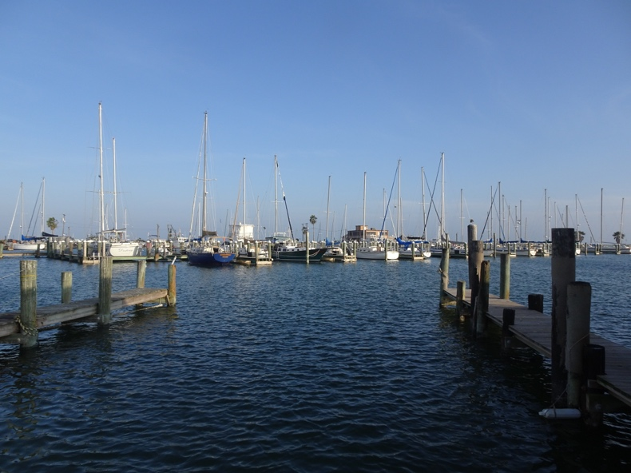
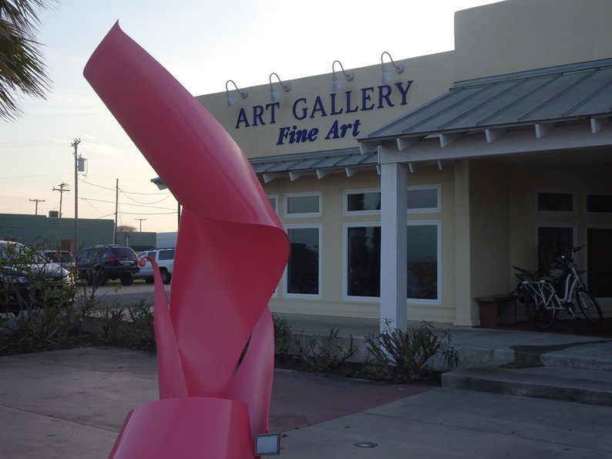
The Facilitating Our Future Series
Thank You for Your Participation.
Questions and Answers

