Slide 1


Plan Integration for Resilience Scorecard
How to spatially evaluate networks of plans to reduce hazard vulnerability
Texas A&M Corpus Christi
November 29, 2018
Philip Berke, PhD
Institute of Sustainable Communities, Director
Texas A&M University
Jaimie Hicks Masterson, AICP
Institute of Sustainable Communities, Engagement Coordinator
Texas A&M University
This material is based upon work supported by the U.S. Department of Homeland Security Science and Technology Directorate under Grant Award Number 00313690. The views and conclusions contained in this document are those of the authors and should not be interpreted as necessarily representing the official policies, either expressed or implied, of the U.S. Department of Homeland Security.
Notes:
Four key points:
-Planning is about designing spatial arrangements of land use activities and development. Different than architecture that is focused on building.
-Avoiding or relocating development from hazard areas.
-Regulation of private property occurs primarily at local level. Constitution devolves authority.
-Planning ahead improves ability to: a) anticipate and reduce future vulnerability, b) monitor change, c) adapt to uncertainty, and d) more rapidly recover.

Slide 2
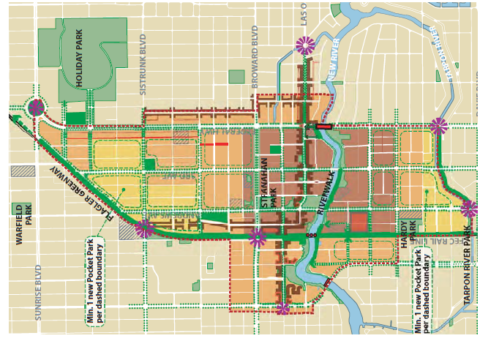
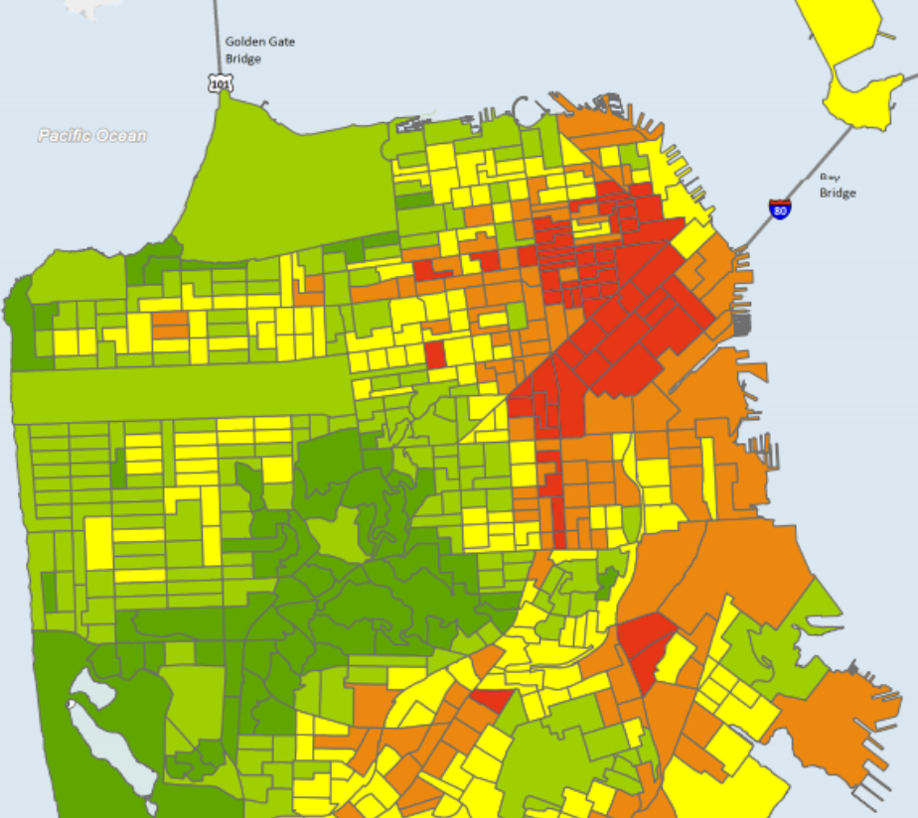
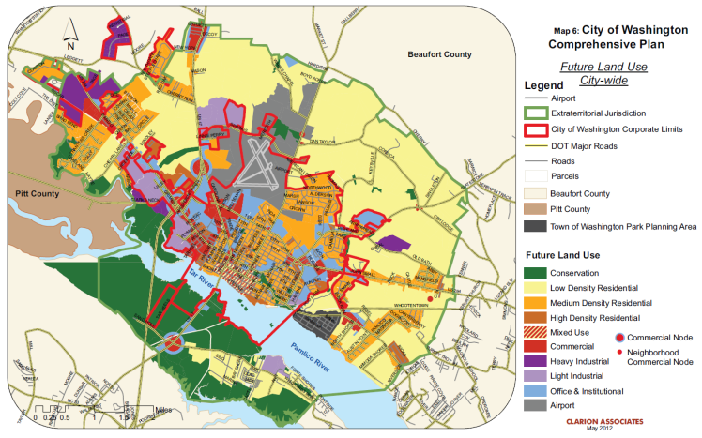
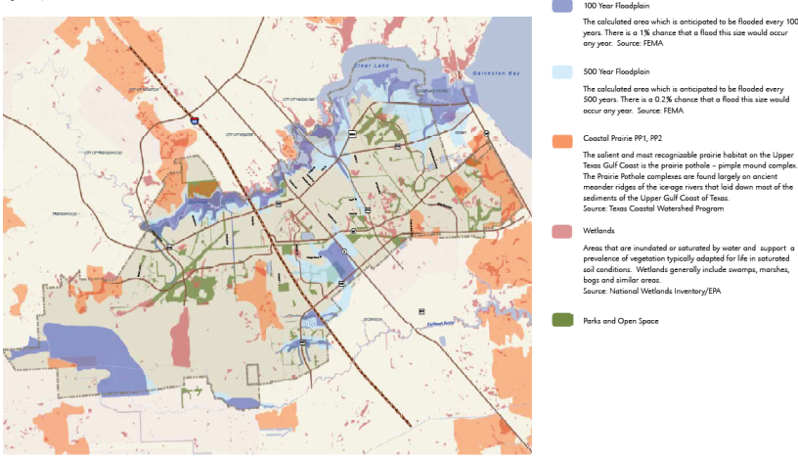
Networks of Plans
Communities adopt a plethora of plans that require collaboration.
Mitigation plans are disconnected from urban planning initiatives that influence development in hazard areas.
Ft. Lauderdale Downtown Area Framework Plan
San Francisco Hazard Mitigation Plan
City of Washington, NC Comprehensive Plan
League City Open Space Plan

Slide 3
Before Hurricane Sandy: Opposing Intentions?
100-year floodplain &
severe repetitive loss
designation
Hazard Mitigation Plan
Comprehensive Plan

Slide 4
Project Objectives
To evaluate the coordination in local networks of plans at the neighborhood scale.
To assess the degree to which the network of plans targets areas most vulnerable.
Source: Berke, P. et al. 2015. Journal of the American Planning Association. 81(4): 287-302

Slide 5
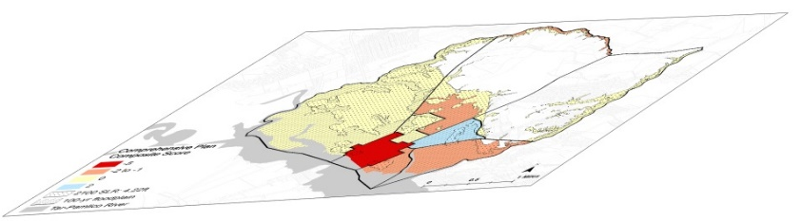
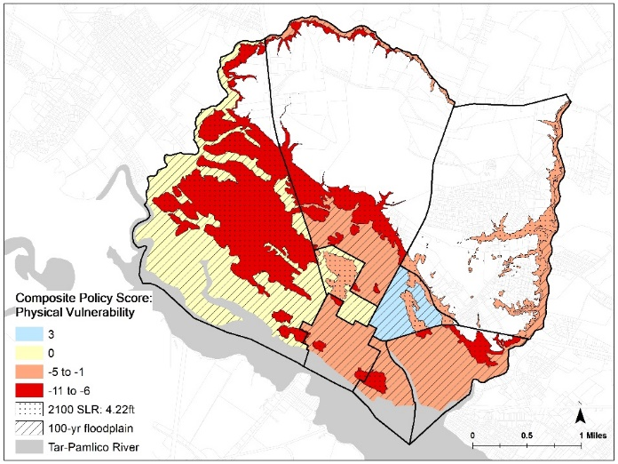
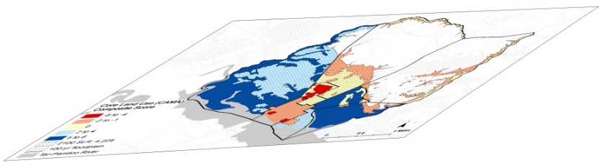
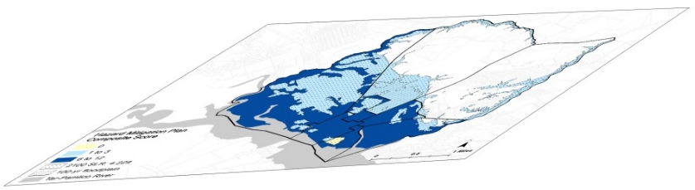
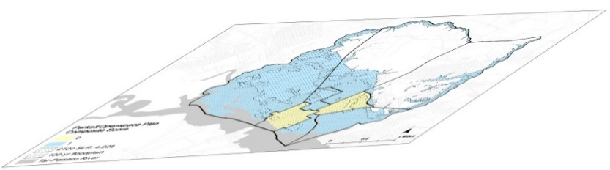
Policy Score for Each Plan
Composite Policy Score
Comprehensive Plan
+
Transportation Plan
∥
+
Hazard Mitigation Plan
+
Park & Open Space Plan

Slide 6
Project Objectives
To evaluate the coordination in local networks of plans at the neighborhood scale.
To assess the degree to which the network of plans targets areas most vulnerable.
Source: Berke, P. et al. 2015. Journal of the American Planning Association. 81(4): 287-302

Slide 7
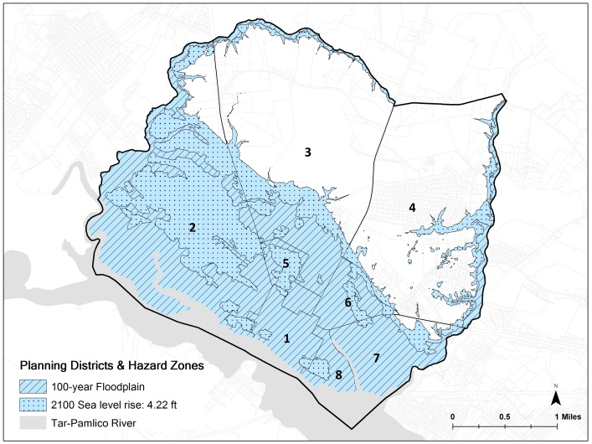
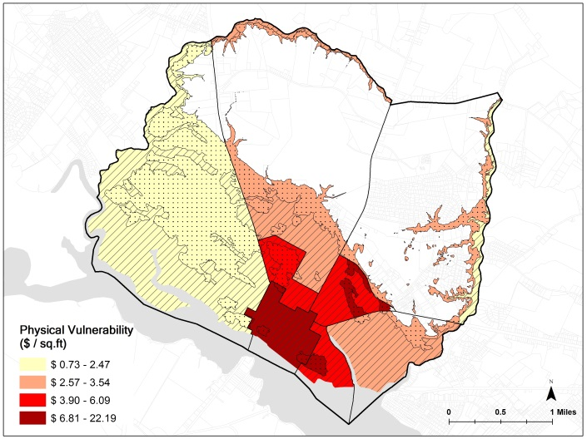
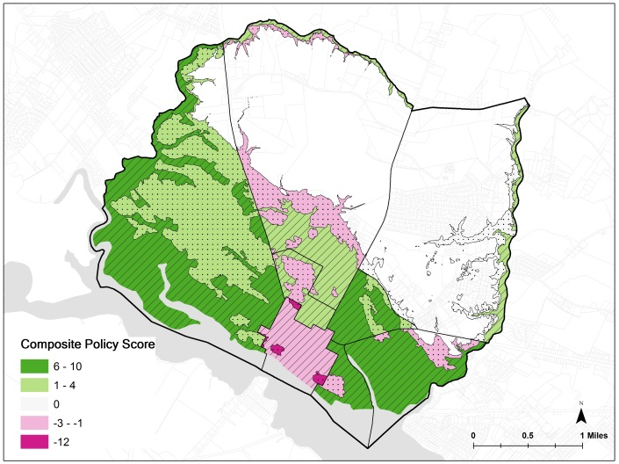
Phases for Spatial Evaluation of Networks of Plans for a Resilience Scorecard
Phase 1
Phase 2
Phase 3
Delineate planning districts and hazard zones
Determine vulnerability
(physical)
Score plans
Notes:
Plan policies for District 6 include land acquisition, rezoning to lower land use densities, and overlay
zones to protect wetland vegetation that mitigates flooding.
Downtown: prominent theme of both the CAMA Land Use Plan and the 2023 Comprehensive Plan is downtown and waterfront revitalization. Plan polices for the downtown promote smart growth principles by increasing densities, shifting single-use to mixed-use development, incentivizing redevelopment and infill, and expanding public infrastructure investments to enhance
pedestrian movement, amenities, and transit.

Slide 8
Networks of Plans
Asbury Park, New Jersey | League City, Texas
Master Plan (2006) | Comprehensive Plan 2035 (2013)
Monmouth Co. Mitigation Plan (2012) Consolidated Housing Plan (2015) Waterfront Redev. Plan (2005) Main Street Redev. Plan (2008) CBD Redevelopment Plan (2003) Scattered Site Redev. Plan (2003) | Local Mitigation Plan (2010) Parks & Open Space Plan (2006) Consolidated [Housing] Plan (2012)

Slide 9
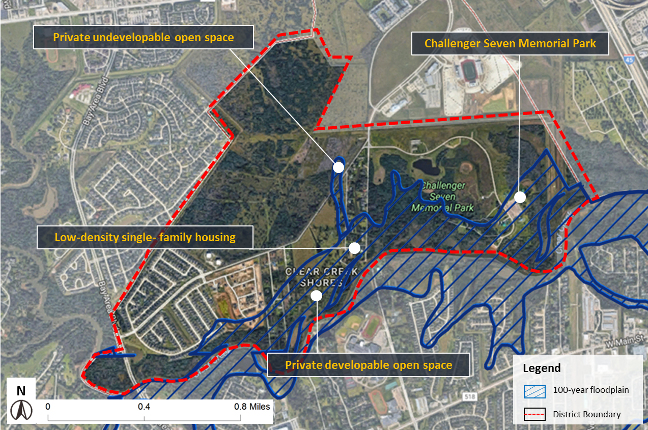
District #7: Clear Creek, League City, TX
Total Plan Integration Score = +37
Innovative Policies in Low Density Area
Land use regulations that limit new development.
  riparian buffer, cluster development, low density
Land acquisition in proposed conservation areas.
  repetitive loss areas, parks and recreation
Investments for stormwater drainage
  low impact design technologies
Development limits tied to evacuation times.

Slide 10
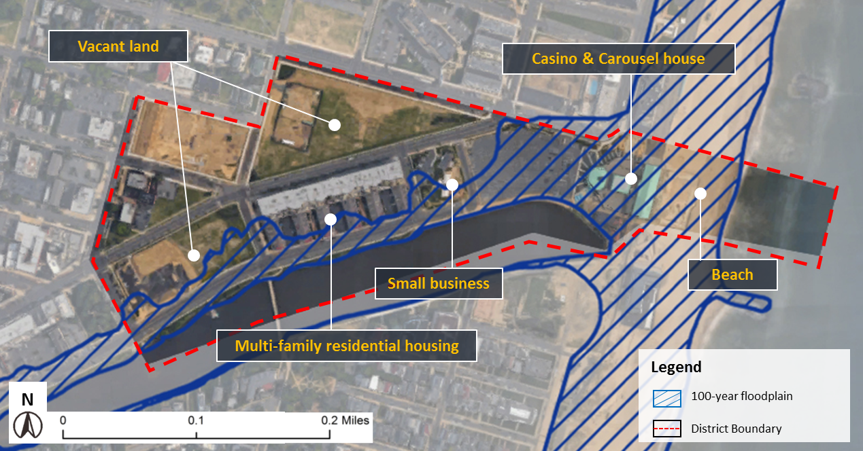
District #12: Waterfront Redevelopment, Asbury Park, NJ
Total Plan Integration Score = -12
Policies Support Buildup of Already High Vulnerability Area
Smart growth
  raise density, mix uses,
  complete streets
Zoning overlays support economic development
  boardwalk, entertainment
Development agreements for
affordable housing
  5% of the new housing units

Slide 11
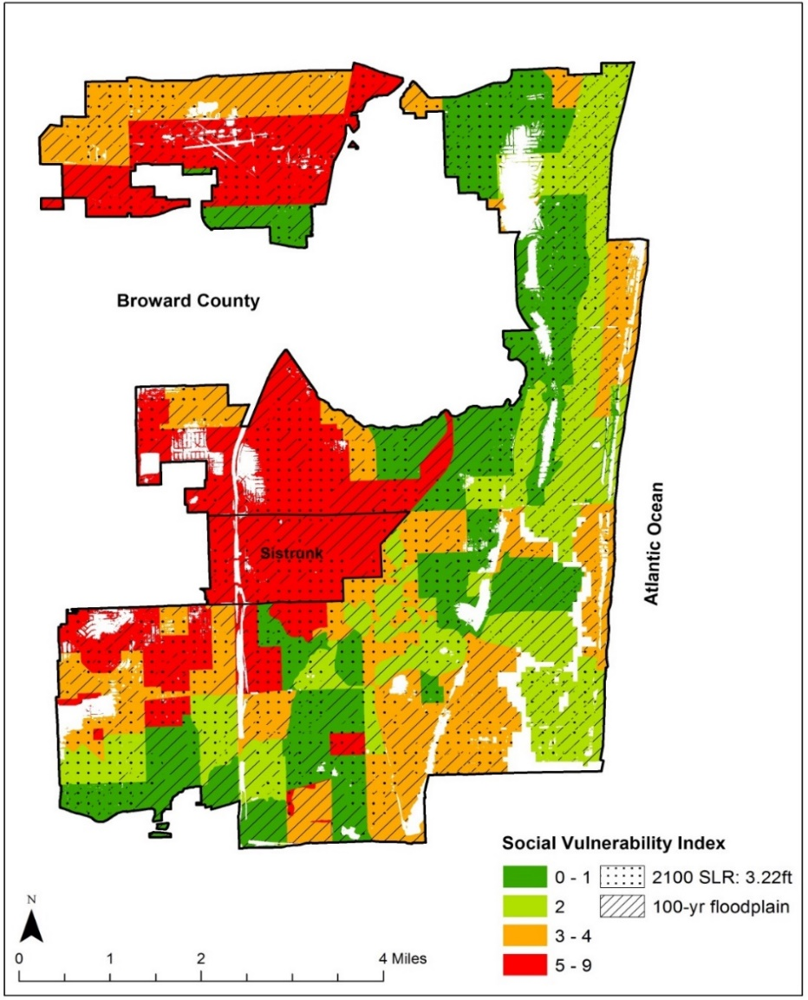
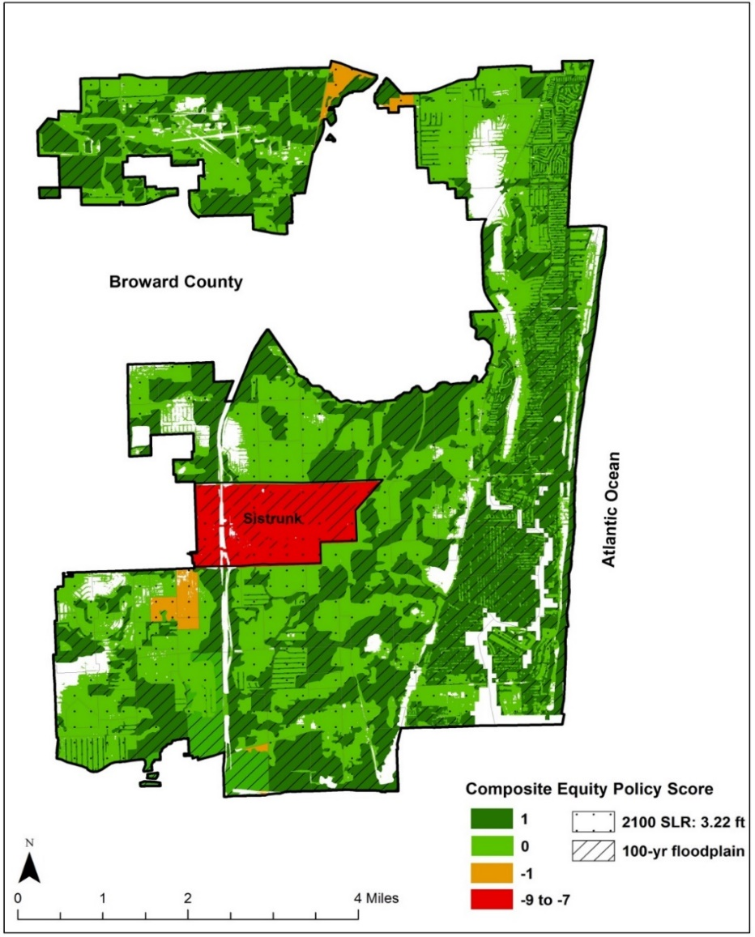
Sistrunk Neighborhood: Ft. Lauderdale, FL
High Social Vulnerability
Low Equity Mitigation Policy Score
Enterprise Zone Policies
-fast track permitting
-tax credits
-low interest loans
-tax increment financing
-infrastructure investments

Slide 12
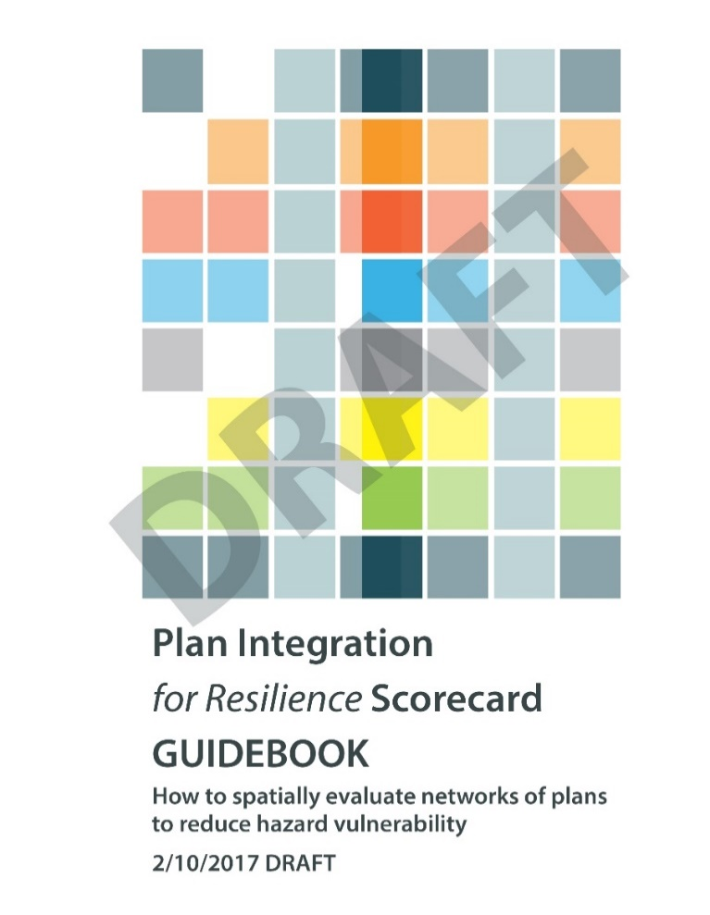
Translating Research to Practice:
Guidebook & Software
Scoring as Learning: What’s in the plans?
Scoring as Analysis: How do plans measure up?
Use Scorecard to:
  Search the Plans
  Evaluate the Contents
  Calculate the Scores
  Improve Existing Plans
  Create New Plans
mitigationguide.org

Slide 13
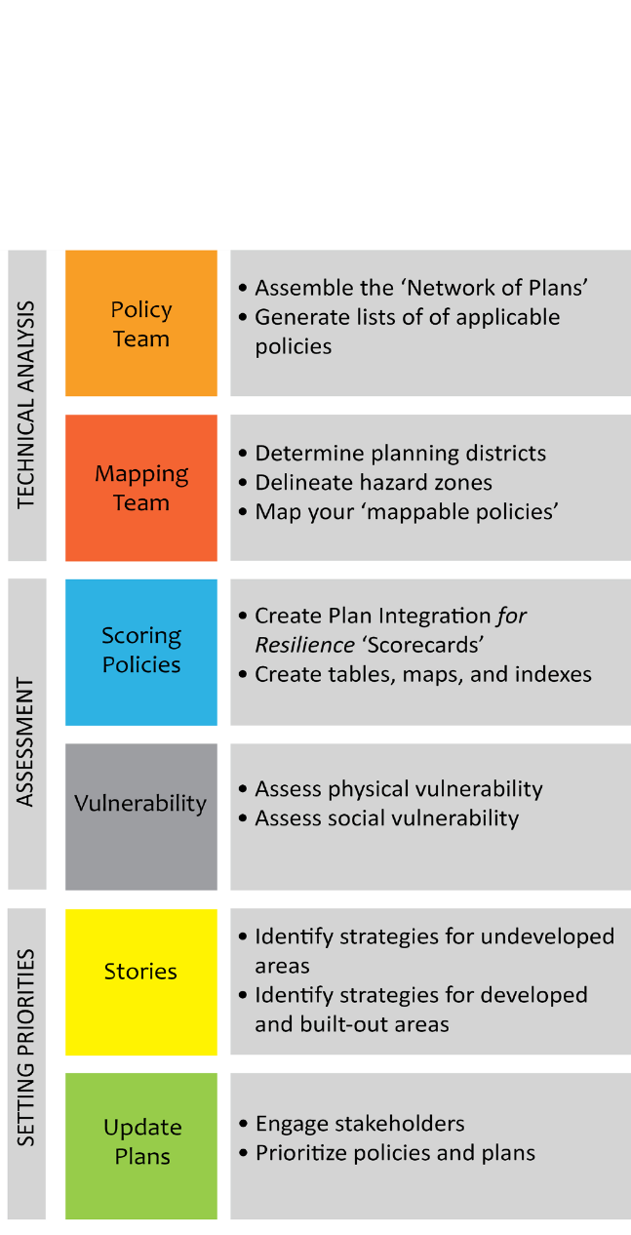
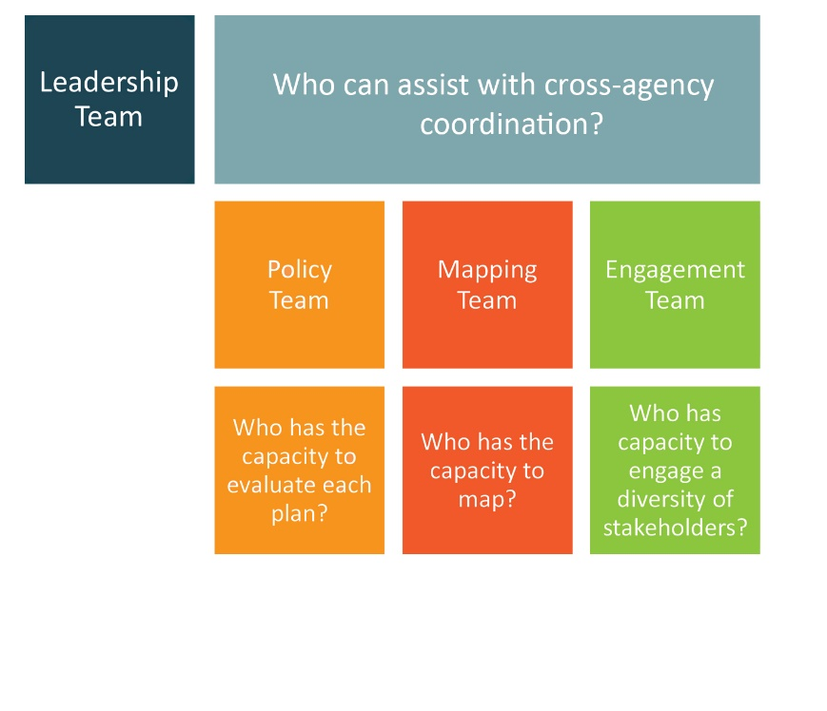
Structure of the guidebook

Slide 14
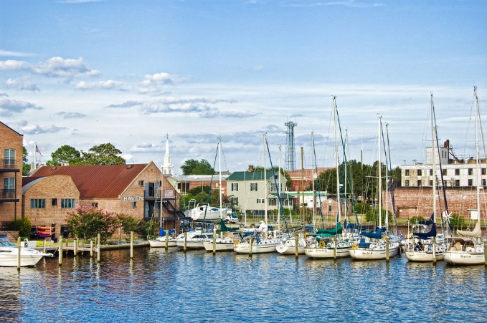
Gathering plans and pulling policies
Policies should:
Contain at least one mappable, place-specific term.
Contain a recognizable policy tool, or a form of government intervention to achieve specific objectives and outcomes.
Potentially reduce or increase vulnerability to hazards.
Case Study: City of Washington, NC
Population of 10,000 (2018)

Slide 15
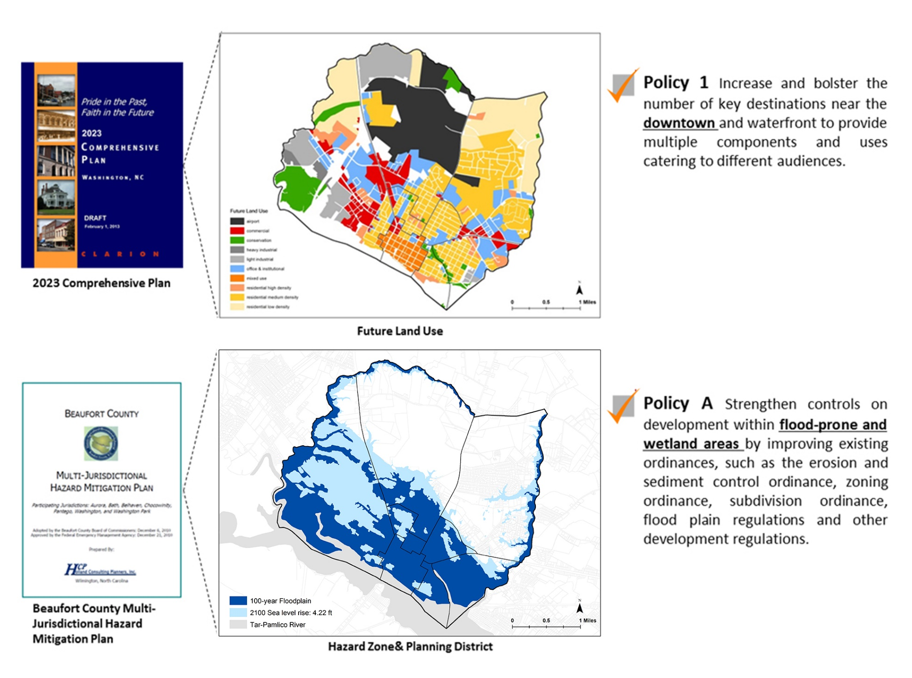
Notes:
---Insight on the impacts of policies in regards to flood resilience. For example, a policy within a plan might say, “Encourage higher-density multifamily development in pedestrian-oriented urban areas with access to transit, a broad range of services and amenities and access to employment.” While this is a policy that many planners strive for, if it is in a flood hazard zone, unfortunately, it is actively increasing vulnerabilities.
---Insight on the spatiality of policies and the impacts on specific areas. For example, a policy within a plan might say, “Strengthen controls on development within flood-prone and wetland areas by improving existing ordinances.” We can map the flood-prone and wetland areas, and most policies are inherently spatial. Because of this, we can see the stack of policies in a planning district.

Slide 16
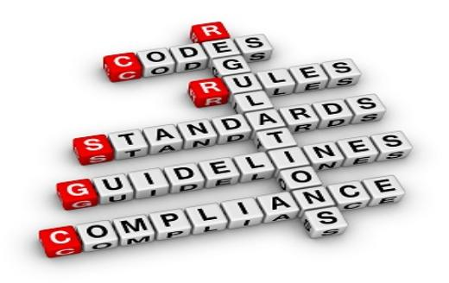
Types of policy tools
Development regulations
Land acquisition
Density transfer provisions
Financial incentives and penalties
Land use analysis and permitting process
Public facilities (including public housing)
Post-disaster reconstruction decisions
Capital improvements
Notes:
Quality plans…makes plans stick, legislative commitment
Dev. Regs (sub regs, zoning overlays, setbacks)
Land acqu (open space easements)
Fin. Incen (density bonuses, tax abatement, impact fees)
Post-dis. Recon (development moratorium)

Slide 17
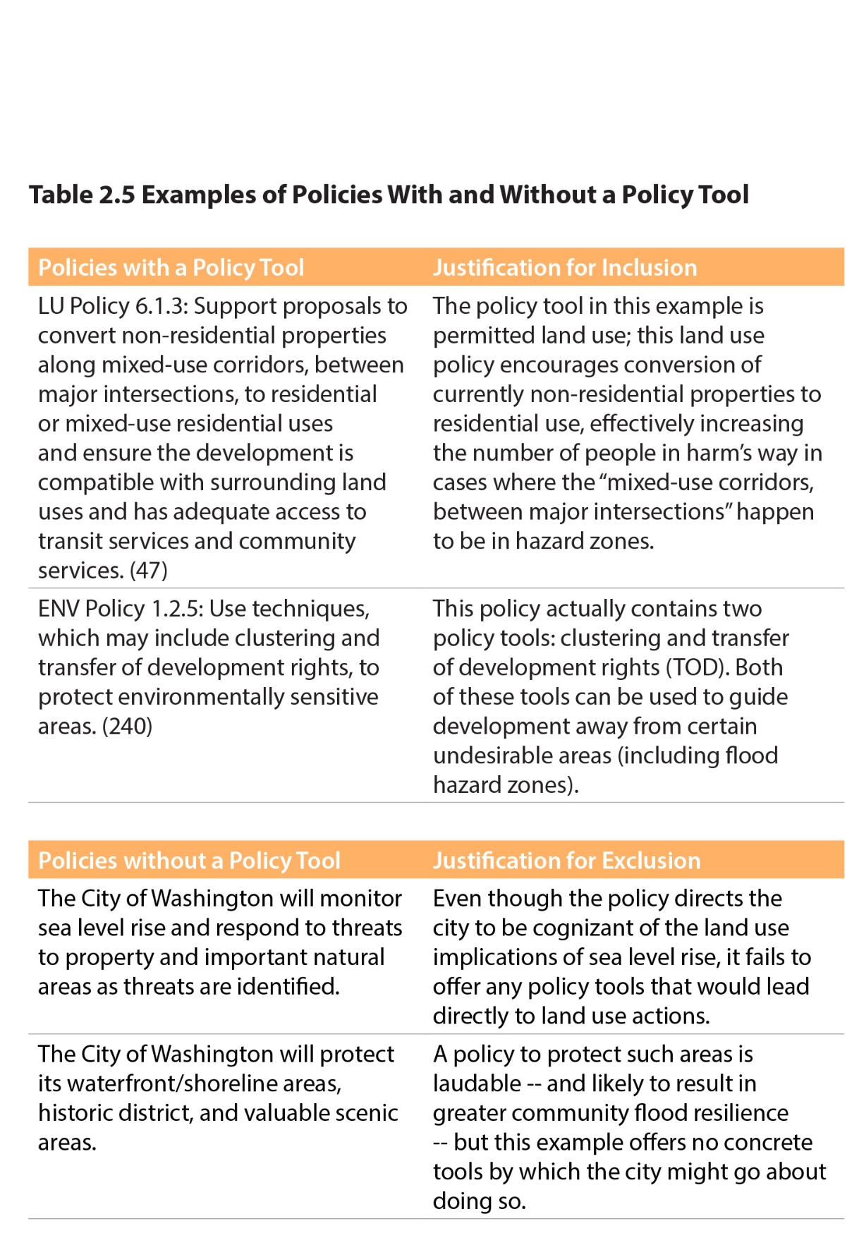
Policies pulled:

Slide 18
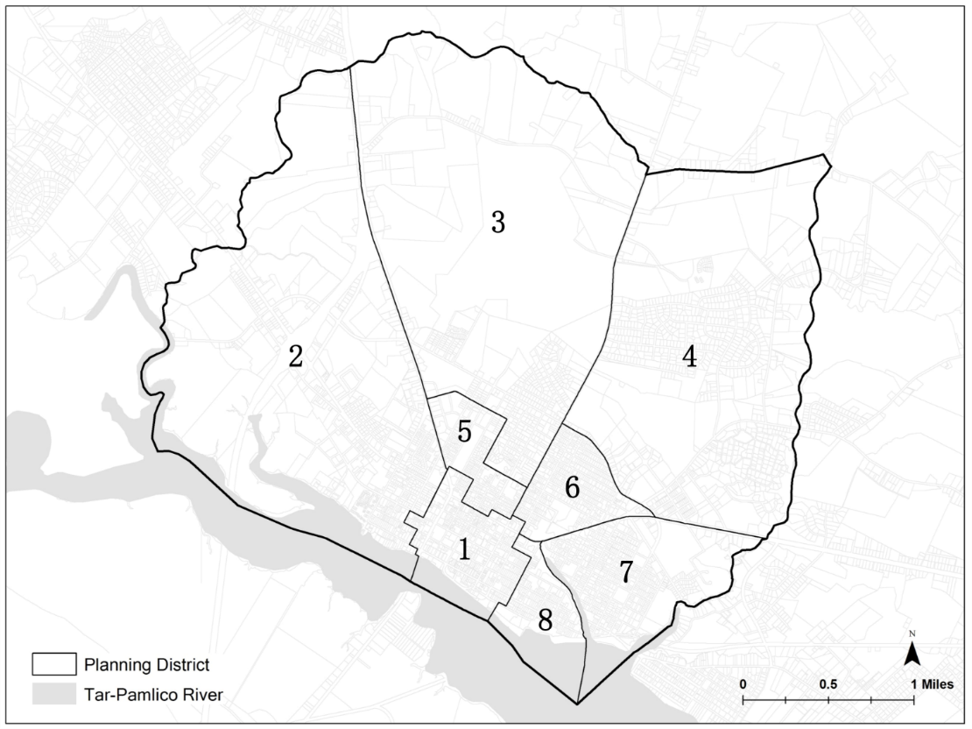
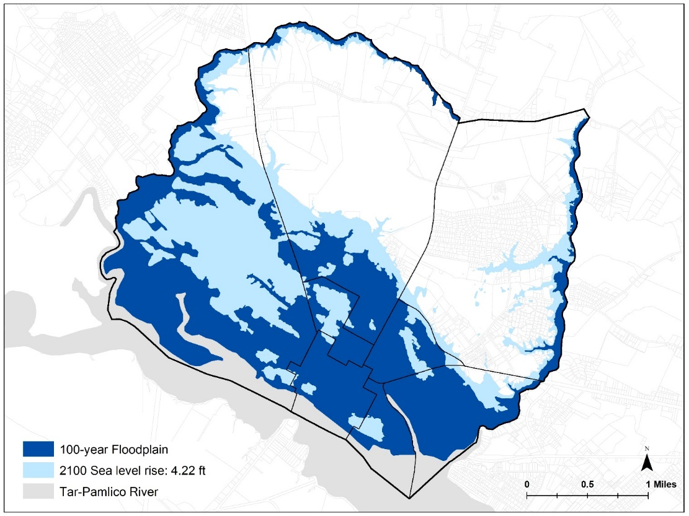
Mapping
Delineate planning districts and hazard zones to create ‘district-hazard zones’
  Neighborhoods
  Waterfronts
  Commercial areas
  Census Tracts or Block Groups*
  *Norfolk chose Census Tracts

Slide 19

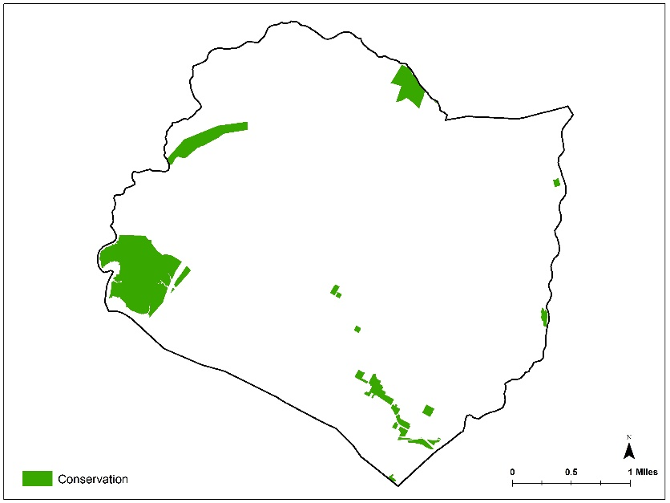
Mapping
Gather maps or layers in policies
Policy:
Use policy tools, which may include clustering and transfer of development rights, to protect environmentally sensitive areas and conservation areas.

Slide 20
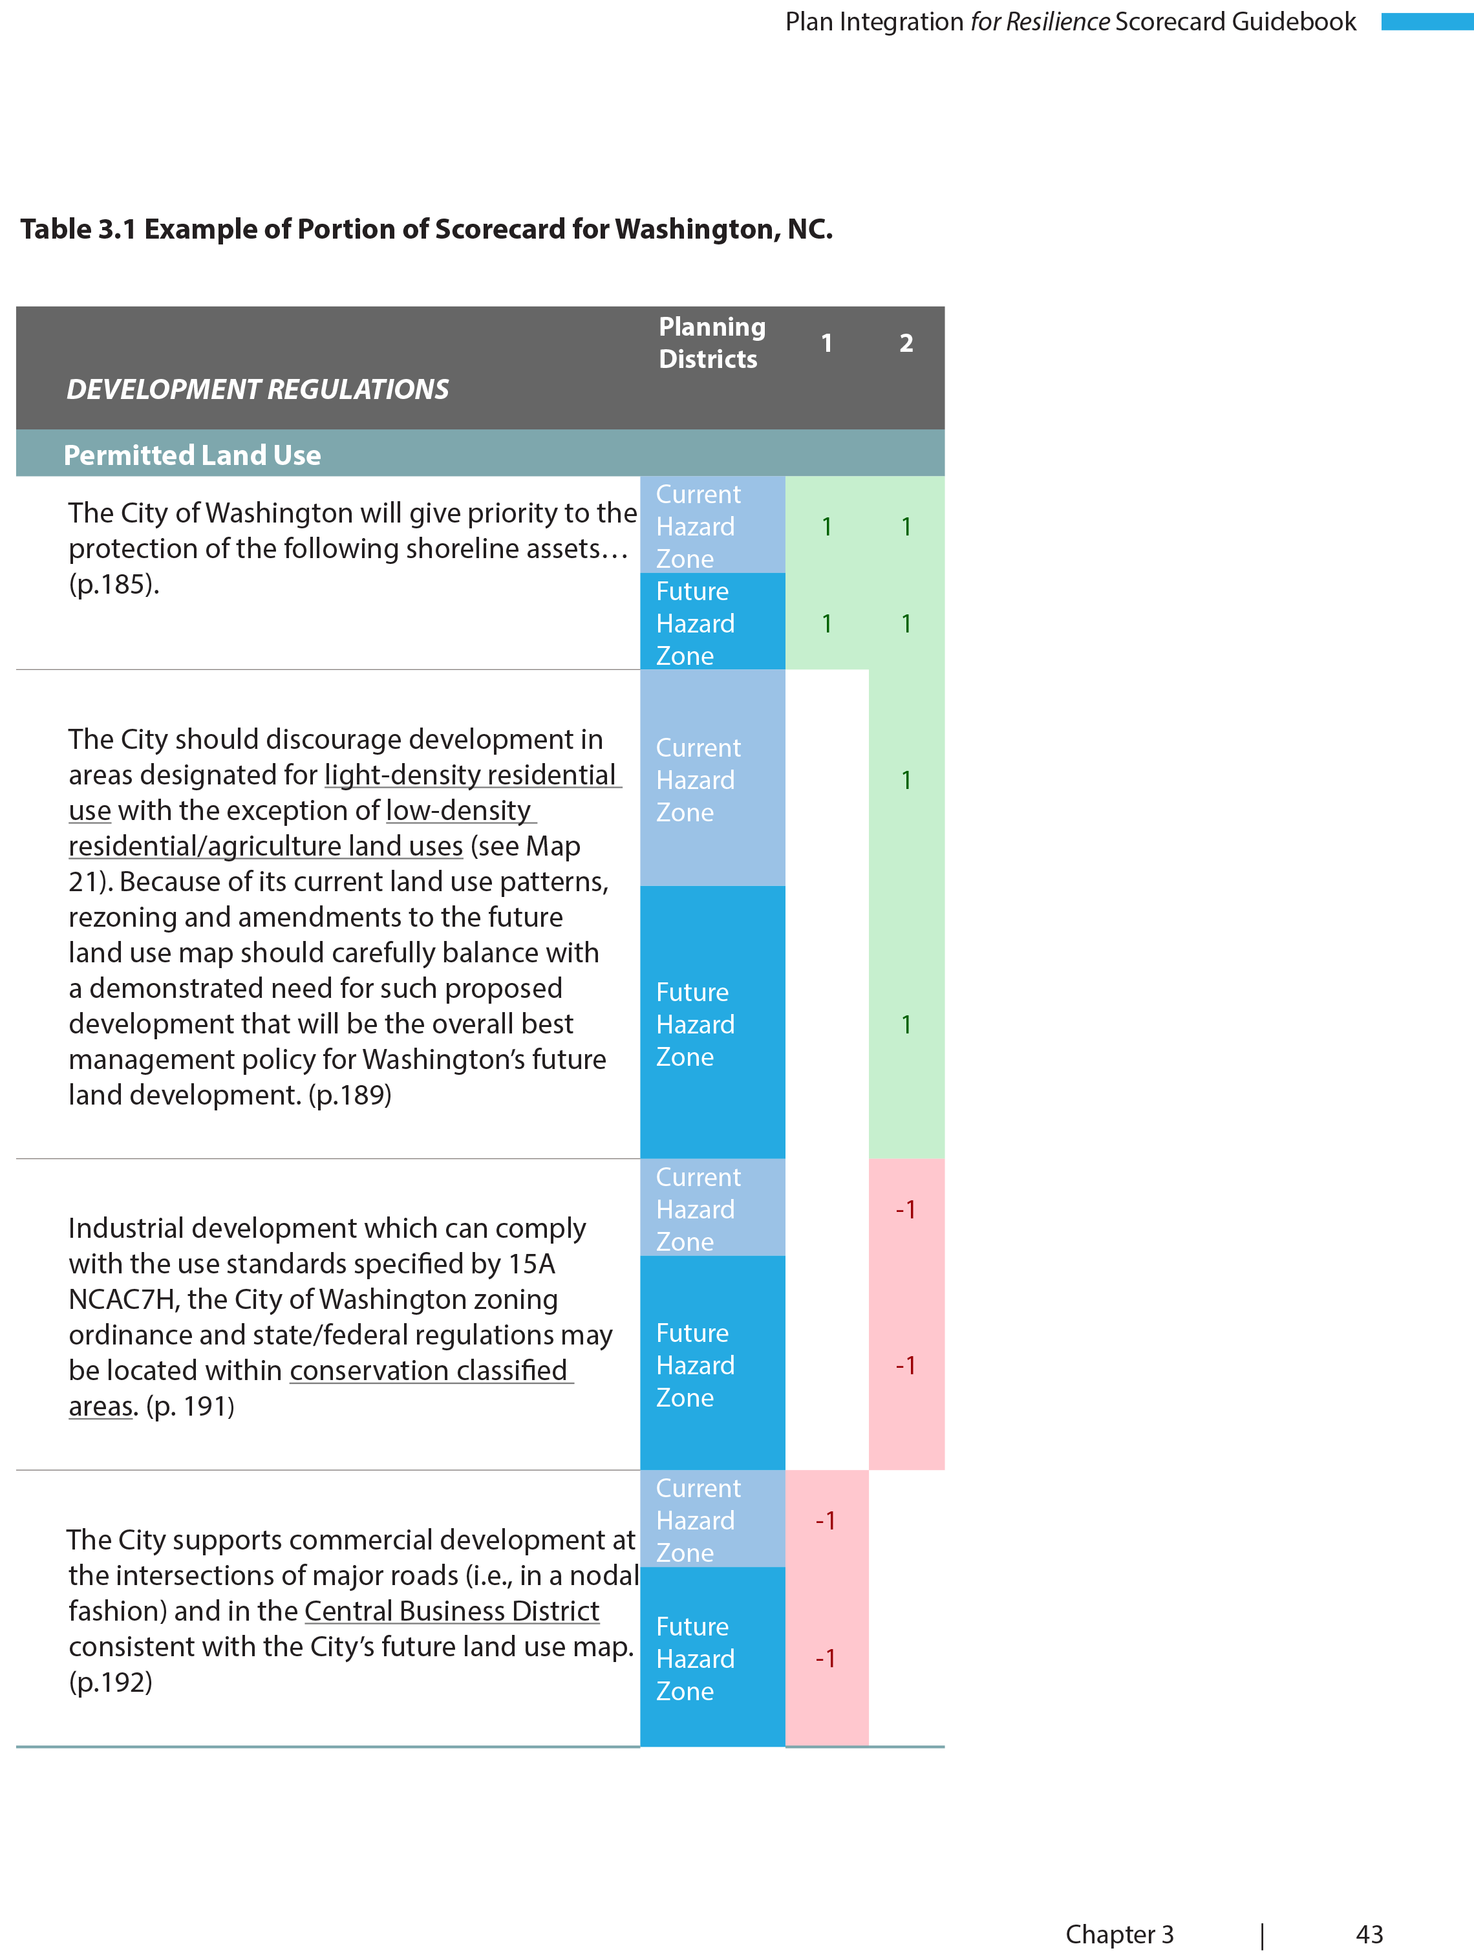

Scoring Policies
Create scorecards
Create tables and maps
2
1

Slide 21
Scoring Policies
District 2
2

Slide 22
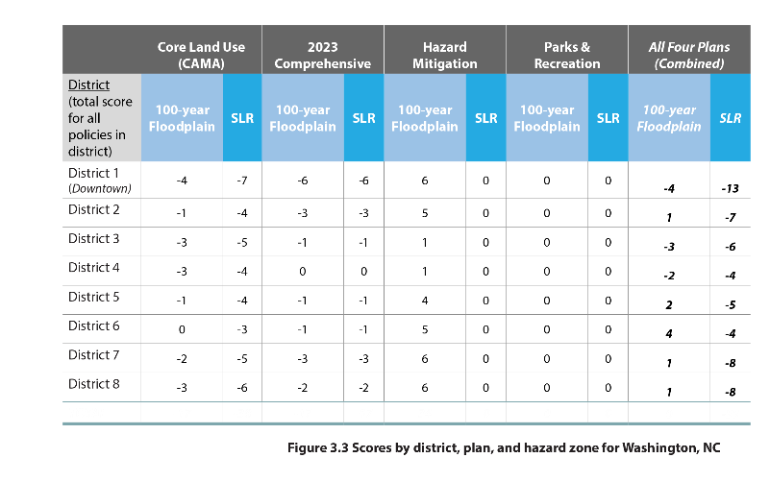
Hypothetical: Scores by district, plan and hazard zone

Slide 23
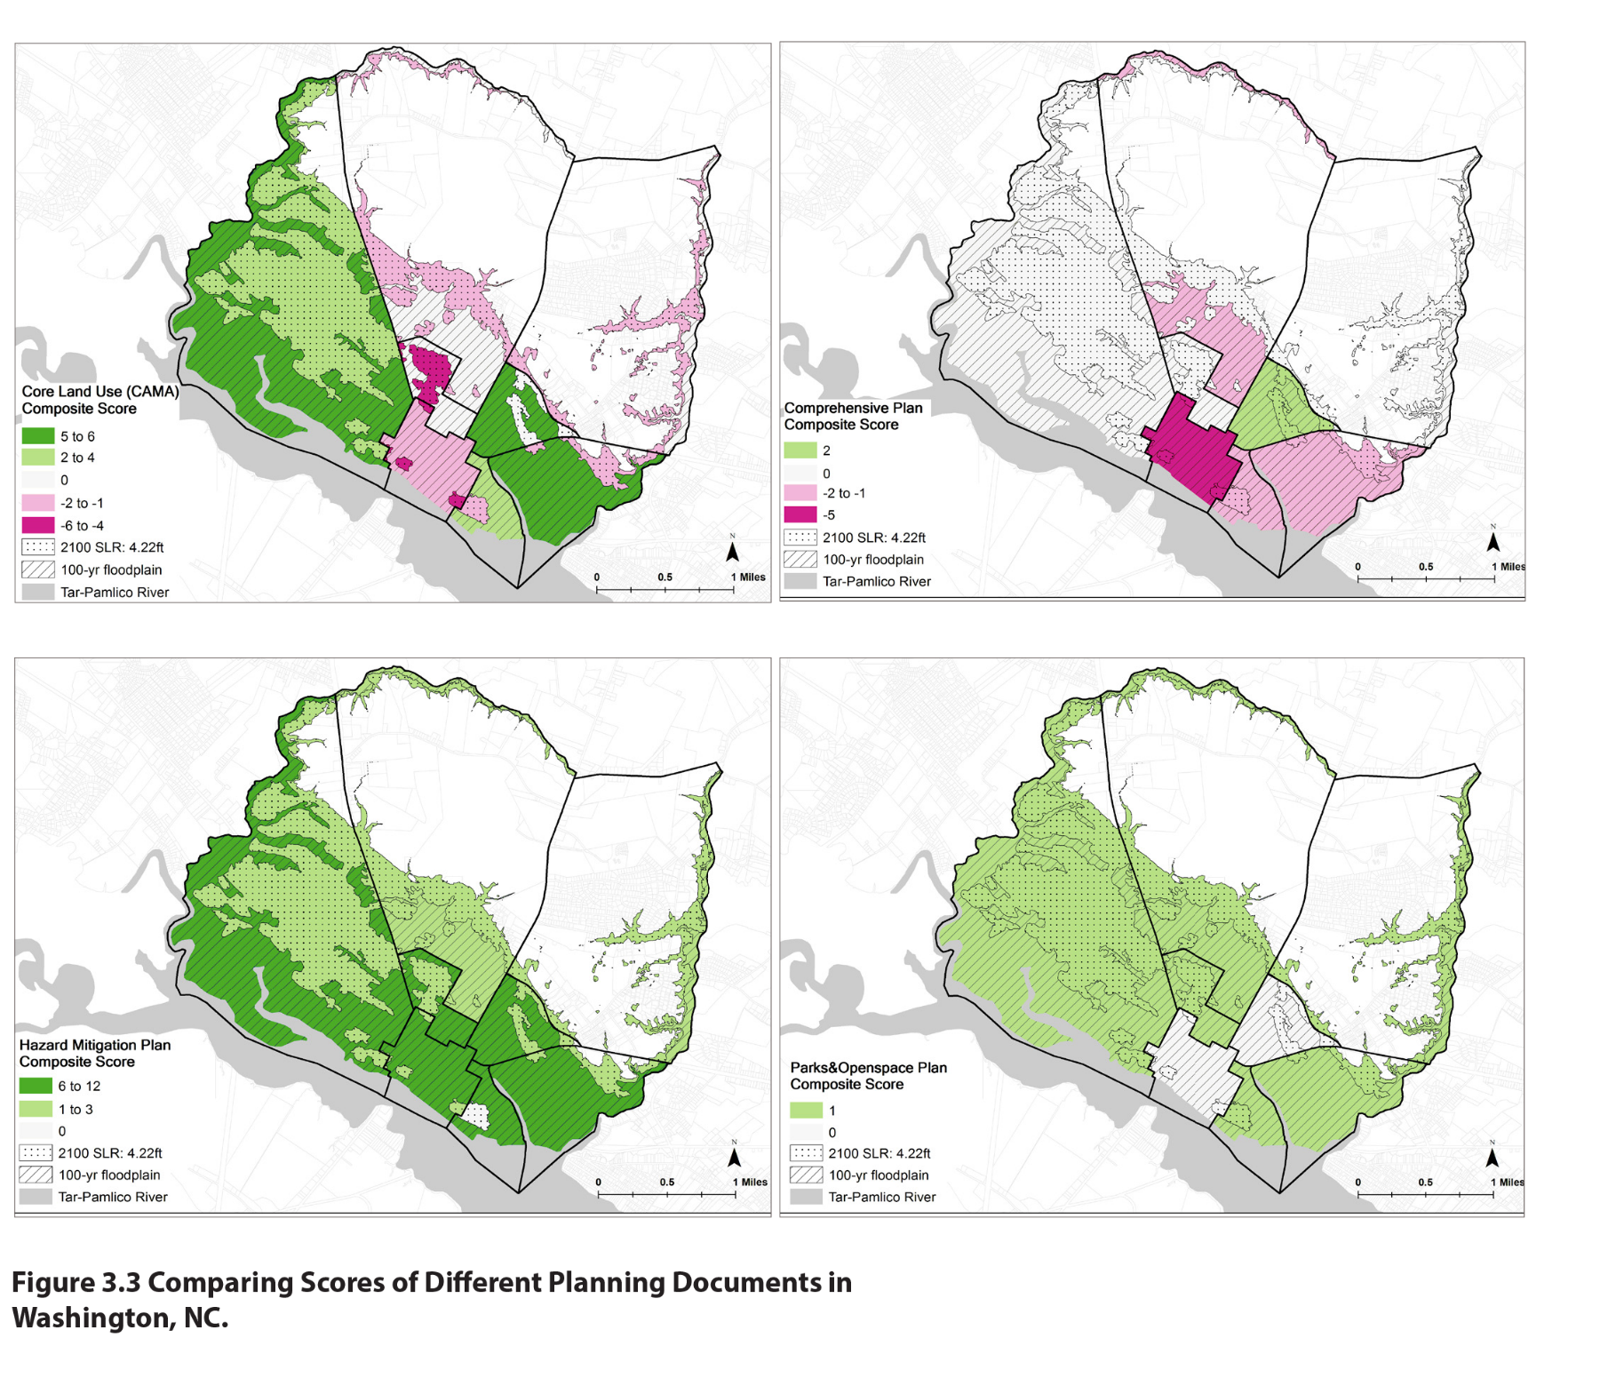
Comparing scores in different plans

Slide 24
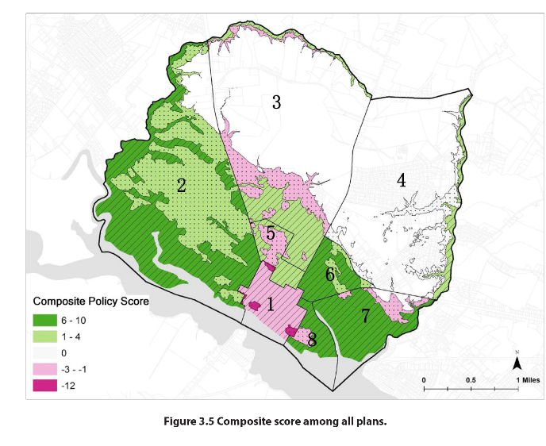
Composite score for all plans

Slide 25

High Tide, City of Norfolk
Motorists drive through so-called nuisance flooding in Norfolk, VA.
©Will Parson, Chesapeake Bay Program, 2015.

Slide 26
Norfolk’s Team
George Homewood, FAICP CFM, Director of Planning
Paula Shea, AICP, Principal Planner
Jeremy Sharp, AICP, Principal Planner
Steven Pyle, Assistant Emergency Manager
Matt Straley, GIS Coordinator
Katerina Oskarsson, deputy to the Chief Resilience Officer of 100 Resilient Cities
Leadership Team
*Policy Team*
Policy Team
Policy Team
Mapping Team
Policy Team
Process
1.5 hr initial webinar training with guidebook
Monthly check in web-conference calls (30 min or less)
Average plan took 2 hours to pull policies and score

Slide 27
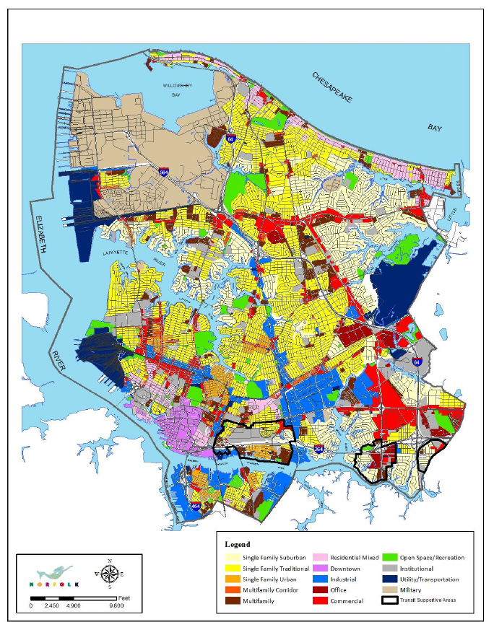
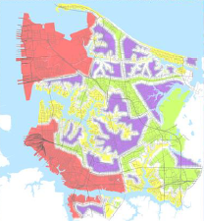
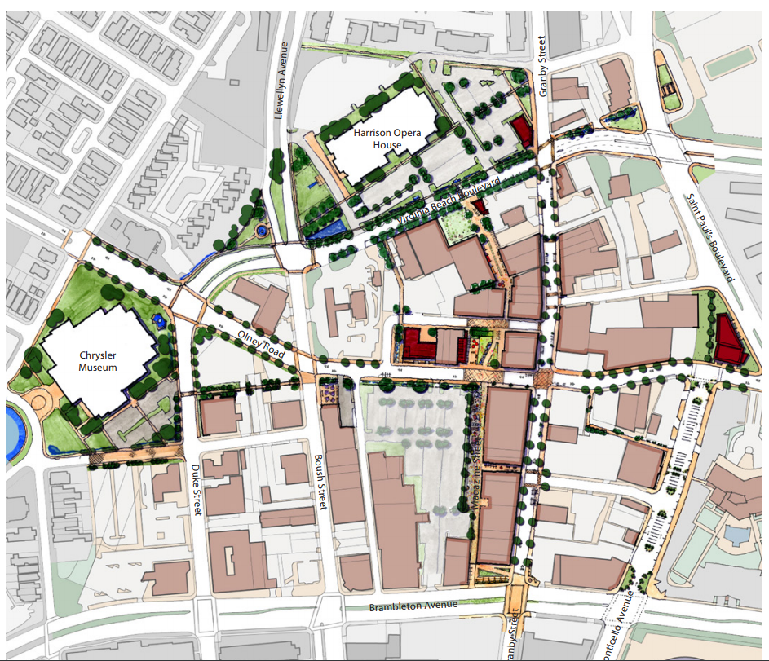
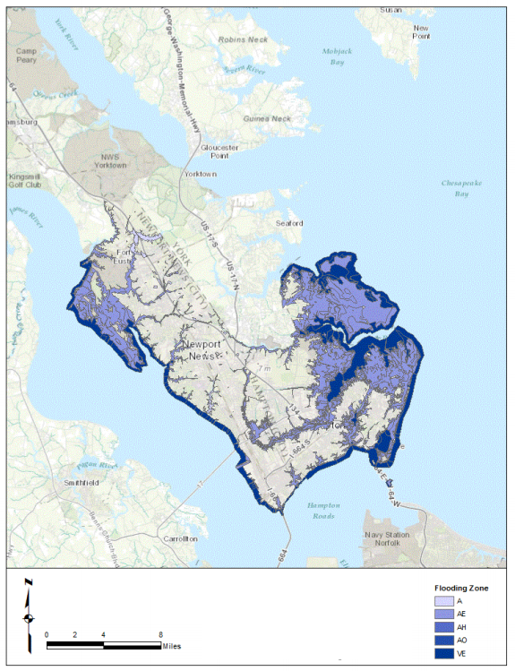
Network of Plans in the City of Norfolk
Plan Type | Lists of Plans (Year Adopted)
Comprehensive Plan | 1. PlaNorfolk 2030: The General Plan of the City of Norfolk (2016 update)
Mitigation Plan | 2. Hampton Roads Hazard Mitigation Plan (2016)
 | 3. Sand Management Plan Guidance Document (2016)
Resilience Plan | 4. Norfolk Vision 2100 (2016) Rockefeller Foundation
Small Area Plans | 5. Downtown Arts and Design District Revitalization Strategy (2013) 6. Military Circle / Military Highway Urban Development Area: A Vision for the Future (2017)
PlaNorfolk 2030
Norfolk Vision 2100
Downtown Arts and Design
District Revitalization Strategy
Hampton Roads Hazard
Mitigation Plan

Slide 28
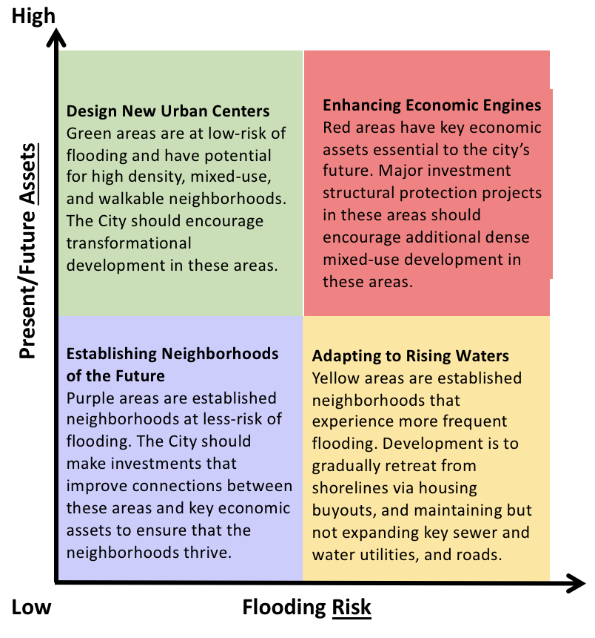
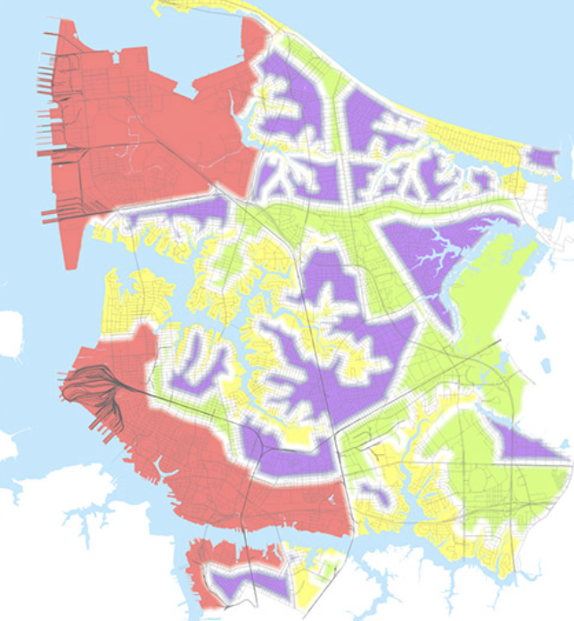
Norfolk, Virginia's Vision 2100 includes land use strategies to reduce vulnerability to coastal floods and sea level rise.
Adapted from www.norfolk.gov.

Slide 29
Project Impact
“The Resilience Scorecard was a great tool to allow us to evaluate our existing plans and policies...Following our participation in scoring Norfolk’s plan, we undertook a major plan amendment to more fully incorporate our Hazard Mitigation Plan as a key element in our comprehensive plan. As we kick off the drafting of our next comprehensive plan later this year, we plan to revisit our scores from the Resilience Scorecard to better guide future development and investments.”
– George Homewood, FAICP, CFM, Planning Director, City of Norfolk

Slide 30
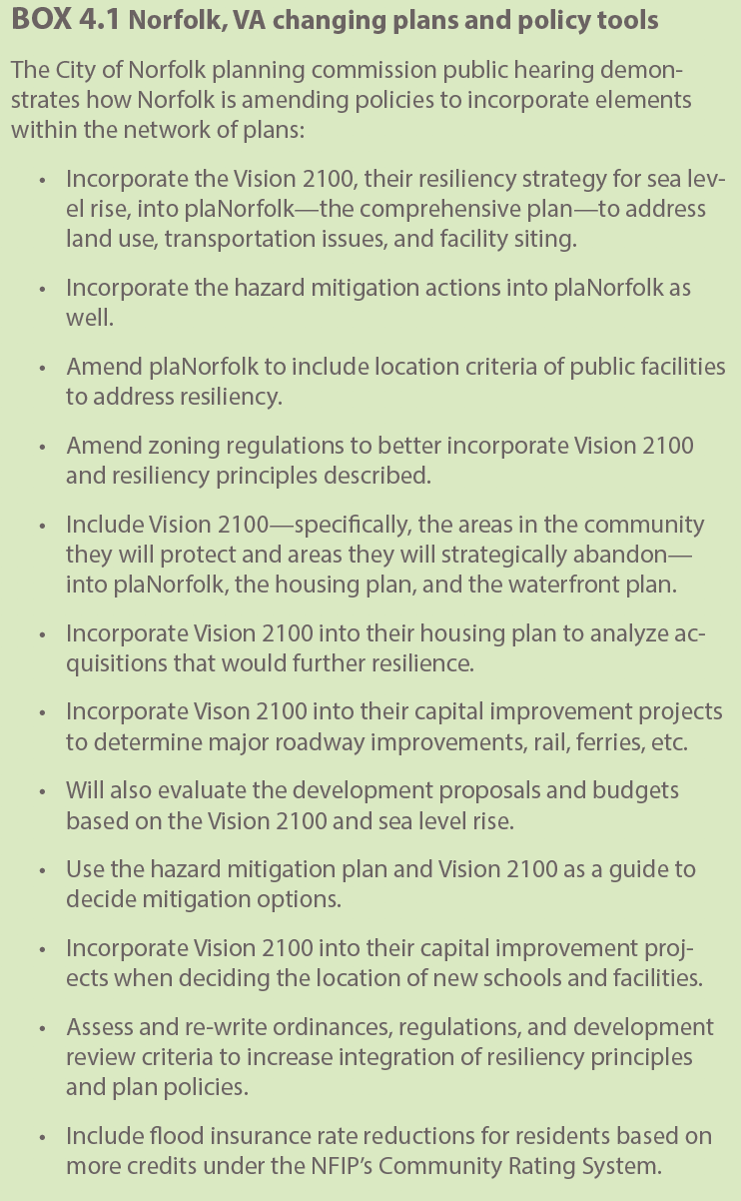
Norfolk, VA:
Changes to plans, policies, and
development regulations and
investments

Slide 31
Thank you
Questions?

