Slide 1
Notes:
ALTERNATIVE COVER
Main Heading
Font: Georgia; 28pts
Color: Blue
Character Spacing: Normal
Line spacing: 1pt
Text alignment: Centered
Subheading 1
Font: Arial Bold; 16pts
Color: Blue
Character Spacing: Normal
Line spacing: Exactly
Text alignment: Centered
Subheading 2
Font: Arial; 14pts
Color: Blue
Character Spacing: Normal
Line spacing: Exactly
Text alignment: Centered
Date
Font: Georgia Italic; 16pts
Color: Yellow
Character Spacing: Normal
Line spacing: 1pt
Text alignment: Centered

Slide 2







Innovation. Regional Collaboration. Job Creation.
EDA Program Portfolio
Trade Adjustment Assistance for Firms
Planning
Technical Assistance
Research and Evaluation
Innovative Manufacturing Loan Guarantee Program
Public Works
Regional Innovation Strategies (America COMPETES / RAMI)
Economic Adjustment

Slide 3
Planning Program
EDA’s Partnership Planning program helps regional planning organizations (Economic Development Districts (EDDs), Indian Tribes, and other eligible areas) with their long-term planning efforts, outreach to communities and development of Comprehensive Economic Development Strategies (CEDS).
A Comprehensive Economic Development Strategy (CEDS) is a strategy-driven plan for regional economic development. A CEDS is the result of a “regionally-owned” planning process designed to build capacity and guide the economic prosperity and resiliency of an area or region. It provides a coordinating mechanism for individuals, organizations, local governments, and private industry to engage about the economic direction of their region.
EDA supports a national network of over 380 regional economic development organizations know as Economic Development Districts (EDDs). EDDs are multi-jurisdictional entities, commonly composed of multiple counties and in certain cases even cross-state borders, that leverage the involvement of the public, private, and non-profit sectors to establish a CEDS for regional collaboration.
Funds may also be used for short term planning needs.

Slide 4
Technical Assistance Program
Supports three specific areas: University Centers, Local Technical Assistance (LTA), and National Technical Assistance (NTA) to foster innovative approaches, economic development and stimulating business growth.
Invests in 58 University Centers that provide technical assistance to public and private sector organizations.
LTA finances feasibility studies, planning efforts, and other projects that enable better understanding of economic assets or specific industries.
NTA disseminates information and studies of economic development issues of national significance.
EXAMPLE:
The Massachusetts Digital Games Institute (MassDiGI) is a statewide center, designated by the Commonwealth, for academic cooperation, entrepreneurship and economic development across the Massachusetts digital and video games ecosystem hosted and located at Becker College…..
As and EDA University Center, MassDiGI has launched several initiatives that support entrepreneurship and strengthen the talent pipeline between higher education and the game industry, drawing talent from Massachusetts’ Gateway Cities.
Notes:
Number of university centers is based on June 2013 report provided by PNP
The funds will be used to support local and regional Technical Assistance project grants. These investments help economically distressed communities look beyond their current, and sometimes obsolete, industrial base to new opportunities that could lead to higher-skill, higher-wage employers. There remains a high demand for these projects as regions recover from the economic downturn of a few years ago.

Slide 5
Innovation. Regional Collaboration. Job Creation.
Public Works Program
EDA investments help facilitate the transition of distressed communities to become more competitive through the development of key public infrastructure such as roads, bridges, sanitary sewers, water, broadband, manufacturing center, incubators, etc. for use by private businesses:
Acquisition or development of land including design, engineering, construction, rehabilitation, alternation, expansion, improvement for use for a public works, public service, or development facility, including related machinery and equipment
Improve the opportunities, in the area where the project is or will be located, for the successful establishment or expansion of industrial or commercial plants or facilities;
Assist in the creation of additional long-term employment opportunities in the area; or Primarily benefit the long-term unemployed and members of low-income families
The project will fulfill a pressing need of the area, or a part of the area
The area for which the project is to be carried out has a comprehensive
economic development strategy and the project is consistent with the strategy
Notes:
Jobs created and private investment based on data provided by PNP, Kerstin Millius.
The Public Works program funding of $85 million results in 13,633 jobs created/saved and $599.8 million in private investment leveraged.
The Public Works program invests in critical infrastructure that meets business expansion needs and lowers business investment risk, including water and sewer system improvements, industrial parks, business incubator facilities, expansion of port and harbor facilities, skill-training facilities, and the redevelopment of brownfields.
EDA considers the Public Works Program one of the critical inputs to growing a strong regional economy. Restoring our industrial commons requires a balanced portfolio of solutions that are critically important to U.S. competitiveness. Taken along with EDA’s other program adjustments, these budget modifications are designed to provide the Bureau with a robust and diverse, yet balanced, portfolio of assistance that can be brought to bear on a broad range of the construction, non-construction, and financing projects that will stimulate economic development in regions across the nation.

Slide 6
Economic Adjustment Assistance Program
The most flexible program in EDA’s toolbox, can address a variety of economic development needs including the response to natural disasters
Provides a portfolio of assistance that can be tailored to meet an applicant’s needs:
  Strategic planning
  Technical assistance
  Construction of physical infrastructure
  Capitalization of revolving loan funds
EDA is the agency delegated by the US DoC to coordinate the long term response to natural disasters by Federal agencies
Most recently, EDA personnel are assigned to the FEMA response to Hurricane Harvey
Notes:
Jobs created and private investment based on data provided by PNP, Kerstin Millius.

Slide 7
Innovation. Regional Collaboration. Job Creation.
Eligible Applicants – Recipients
EDA provides competitive, merit-based grants and technical assistance to private-public partnerships:
State and local governments
Tribal organizations
Colleges and Universities
Non-profit organizations
Context of “in economically distressed communities”
EDA does not provide investments to individuals, private business or for-profit entities nor does it allow pass throughs to these entities
EDA’s grant investments are generally 50% with a equivalent match—but can be up to 80% based on economic distress criteria (Per Capita Income, Unemployment, etc.). Native American grants can be up to 100%

Slide 8
Eligibility for Programs
CEDS (or an approved equivalent) is required for projects under Sections 201 for Public Works and 209 for Economic Adjustment and the project shall be located in an area meeting one or more of the following:
Low Per Capita Income—The area has a per capita income of 80 percent or less of the national average
Unemployment Rate Above National Average—The area has an unemployment rate that is, for the most recent 24- month period for which data are available, at least 1 percent greater than the national average unemployment rate
Unemployment or Economic Adjustment Problems—The area is an area that the Secretary determines has experienced or is about to experience a special need arising from actual or threatened severe unemployment or economic adjustment problems resulting from severe short-term or long-term changes in economic conditions

Slide 9
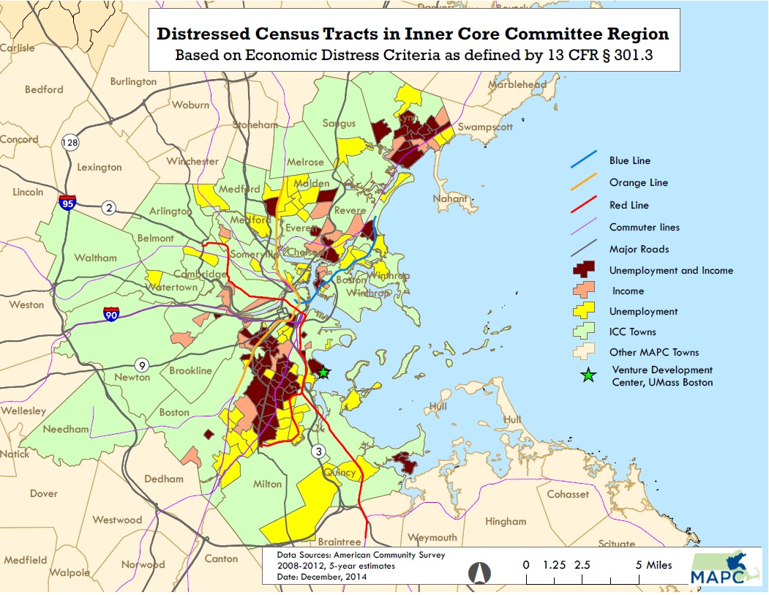
Eligibility for Programs
Political Boundaries of Areas—An area that meets 1 or more of the criteria of subsection including a small area of poverty or high unemployment within a larger community in less economic distress, shall be eligible for assistance under section 201 or 209 without regard to political or other subdivisions or boundaries.

Slide 10
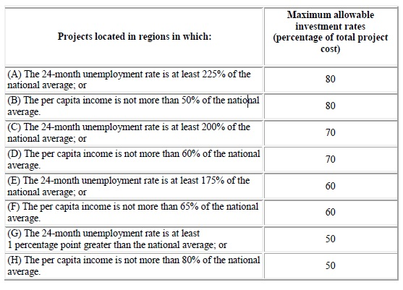
Investment Rates - Typically at a 50 Percent Cost Share and then Relative Need Exceptions
Practical Matter - Investment Rates are Functions of Relative Need Based on Low Per Capita Income or Unemployment Rates Below the National Average

Slide 11
Eligibility of Programs
Unemployment or Economic Adjustment Problems—The area is an area that the Secretary determines has experienced or is about to experience a special need arising from actual or threatened severe unemployment or economic adjustment problems resulting from severe short-term or long-term changes in economic conditions
Closure or restructuring of industries or the loss of a major employer essential to the Regional economy – actual or threatened
Substantial out-migration or population loss
Underemployment, meaning employment of workers at less than full-time or at less skilled tasks than their training or abilities permit
Military base closures or realignments, defense contractor reductions-in-force, or Department of Energy defense-related funding reductions

Slide 12
Eligibility of Programs
Unemployment or Economic Adjustment Problems—The area is an area that the Secretary determines has experienced or is about to experience a special need arising from actual or threatened severe unemployment or economic adjustment problems resulting from severe short-term or long-term changes in economic conditions…..further defined
Natural or other major disasters or emergencies- Stafford Act, Magnuson Steven Fishery Act, Consolidated Farm and Rural Development Act or Small Business Act
Hurricane Harvey impact area under the Stafford Act
Extraordinary depletion of natural resources or other impact attributable to a new or revised Federal regulation or policy
Communities undergoing transition of their economic base as a result of changing trade patterns
Other Special Need as determined by the Assistant Secretary

Slide 13
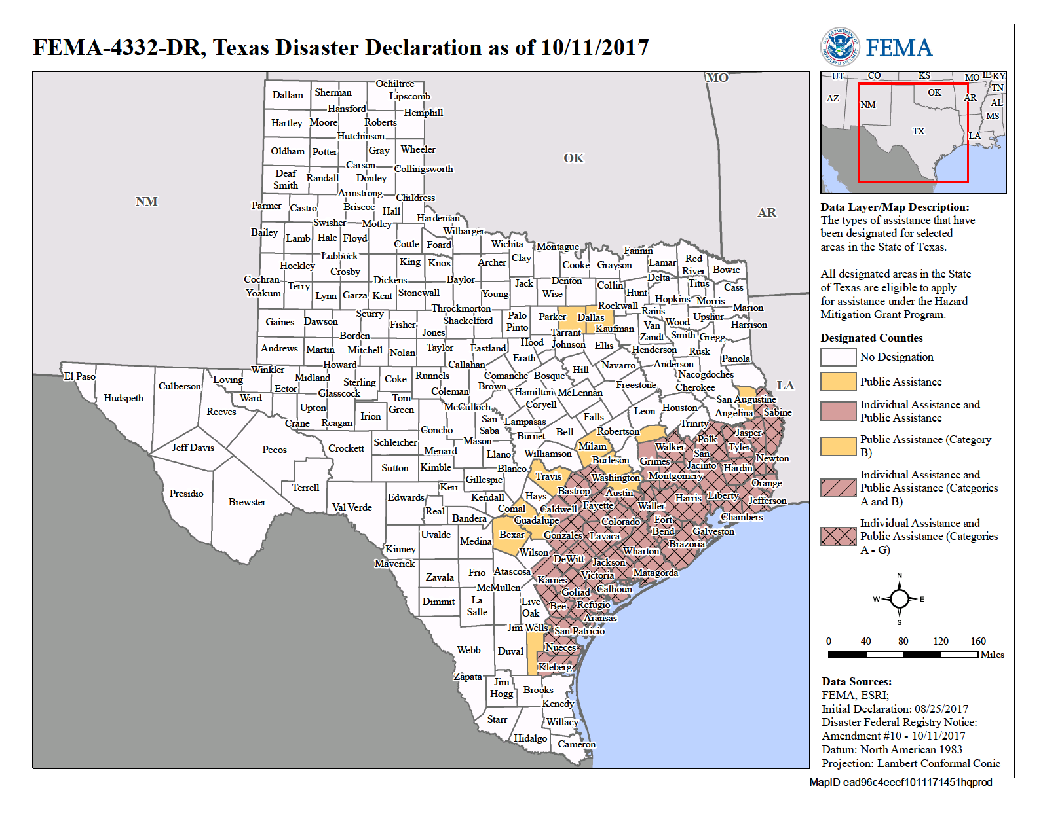
Hurricane Harvey Impact Area
Disaster Supplemental – Provides $129.4million for impacted communities

Slide 14
Application Process – Regional Programs
Applications are accepted throughout the year and are generally submitted through Grants.Gov
Recent changes in the process have resulted in a relatively brief proposal that only requires the highlights of the proposed project in terms of financials, economic impact, etc… for the Public Works and Economic Adjustment programs
If the proposal is deemed competitive with EDA priorities, the applicant will be invited to provide further information for further consideration
Generally grants are awarded within 90 days of the complete application
Notes:
Jobs created and private investment based on data provided by PNP, Kerstin Millius.

Slide 15
Application Process – Regional Programs
Direct consultation with EDA Economic Development Representative- customer service which can be one to one or connection through Economic Development District
Direct consultation provides an opportunity to “vet” project need, alignment with CEDS, appropriate budget and viability with EDA’s competitive process
Engagement with EDA Project Engineer and other Subject Matter Experts as appropriate
Notes:
Jobs created and private investment based on data provided by PNP, Kerstin Millius.

Slide 16
Application Process – Regional Programs
For the Public Works and Economic Adjustment programs the is a Proposal to be completed and submitted – hard copy to regional office or via Grants.gov
For Planning and Technical Assistance a full application is to be completed and submitted –hard copy to regional office or via Grants.gov
University Center program is a competitive pool – every five years in the region exclusive through Grants.gov
Notes:
Jobs created and private investment based on data provided by PNP, Kerstin Millius.

Slide 17
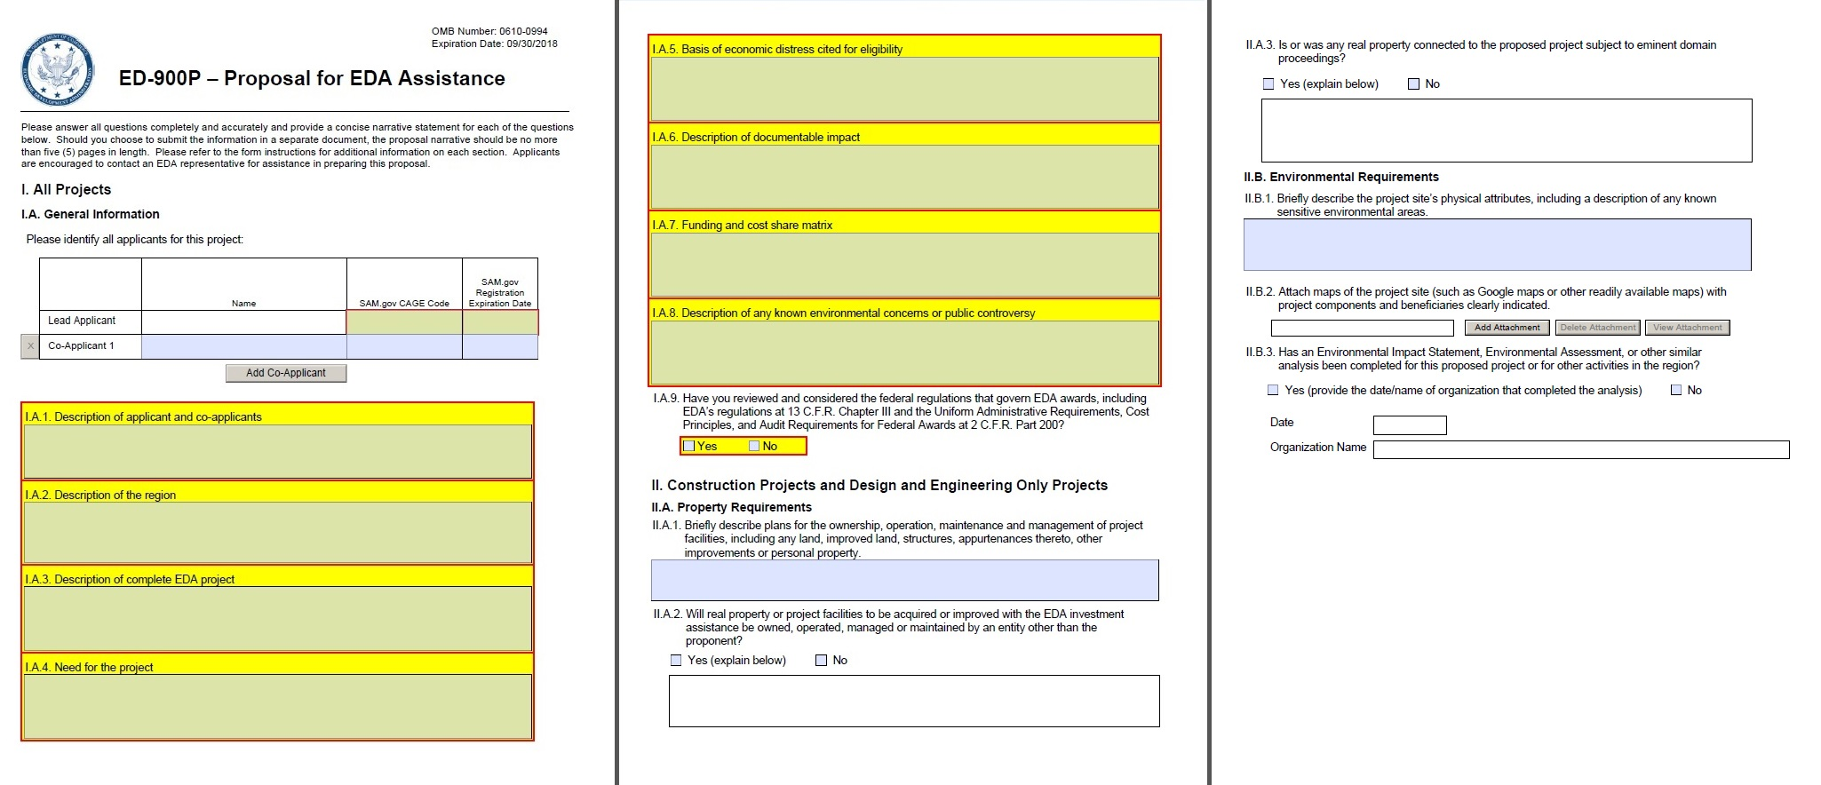
Application Process – Regional Programs
Proposal form (Public Works and Economic Adjustment) – the applicant competes and submits a SF424 and in depth responses to 14-15 preliminary items on the ED-900 P form:
Notes:
Jobs created and private investment based on data provided by PNP, Kerstin Millius.

Slide 18
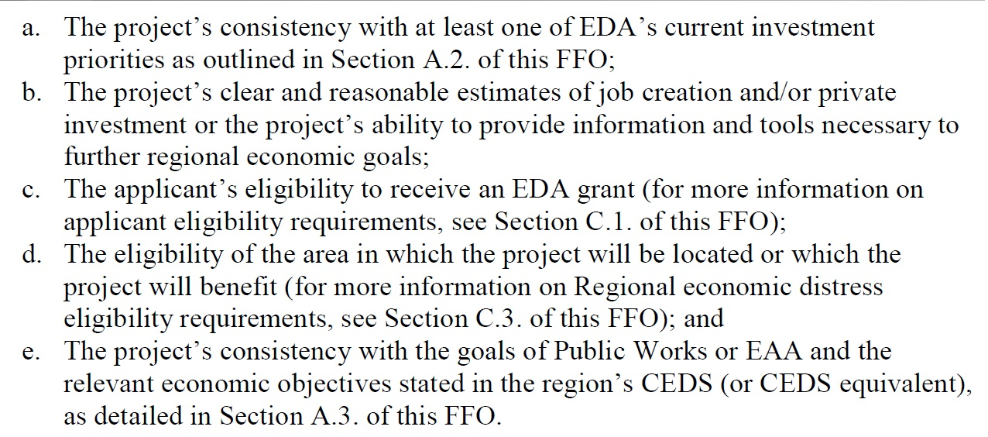
Application Process – Regional Programs
EDA provides a an evaluation in 30 days
“RESPONSIVE” or “NOT RESPONSIVE”
via a Proposal Review Committee:
Notes:
Jobs created and private investment based on data provided by PNP, Kerstin Millius.

Slide 19
Application Process – Regional Programs
If “RESPONSIVE” then Regional Director invites a full application to be submitted within 60 days
Clearances and Considerations: Budget, Environmental Review, Engineering, Method of Construction, Beneficiary Commitments
Investment Review Committee is convened – seven qualitative elements - the deeper dive of enabling the region to become more economically diverse and prosperous
If “NOT RESPONSIVE” further refinement may occur by the applicant, EDR, Integrator or other SMEs may provide technical assistance
Clearances and Considerations – Duration of time to develop
Notes:
Jobs created and private investment based on data provided by PNP, Kerstin Millius.

Slide 20
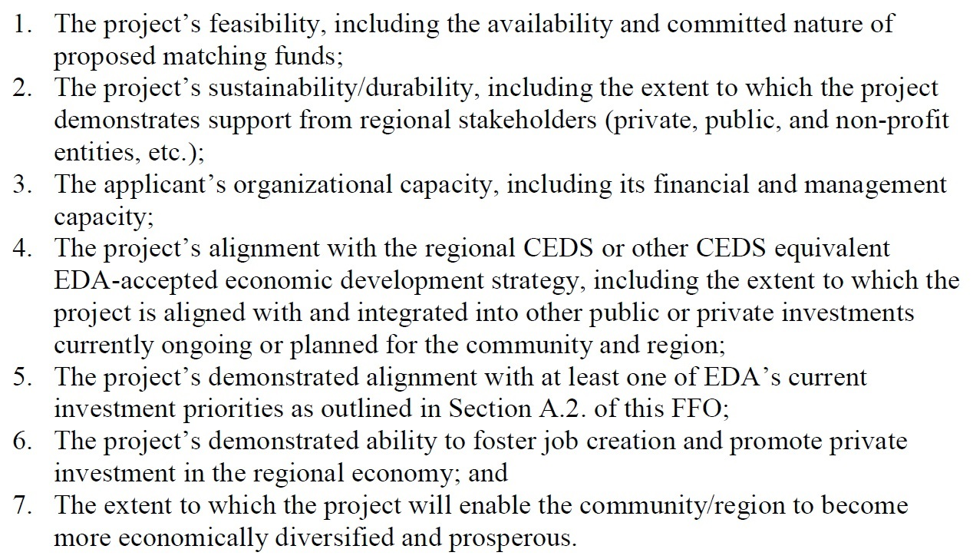
Application Process – Regional Programs
Investment Review Committee’s due diligence
Notes:
Jobs created and private investment based on data provided by PNP, Kerstin Millius.

Slide 21
Application Process – Regional Programs
For the Planning and Technical Assistance programs a full application is submitted
There is no Proposal Review Committee
There is an Investment Review Committee
Notes:
Jobs created and private investment based on data provided by PNP, Kerstin Millius.

Slide 22

Thank You!
Robert Peche
Economic Development Representative
(512) 568-7732
rpeche1@eda.gov
U.S. Department of Commerce | Economic Development Administration | 903 San Jacinto Blvd., Suite 206 | Austin, TX 78701-2450
Notes:
Template notes for Cover Page
EDA Logo
Animation: on click, Fade
EDA Seal
- Animation: (should appear after EDA Logo): after previous, Fade
Power Point Title
Font: Arial Narrow/Bold/All Caps/18pts
Color: Dark Blue (RGB 26,52,104)
Character Spacing: Expanded 1.4pts
Line spacing: None
Text alignment: Centered
Animation: Wipe, from left, with previous, Medium speed
NOTE: If you copy and paste text from Word or other source into any of the text boxes in this presentation, please make sure you select “keep text only” so the text will format. All Caps does not transfer, so after you paste the text and select “keep text only”, you will need to select the text and click the “all caps” icon in the formatting palette.

