Slide 1

Infrastructural and Community Resilience on the Coast: Lessons Learned from Recent Hurricanes
James M. Kaihatu
Zachry Department of Civil Engineering
Texas A&M University
College Station, TX

Slide 2
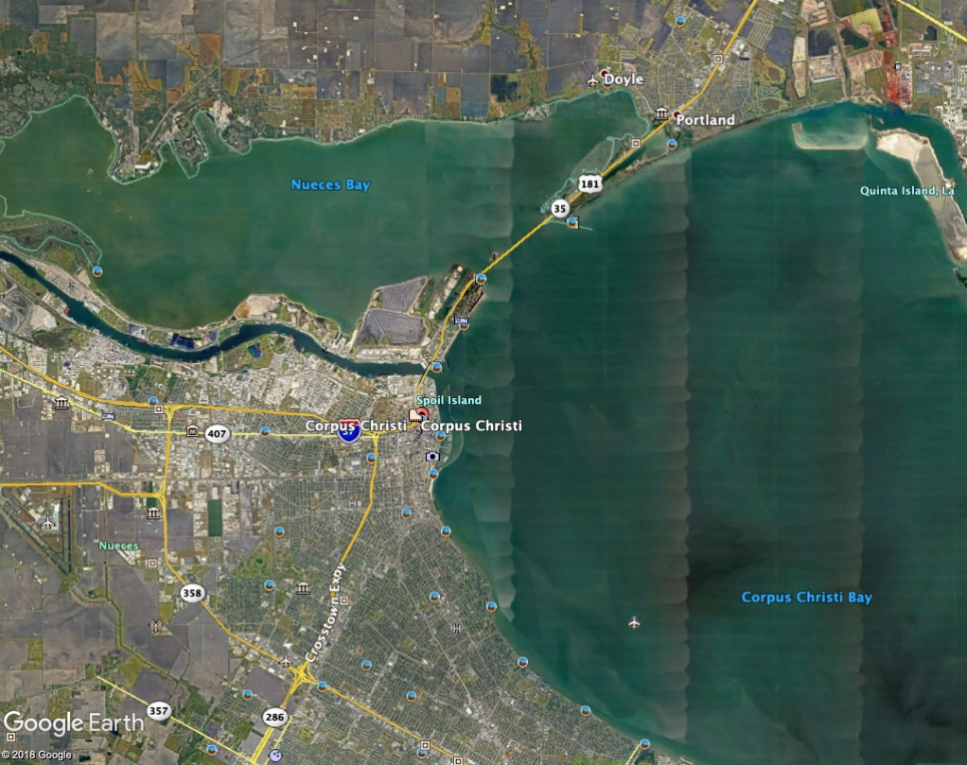
Corpus Christi, TX

Slide 3
Historical Storms
Year | Storm Name | Category at Landfall
1916 | Hurricane | 4
1919 | Florida Keys Hurricane | 3
1961 | Carla | 4
1967 | Beulah | 3
1970 | Celia | 3
1978 | TS Amelia | NA
1980 | Allen | 3
1999 | Bret | 3
2017 | Harvey | 3-5
Source: Wikipedia

Slide 4
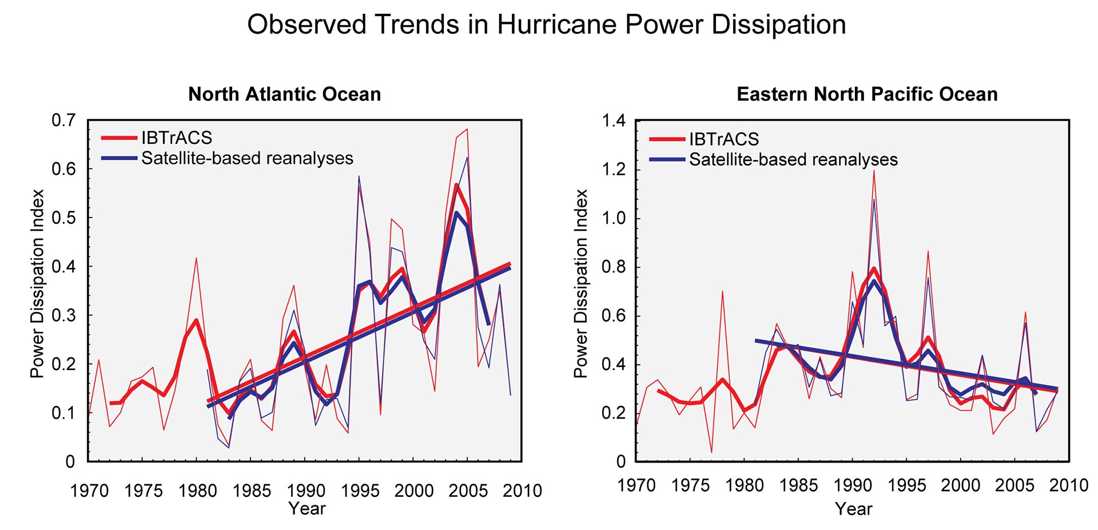
Hazard: Storm Intensity
Kossin et al., GRL v. 34, 2007

Slide 5
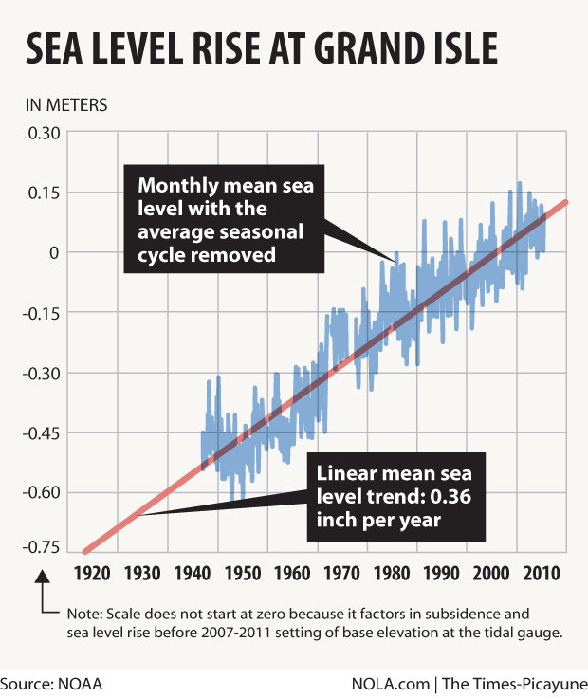
Hazard: Sea Level Rise

Slide 6
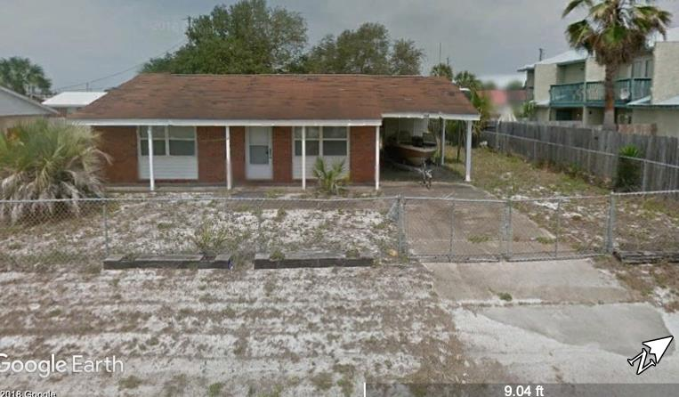
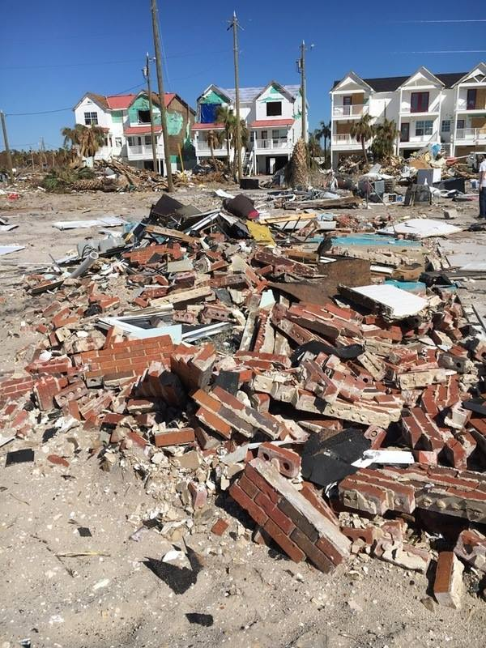
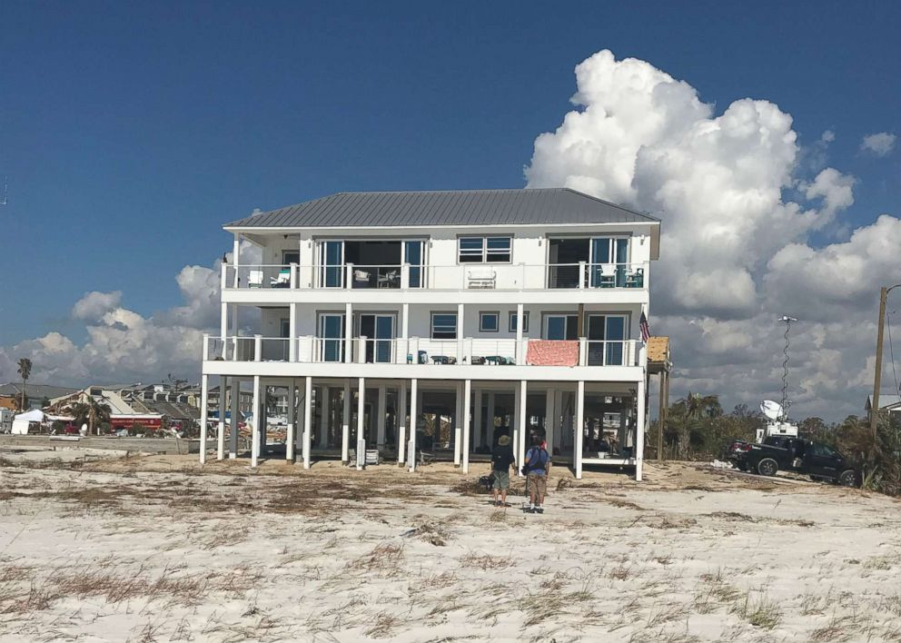
Adaptability to Increasing Hazard
Mexico Beach, November 2018
Mexico Beach, January 2016
Aftermath of Hurricane Michael
Rebuild?
Or adapt?

Slide 7
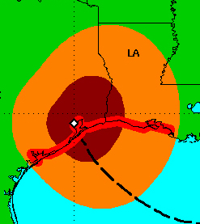
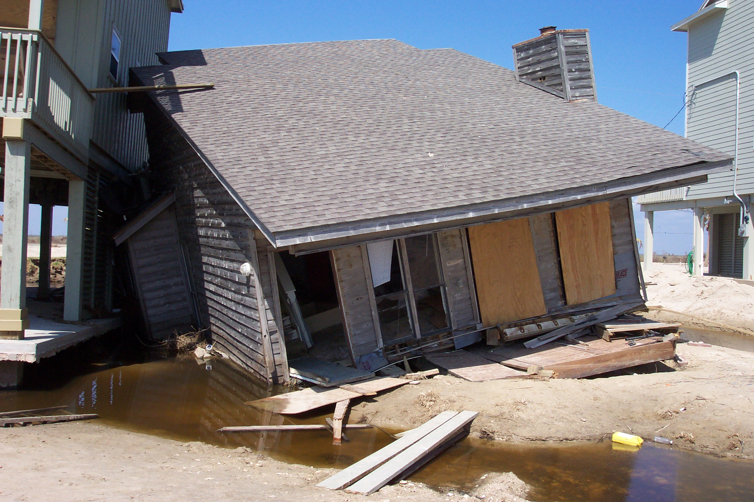
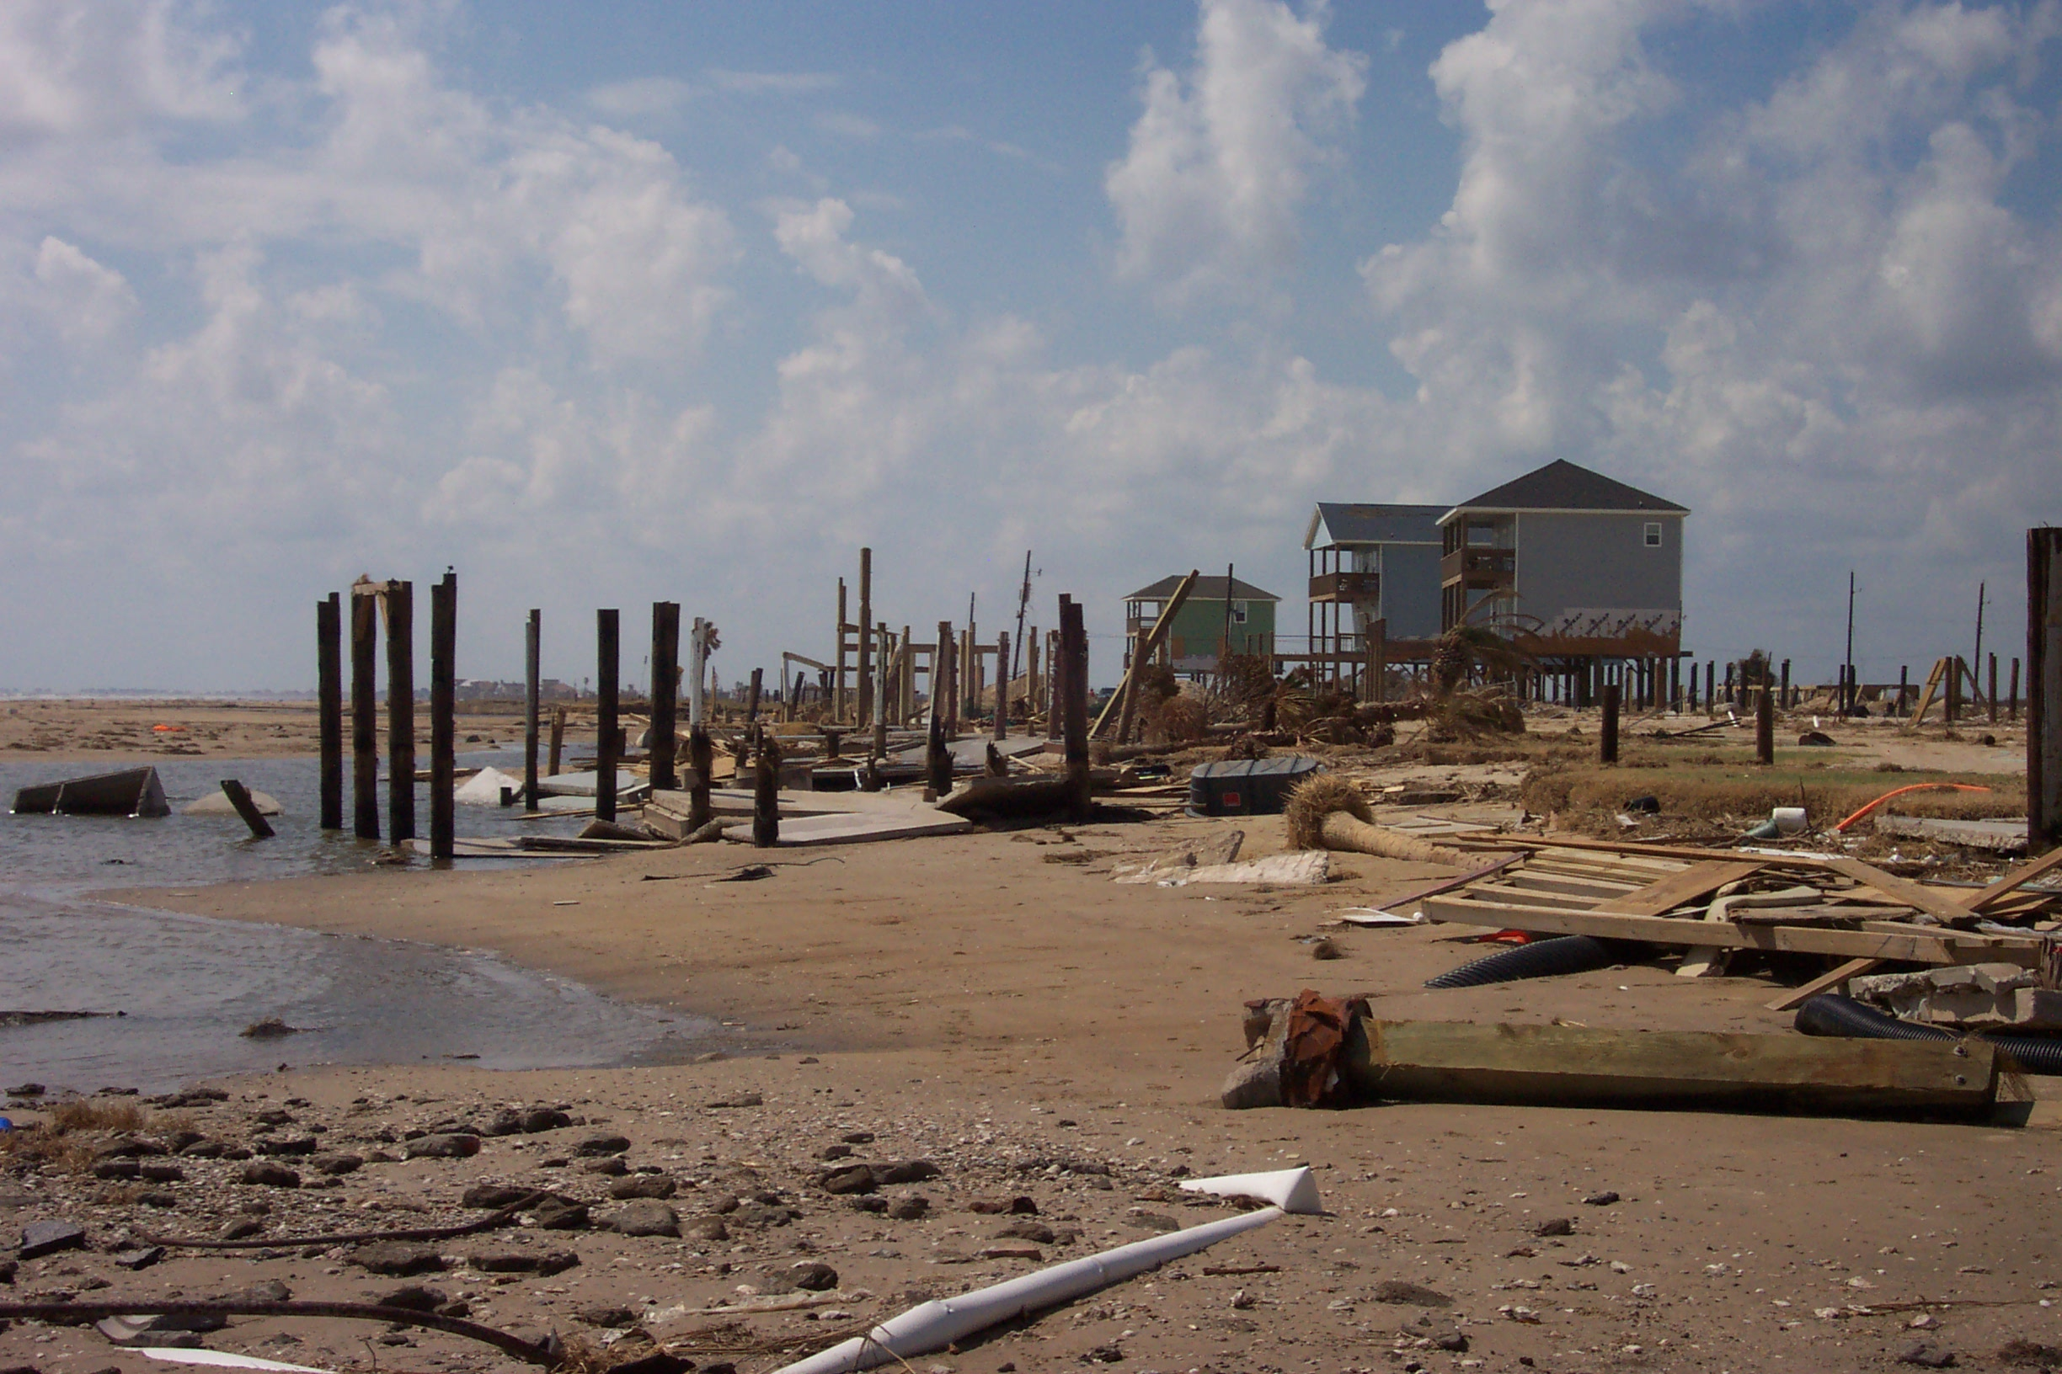
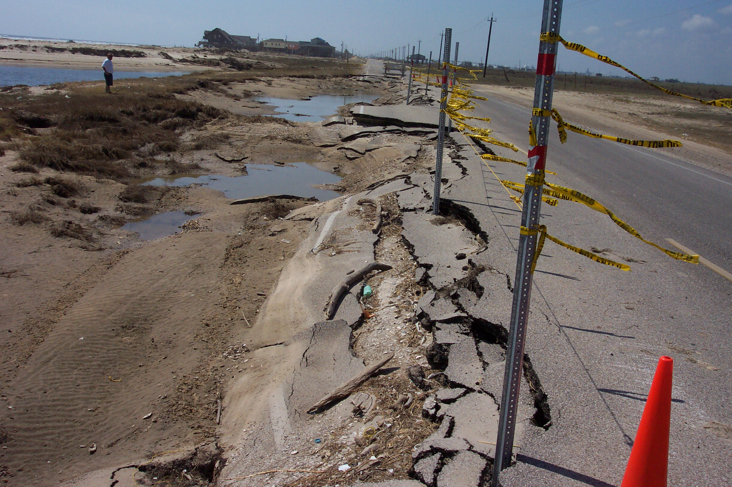
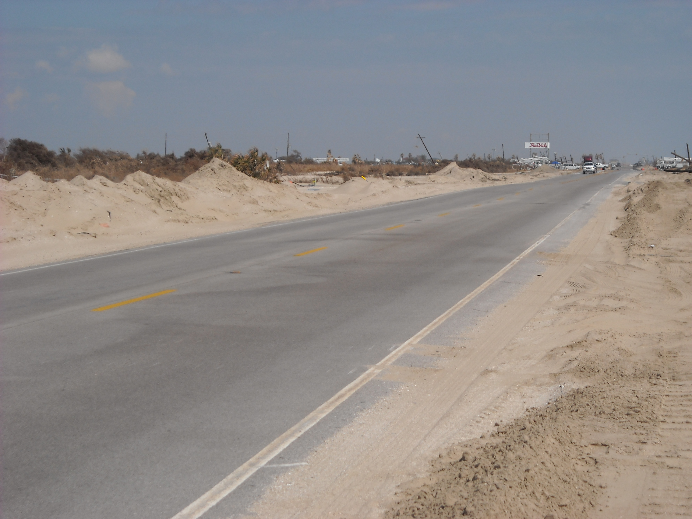
Hurricane Ike
Source for Wind Field Figure: NOAA
Foundation Failure
Intermittent Structural Damage
Same storm
Different damage types
Different design criteria
Evidence of High Surge and Wave Damage
Severe Road Damage
Functional Road
West of Landfall
East of Landfall

Slide 8
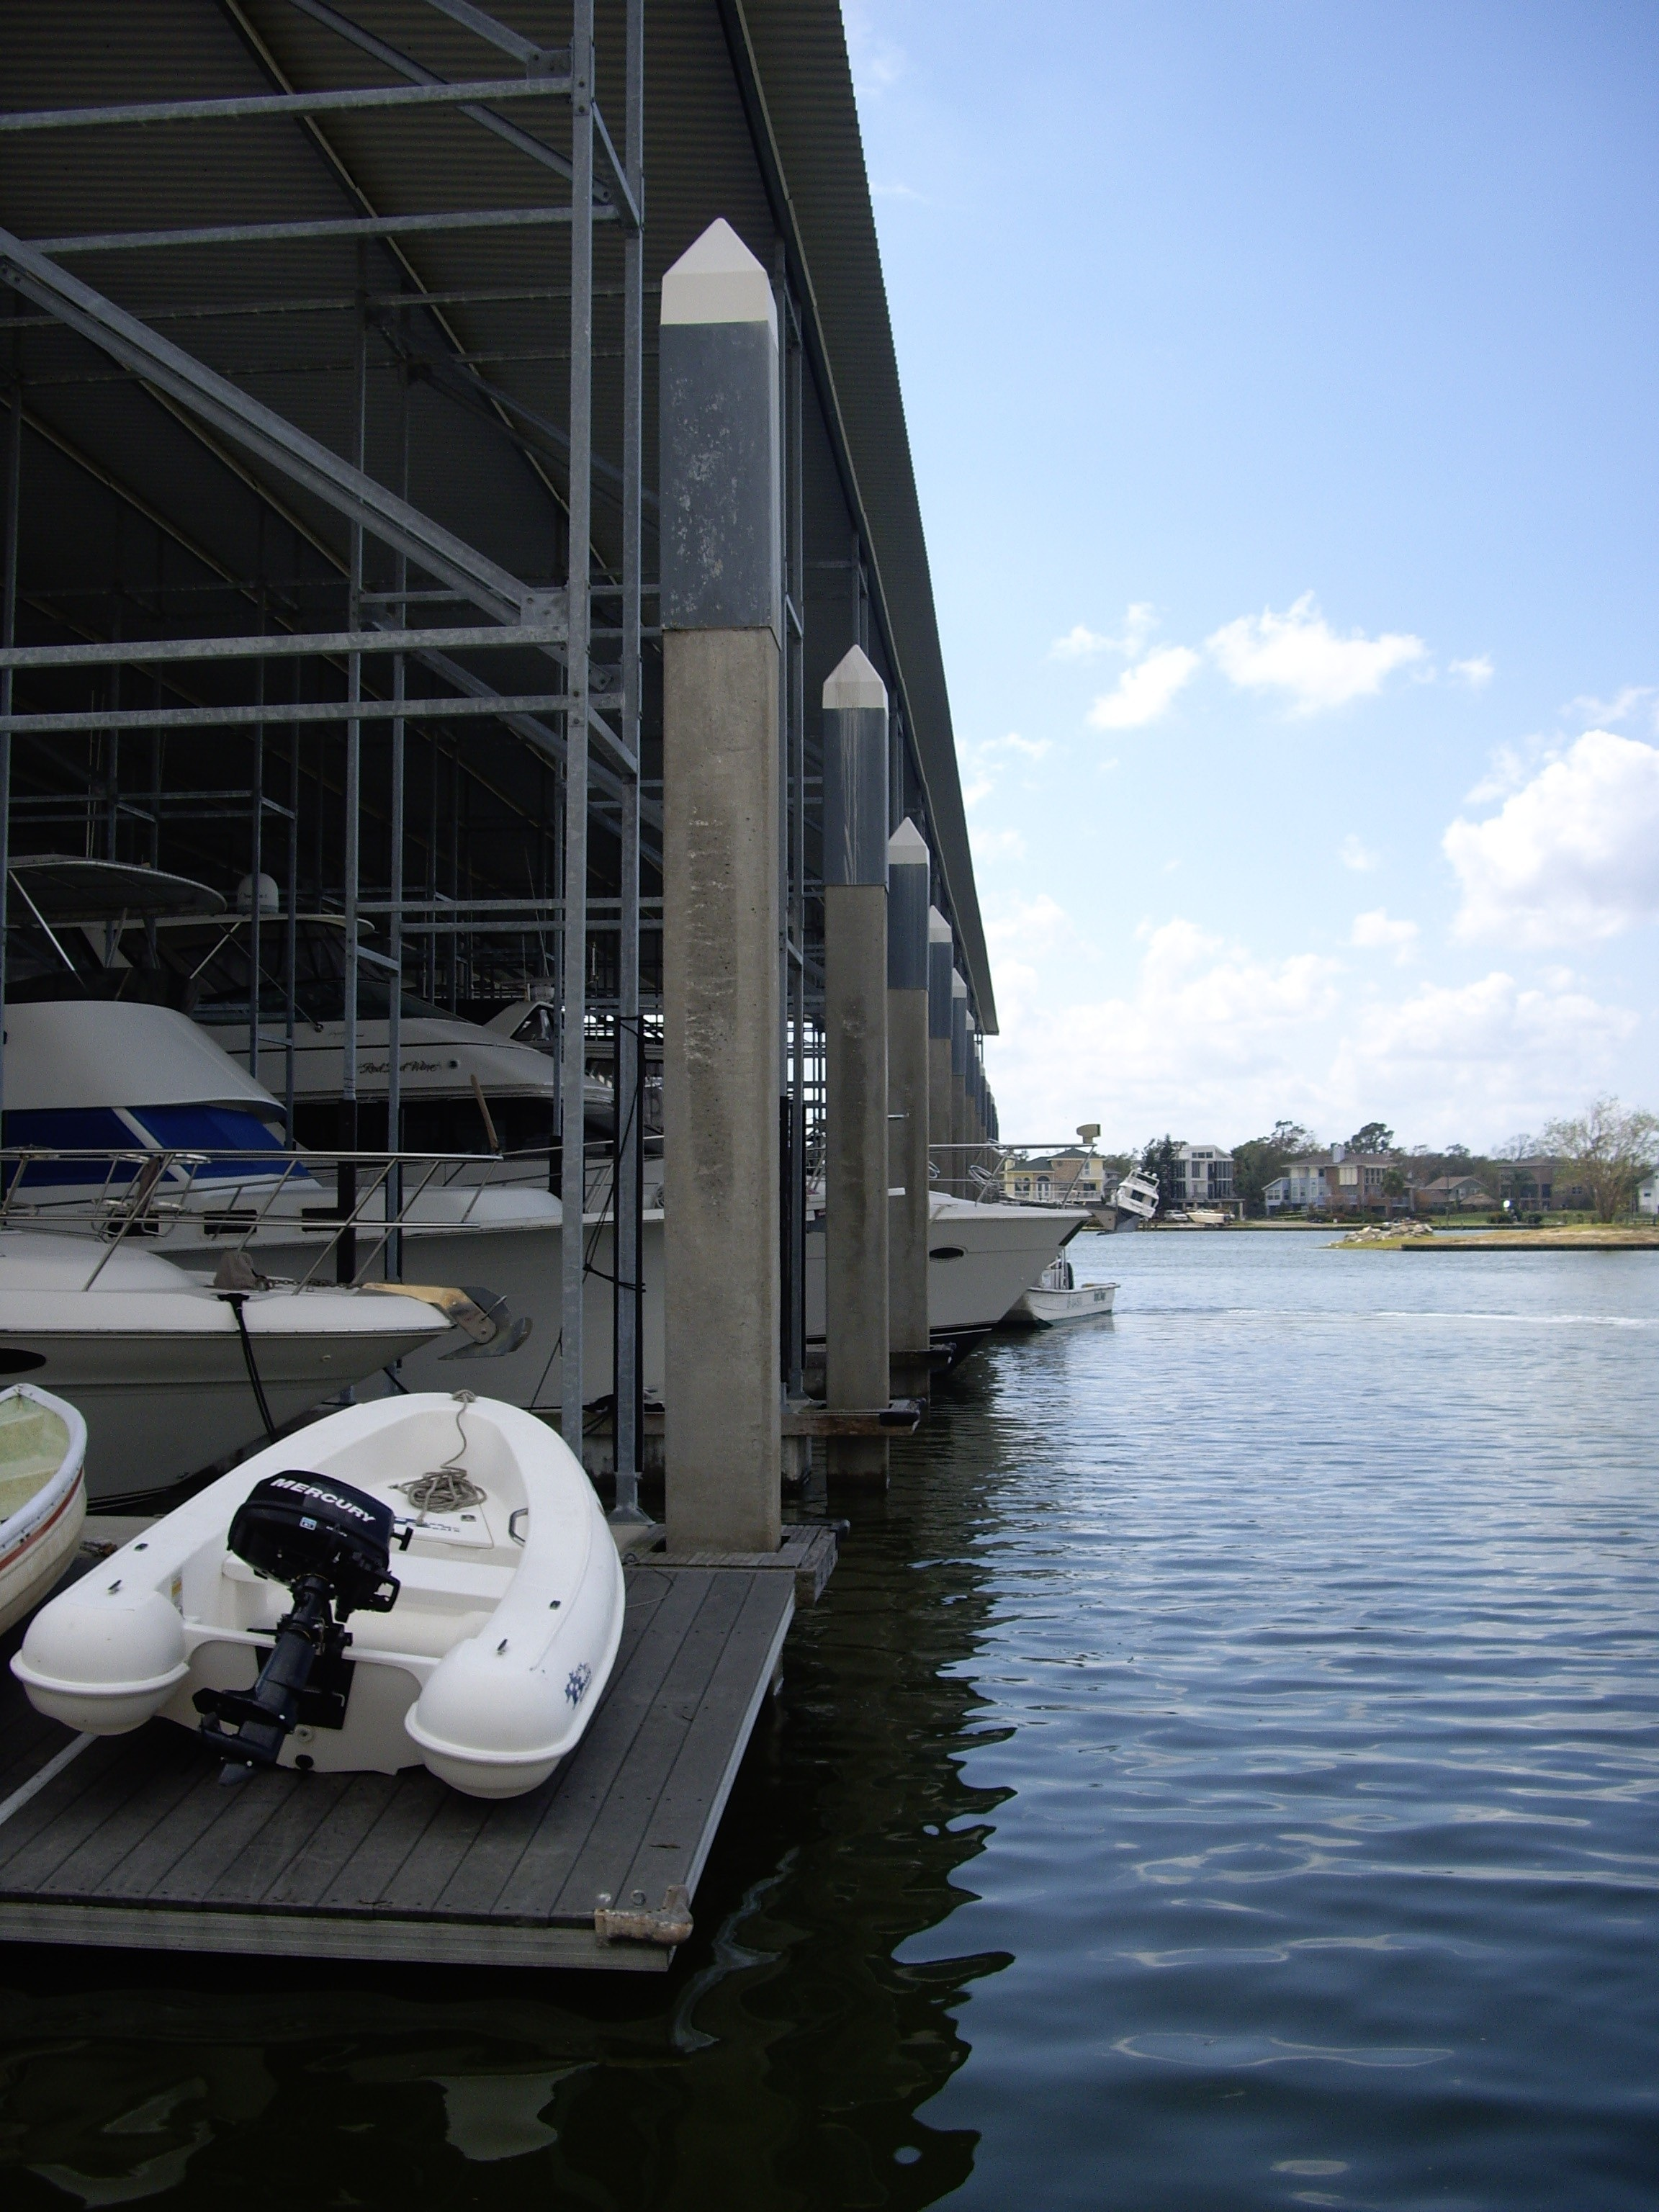
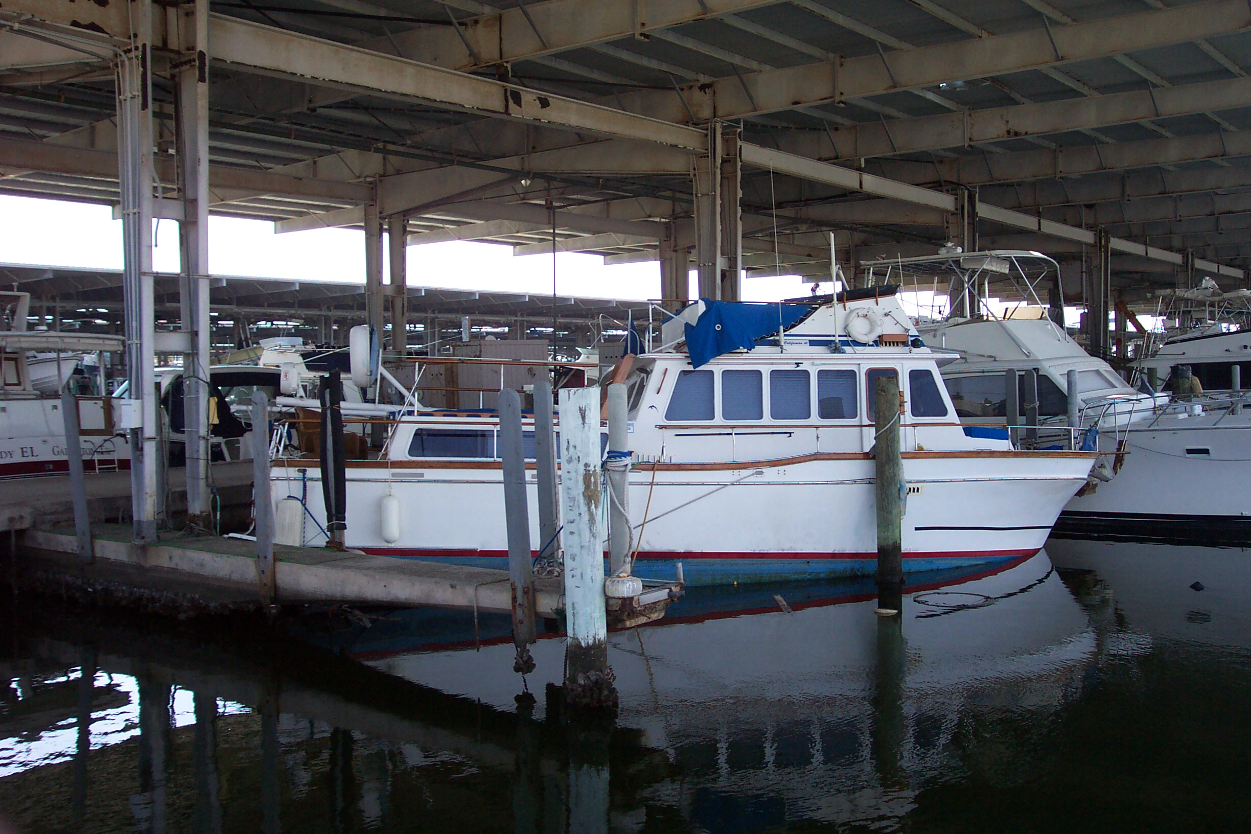
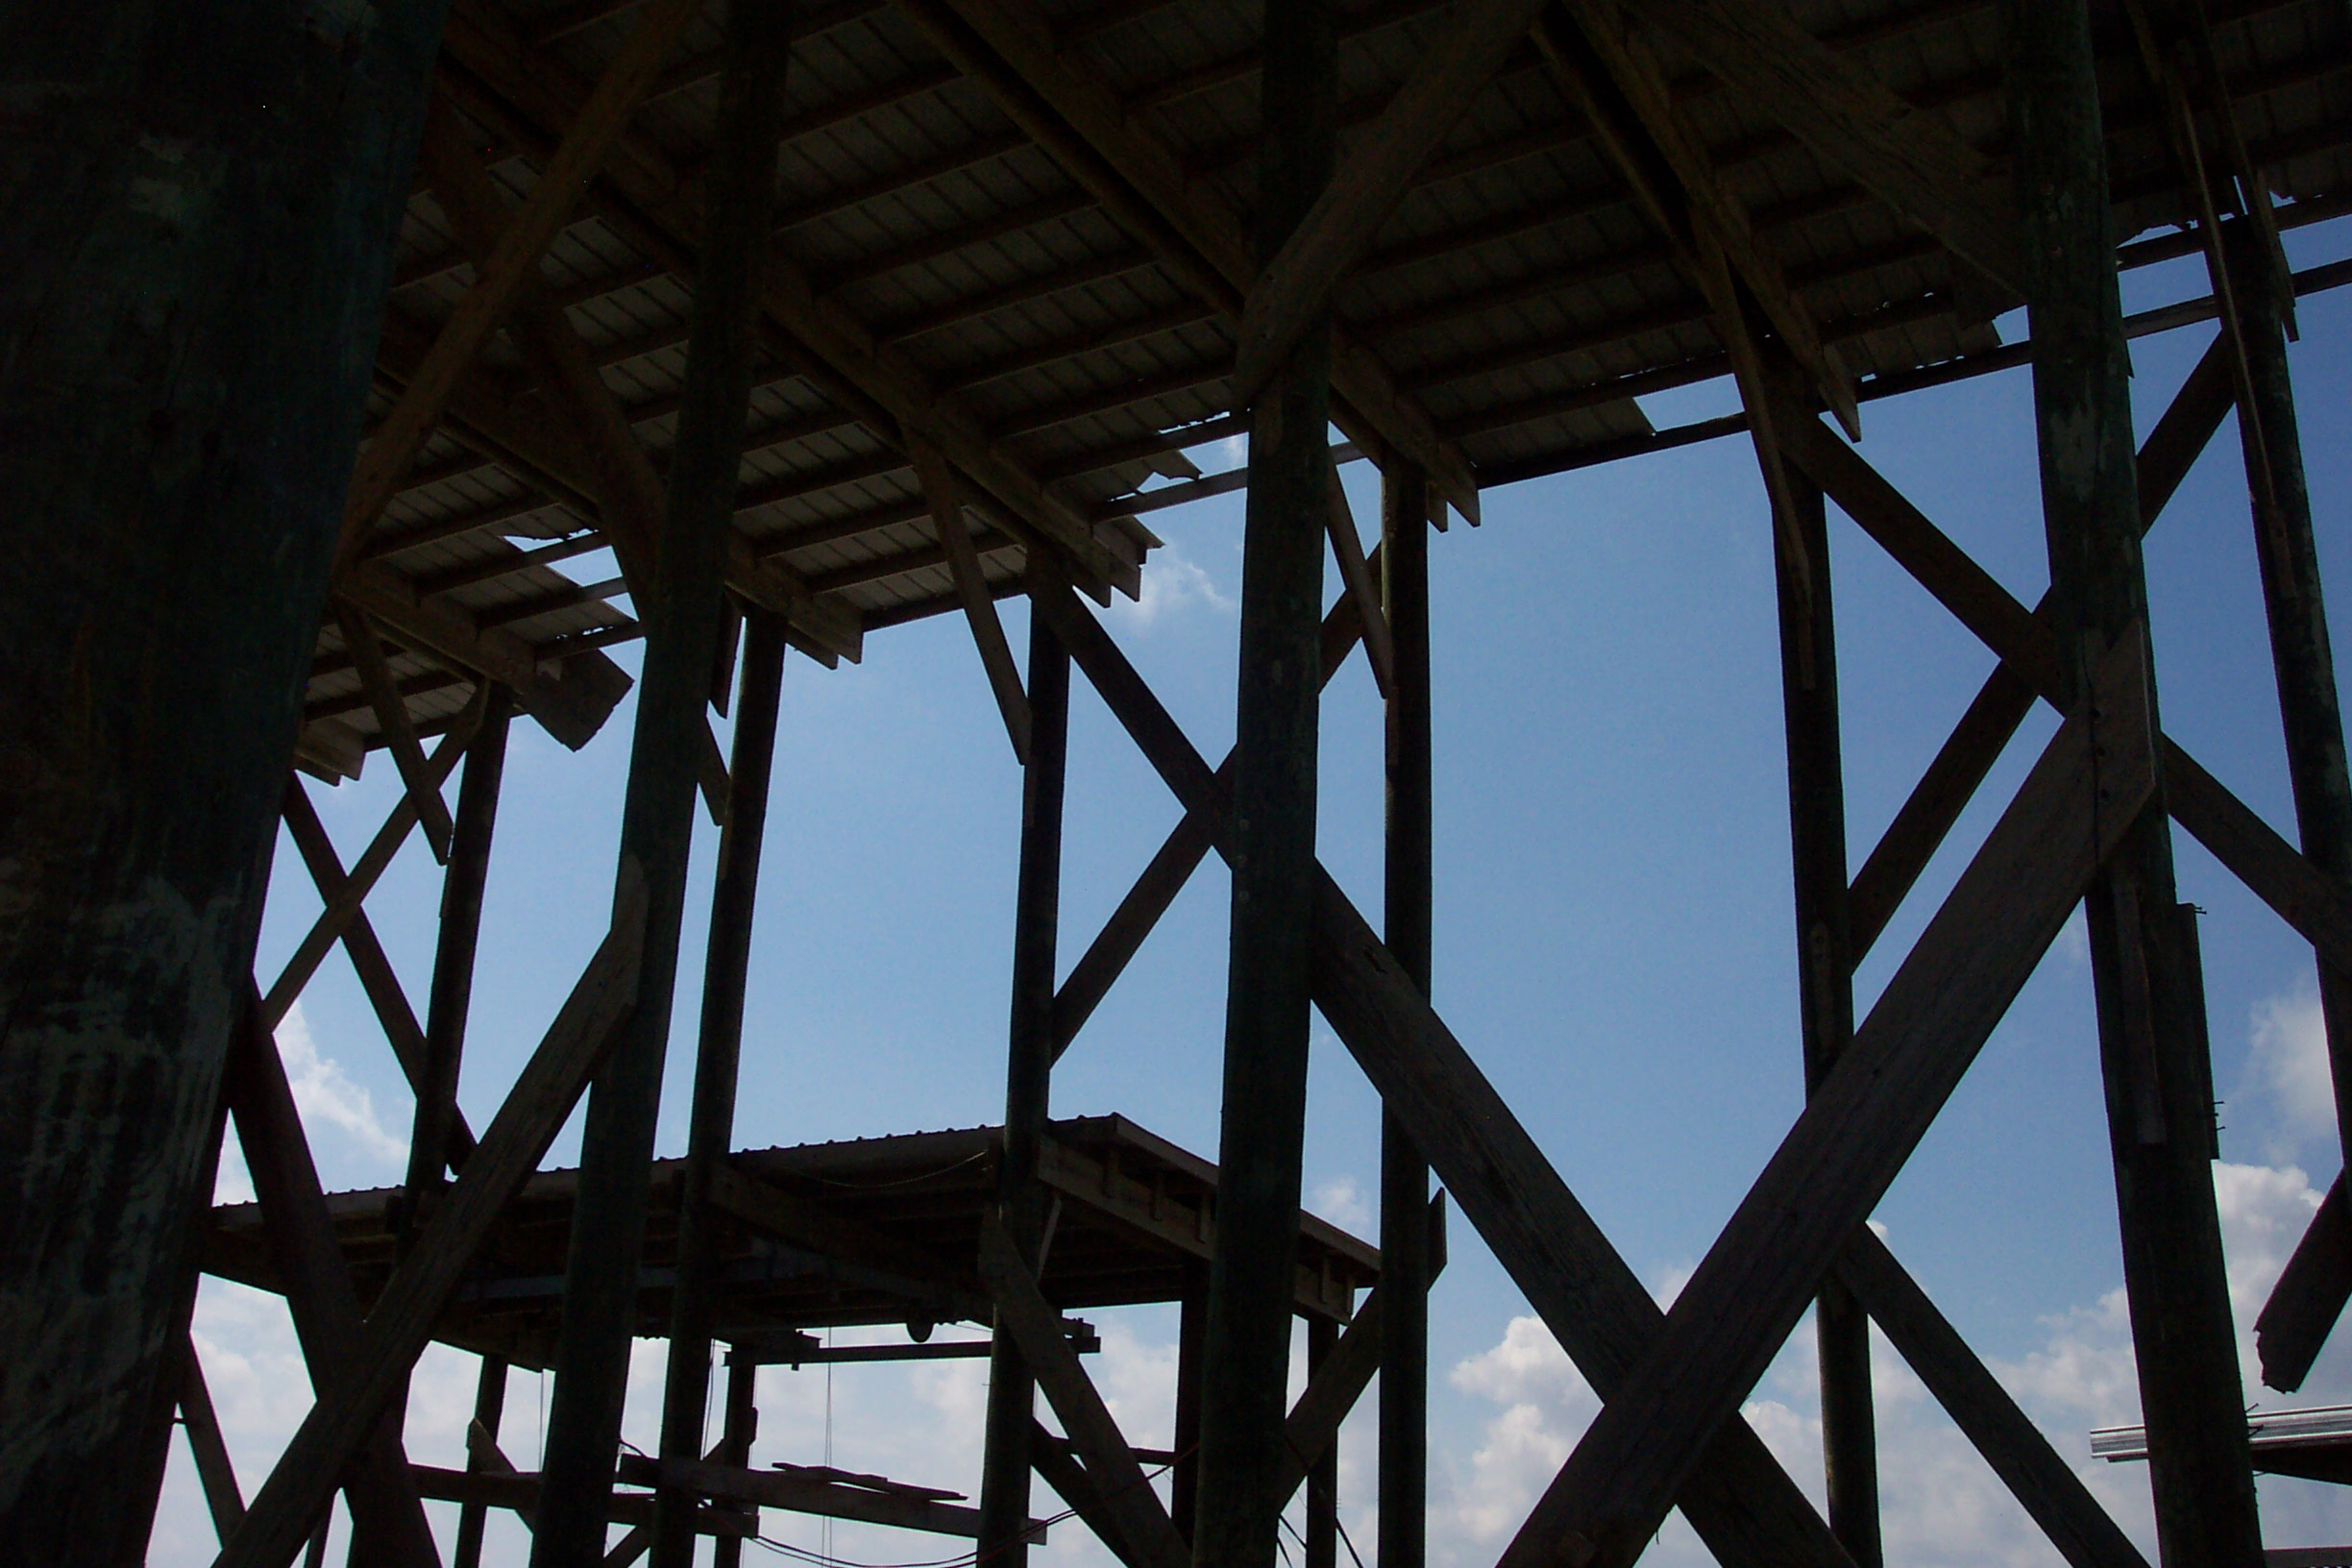
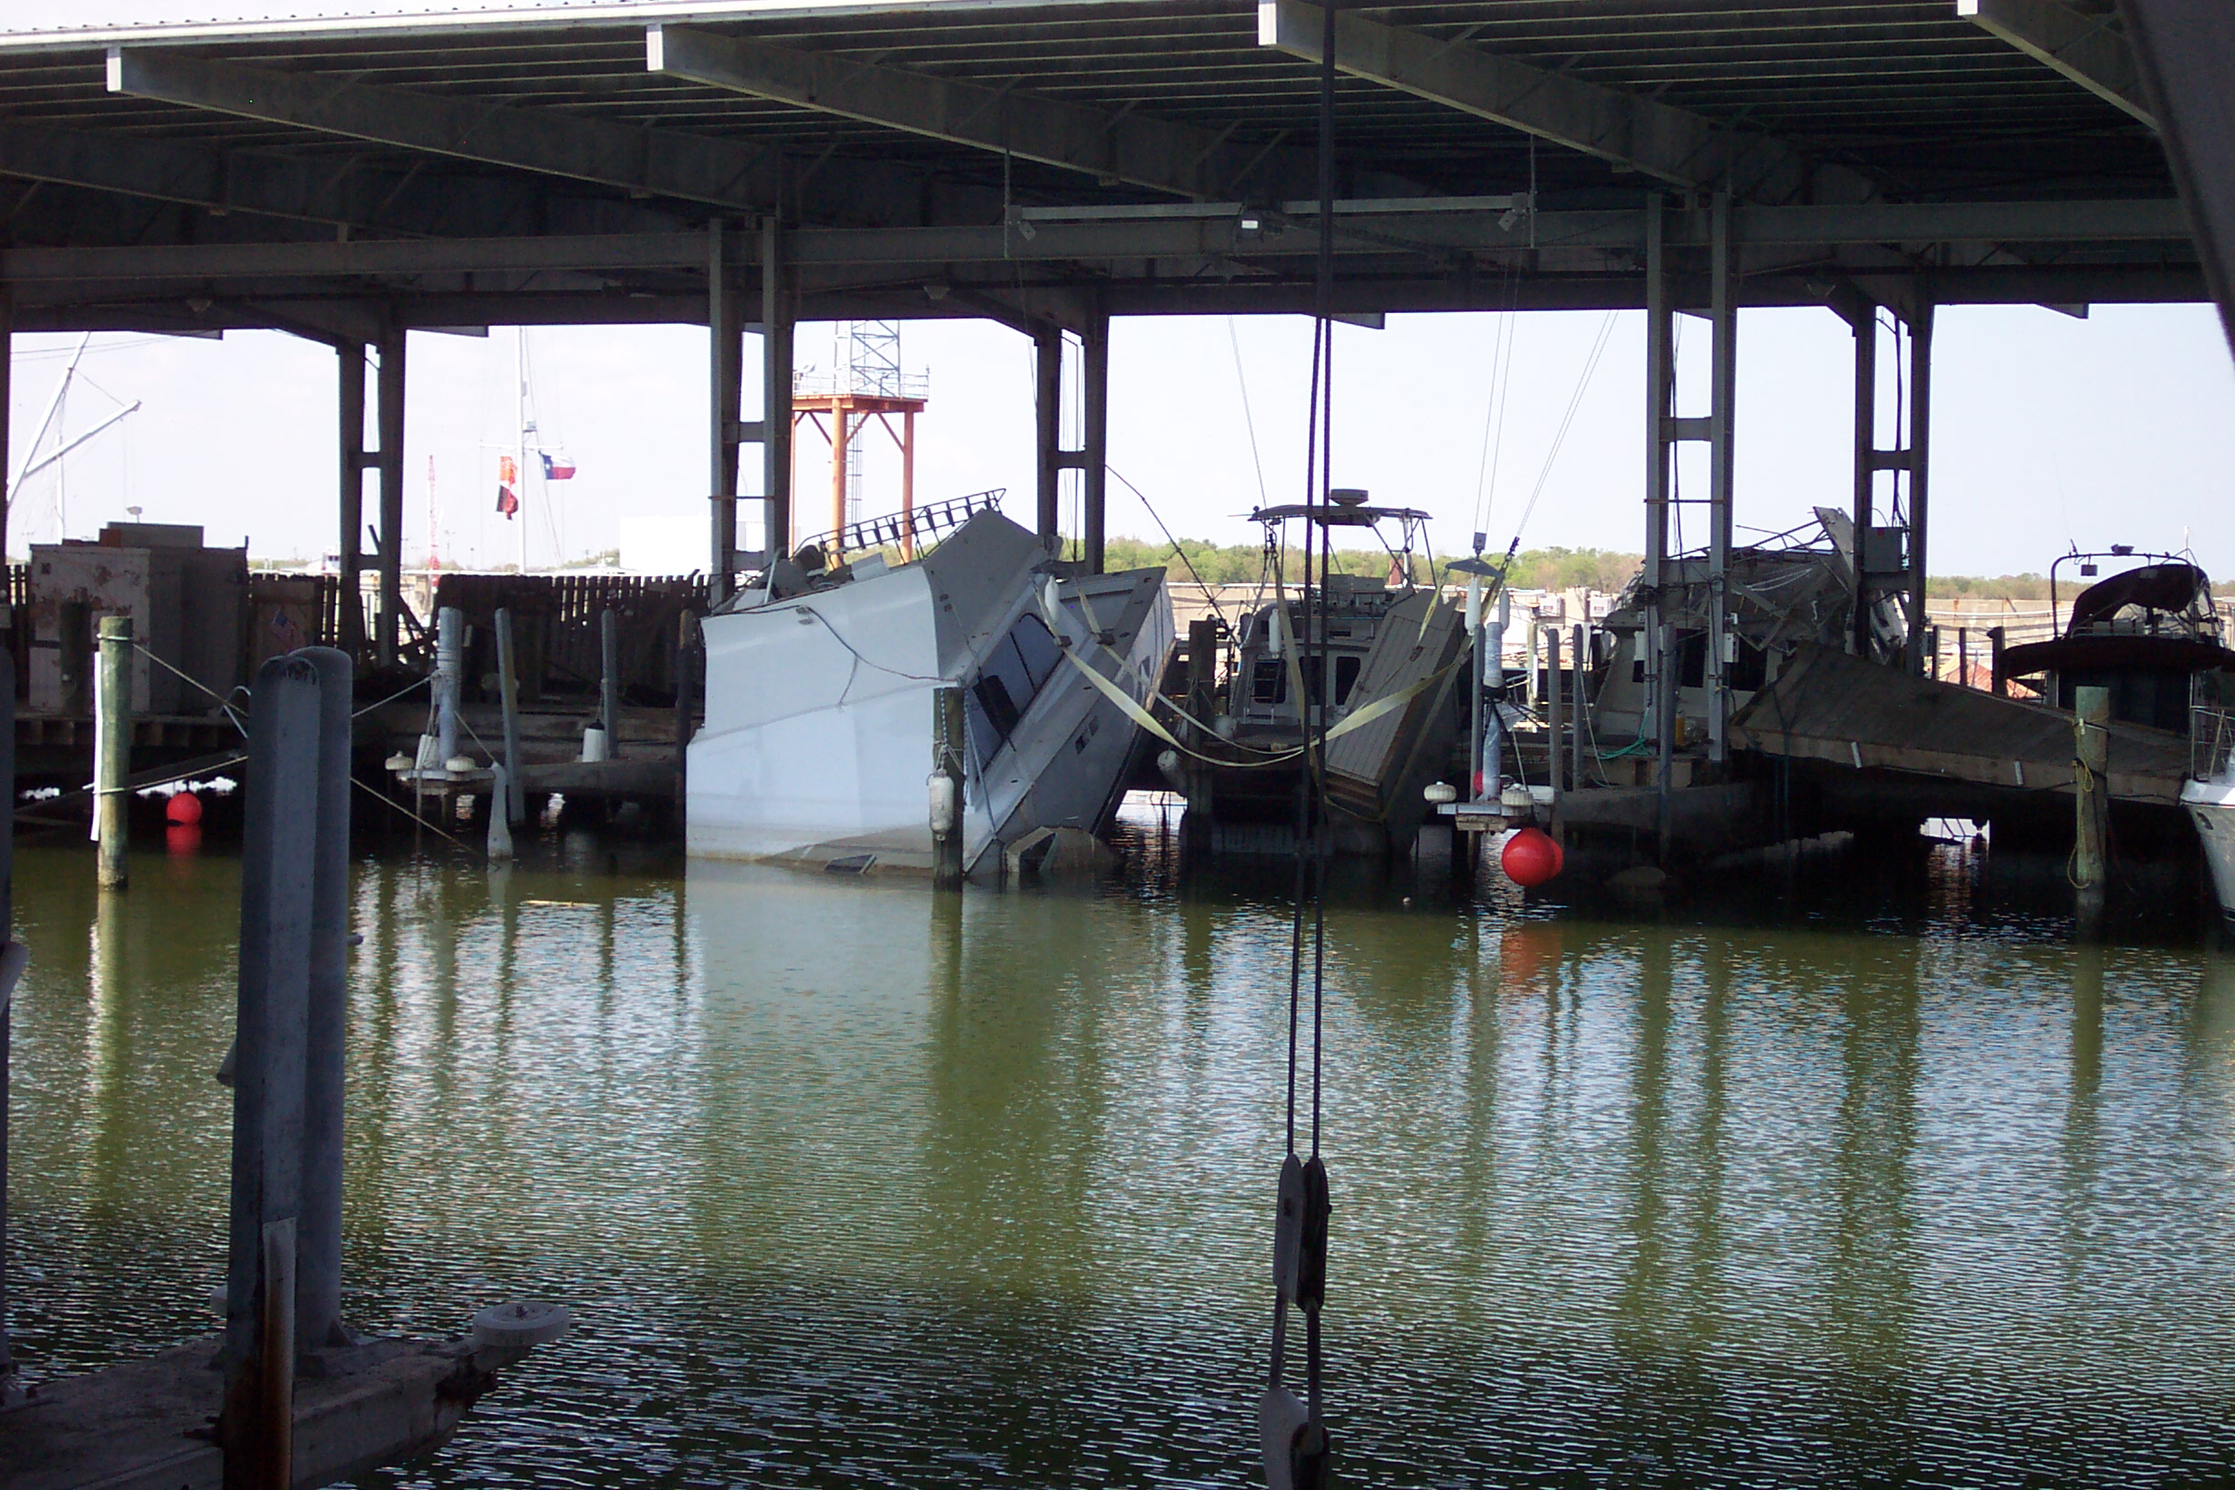
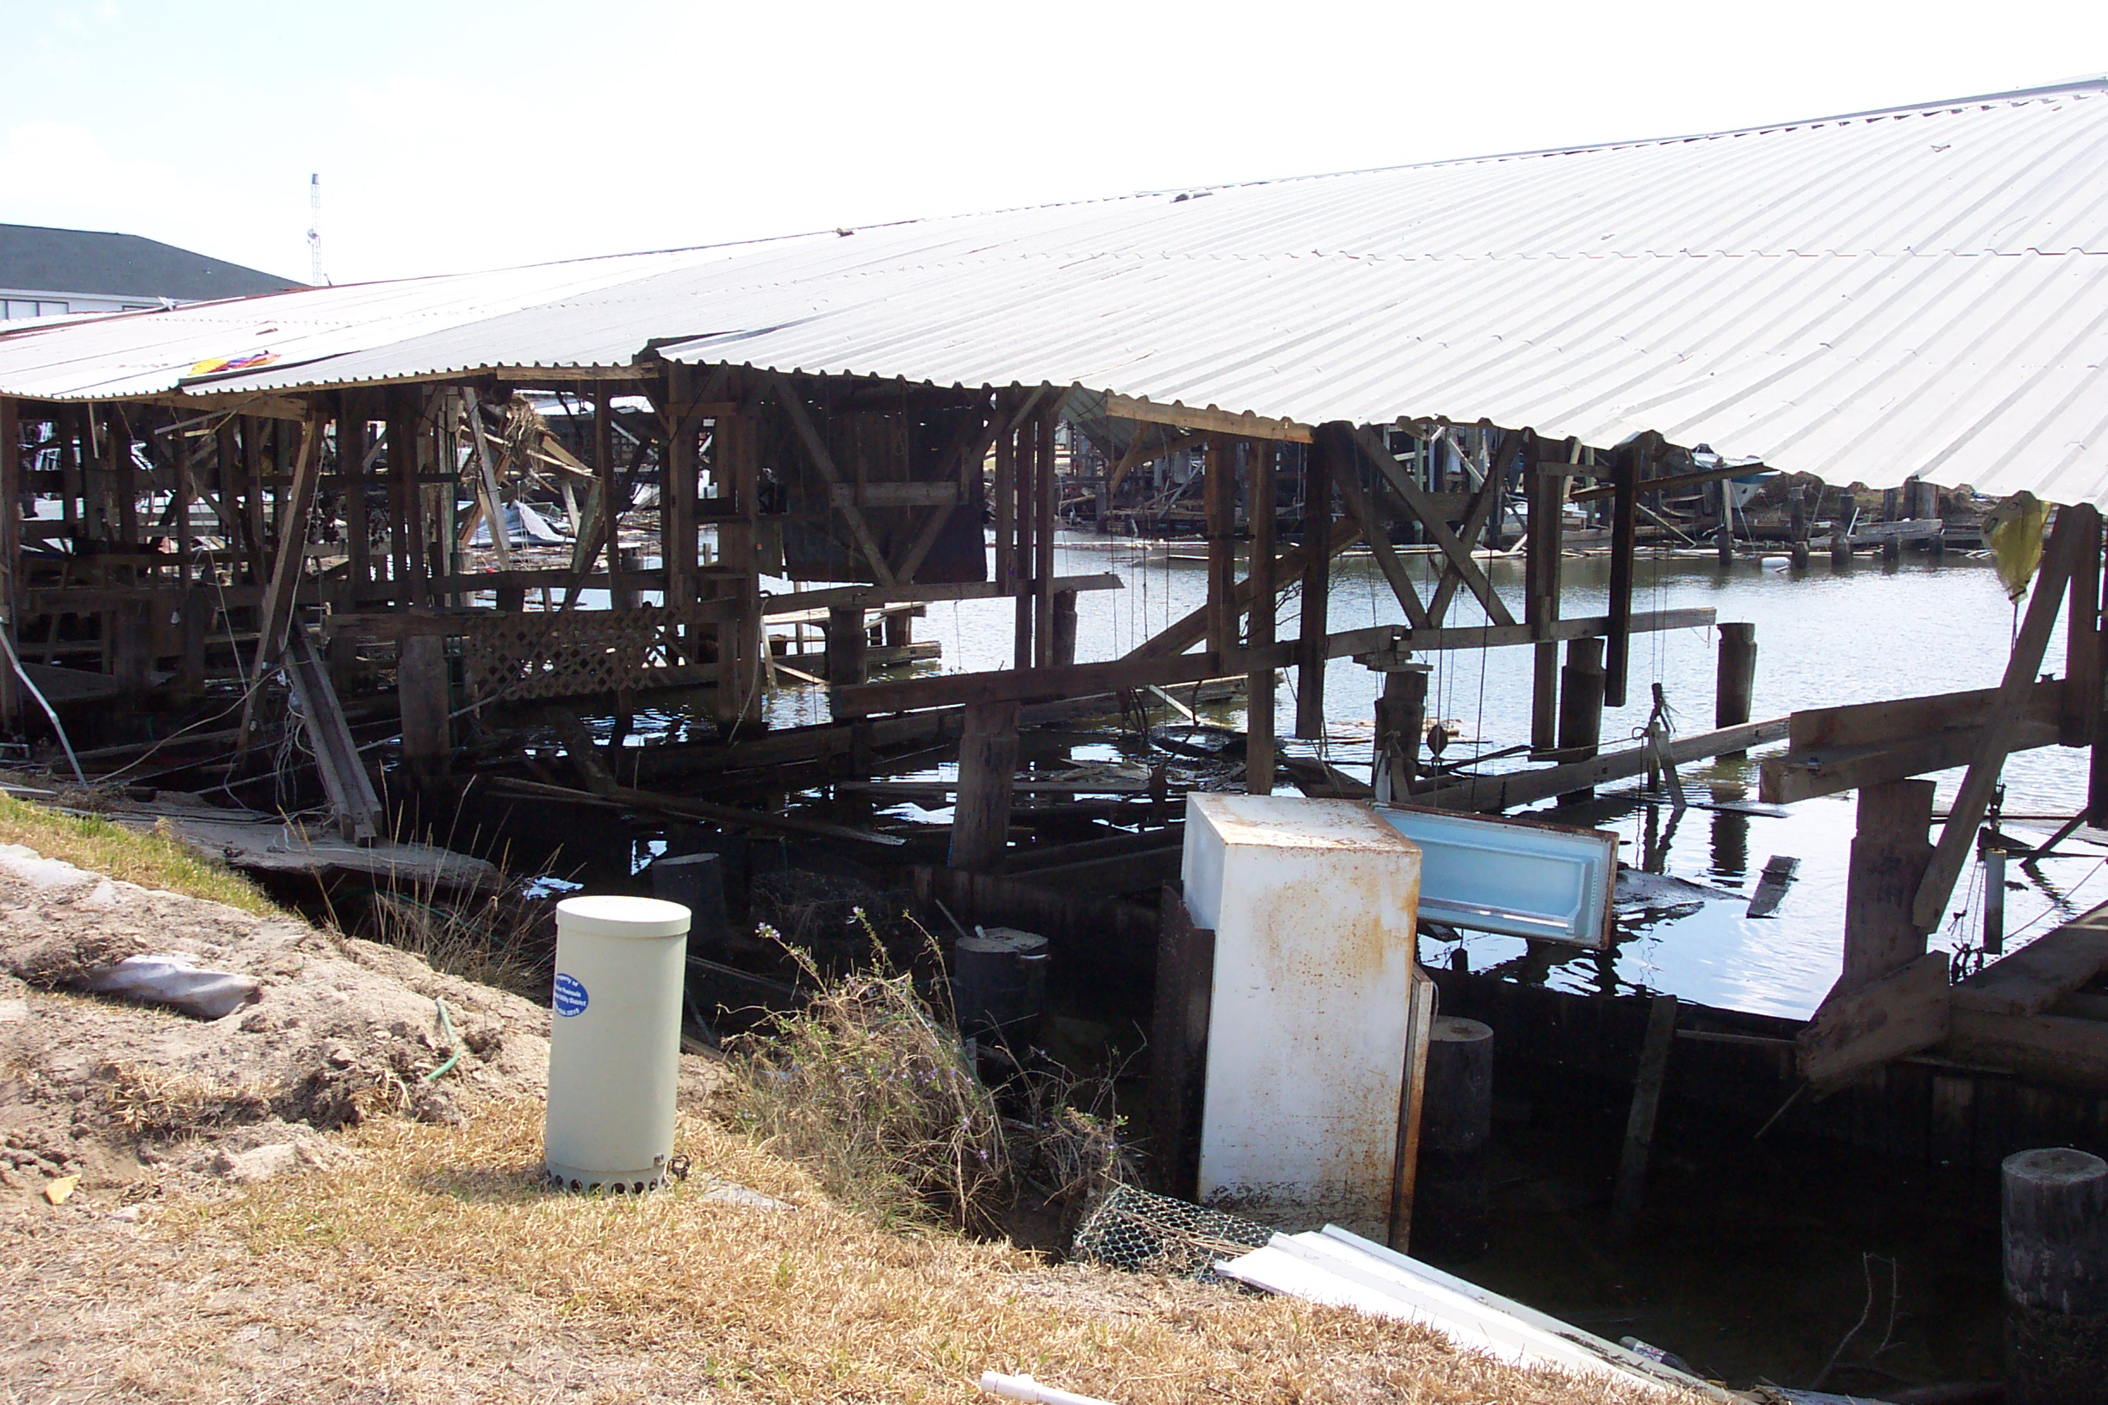
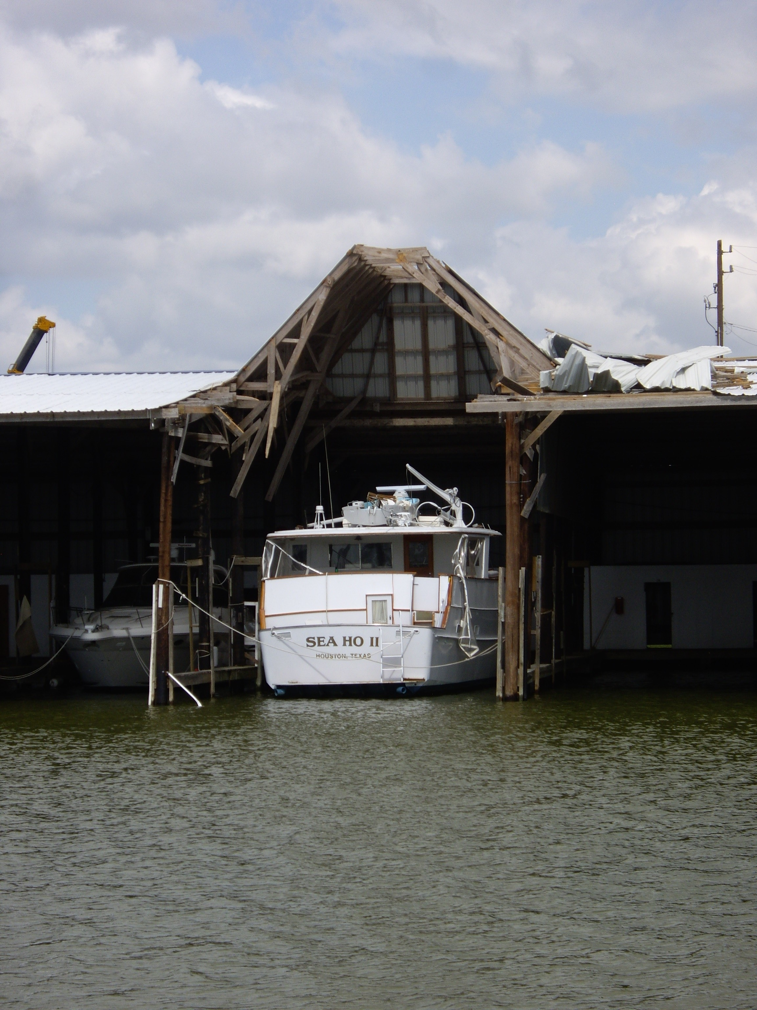
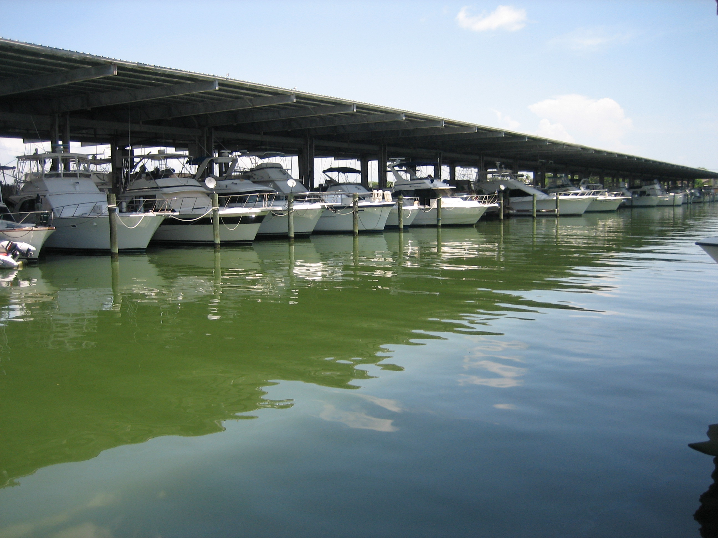
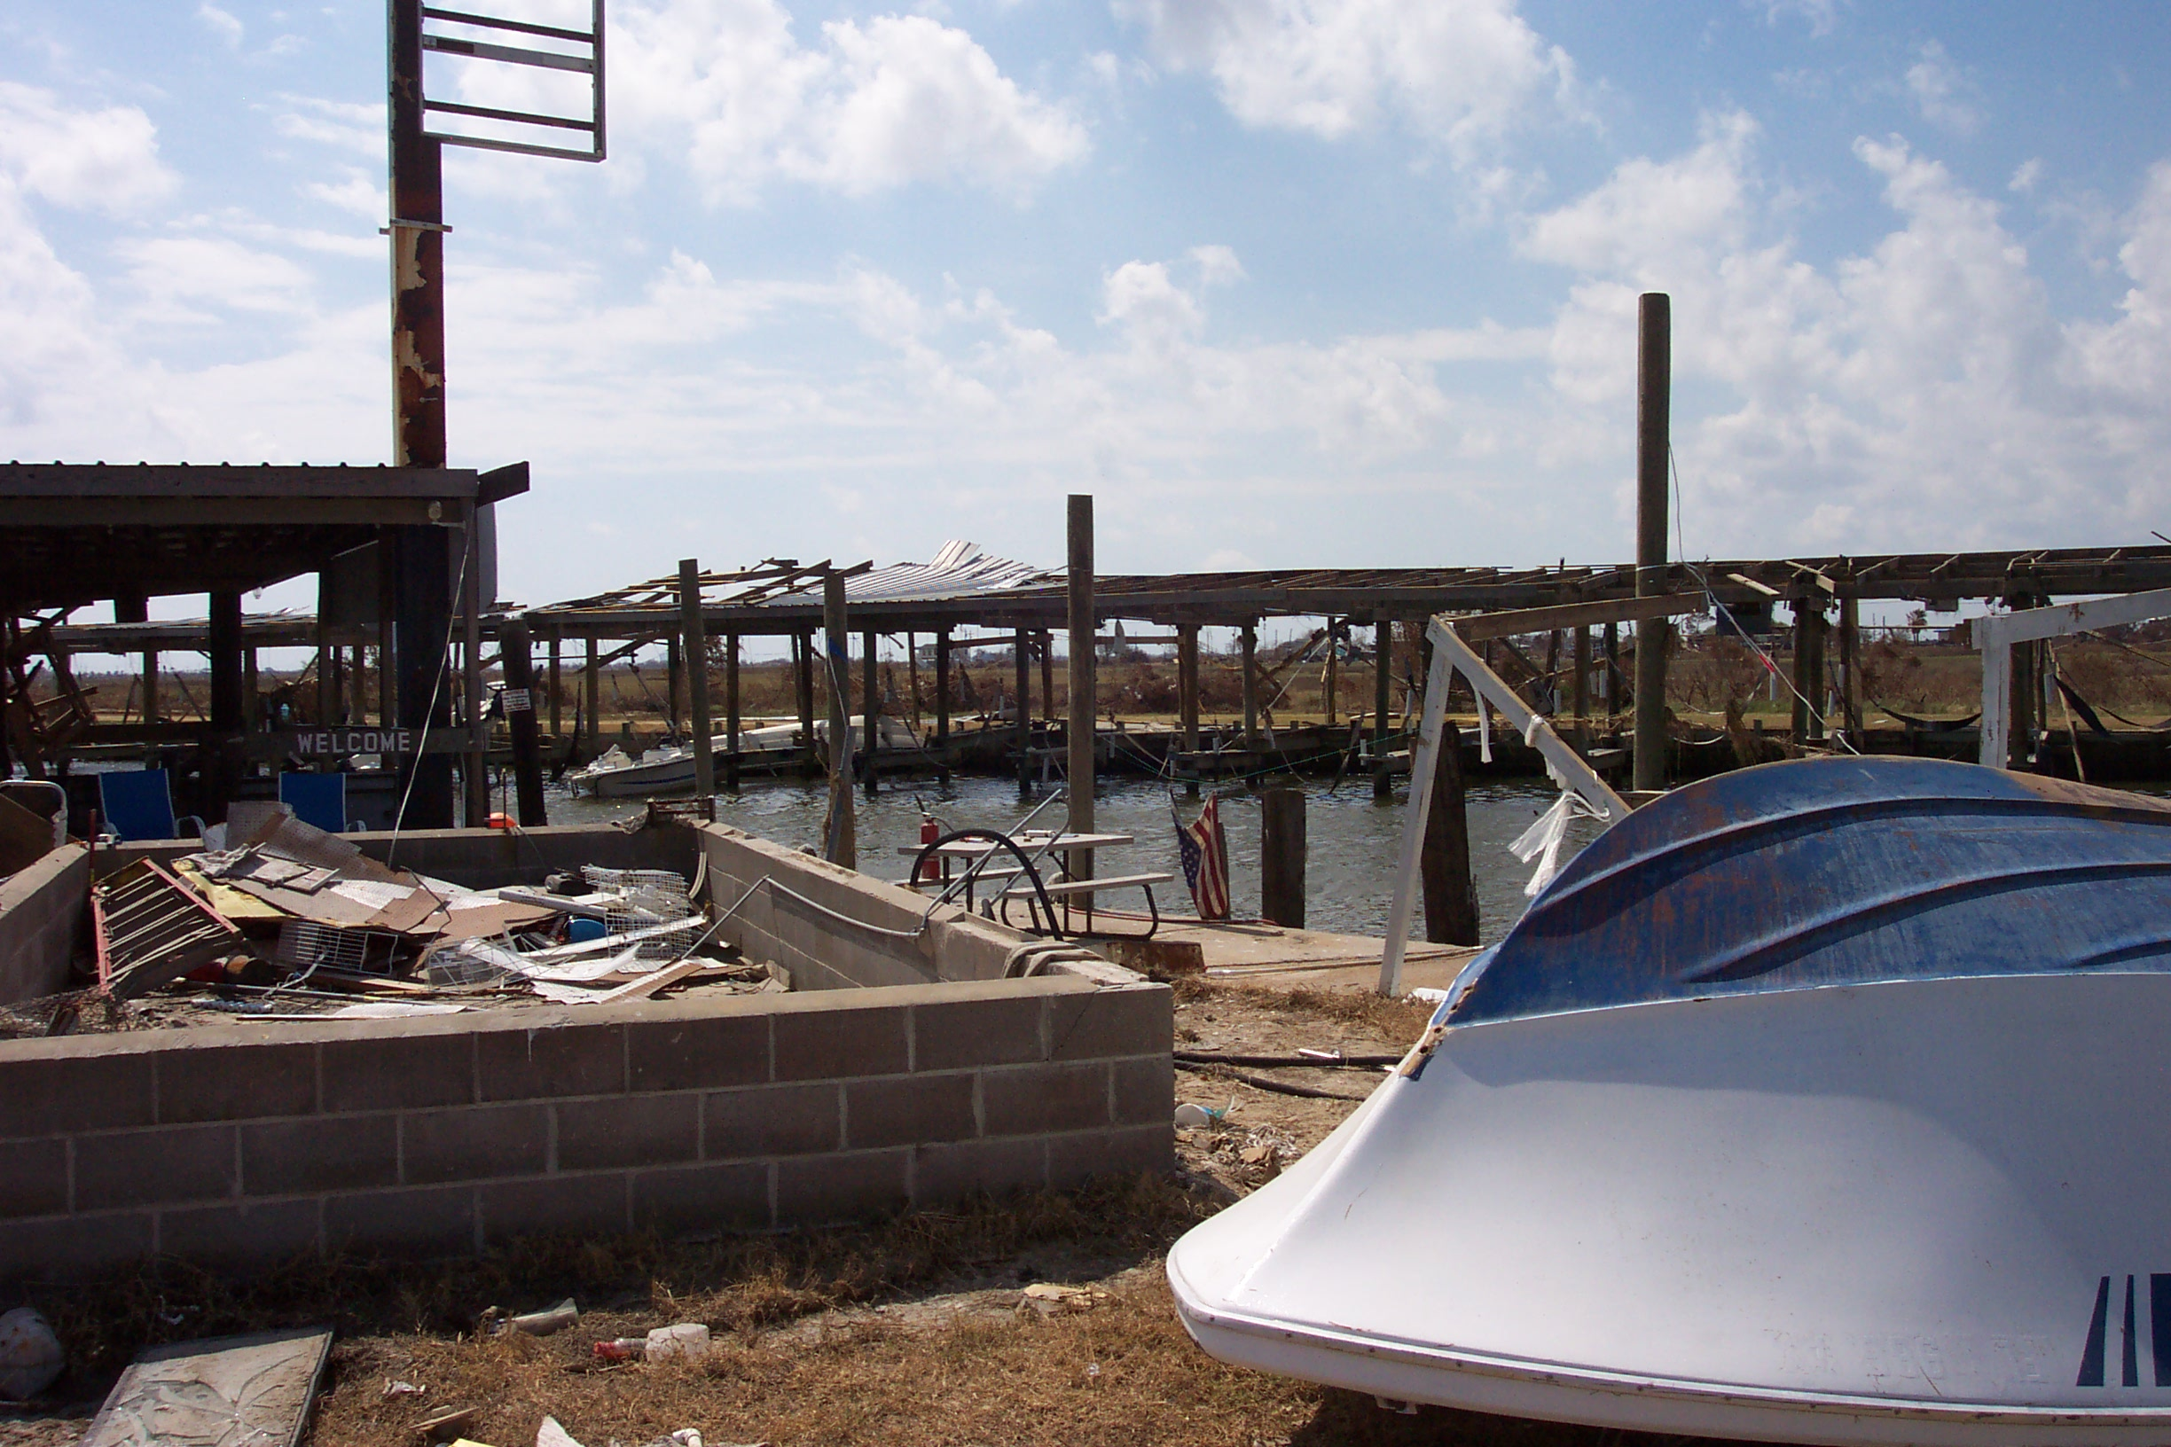
Hurricane Ike
Local Slip Damage
Floating Docks
Metal Roof with Wooden Rafters
Widespread Damage to Slips
Boat Damage
Metal Roof with Wooden Trusses
Metal Roof with Metal Rafters
Missing Roof
Clear Lake Marina
Galveston Boat Basin
Bolivar Boat Basin

Slide 9
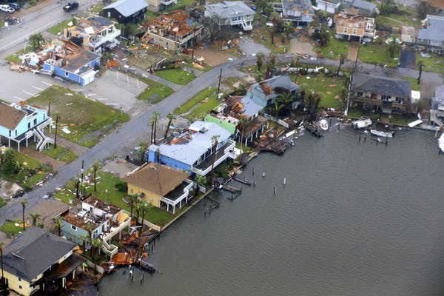
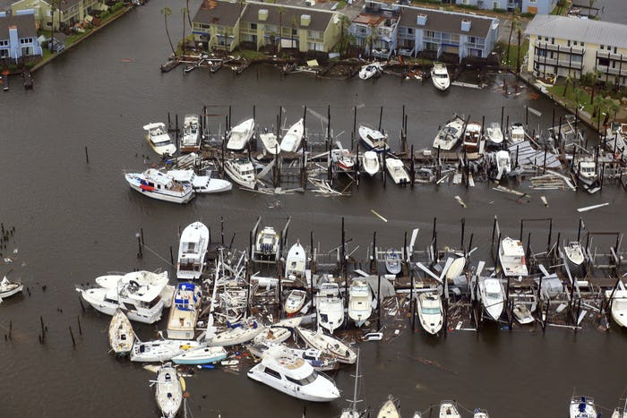
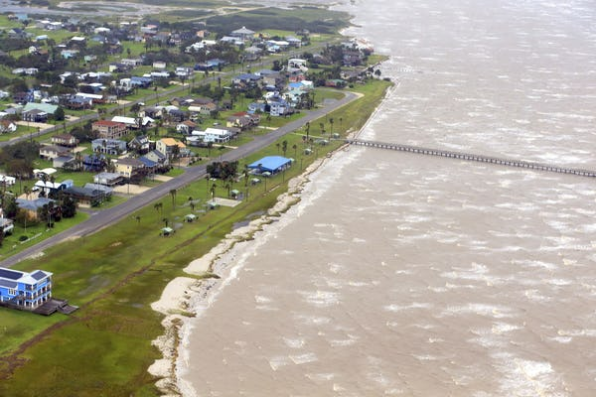
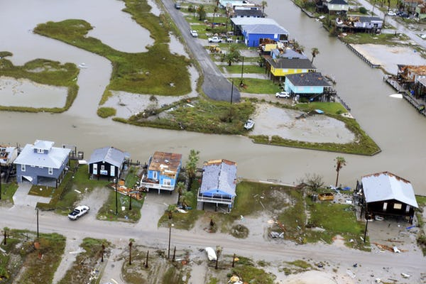
Hurricane Harvey
Source: dallasnews.com

Slide 10
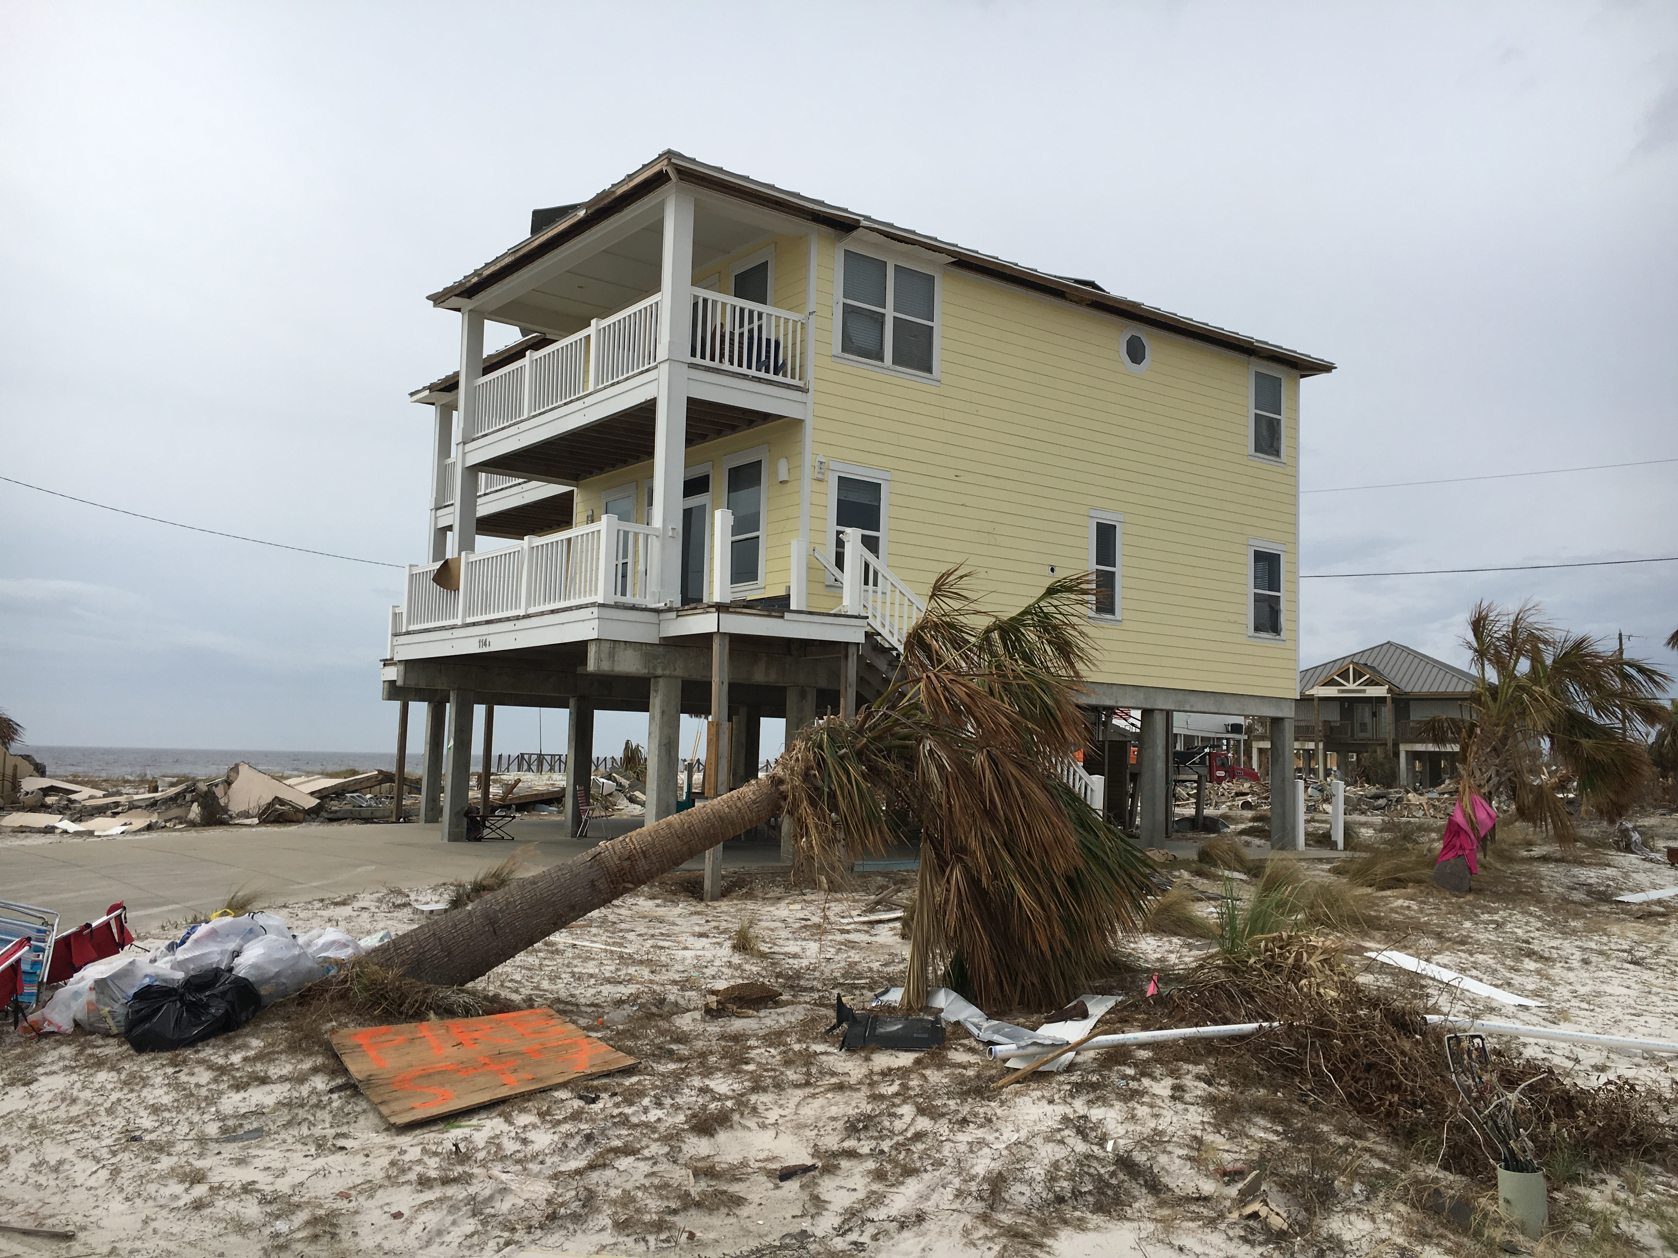
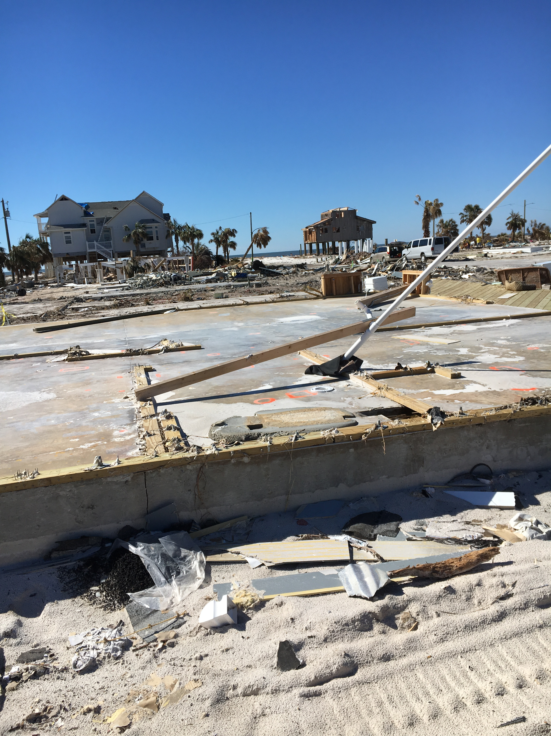
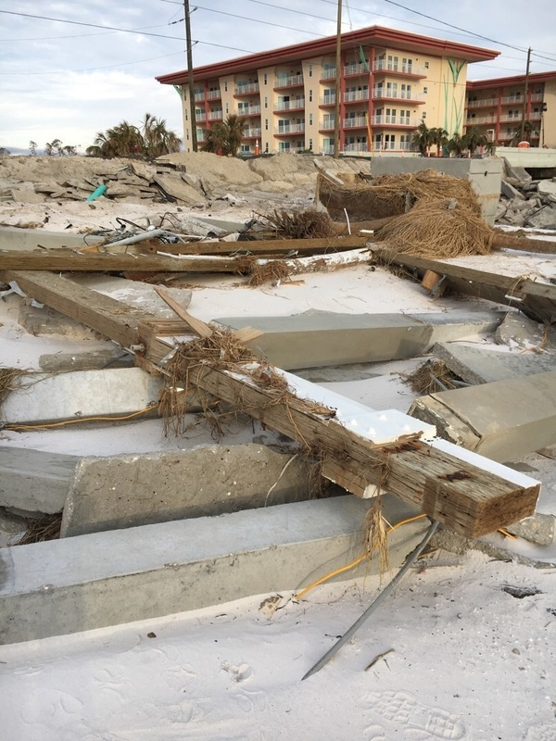
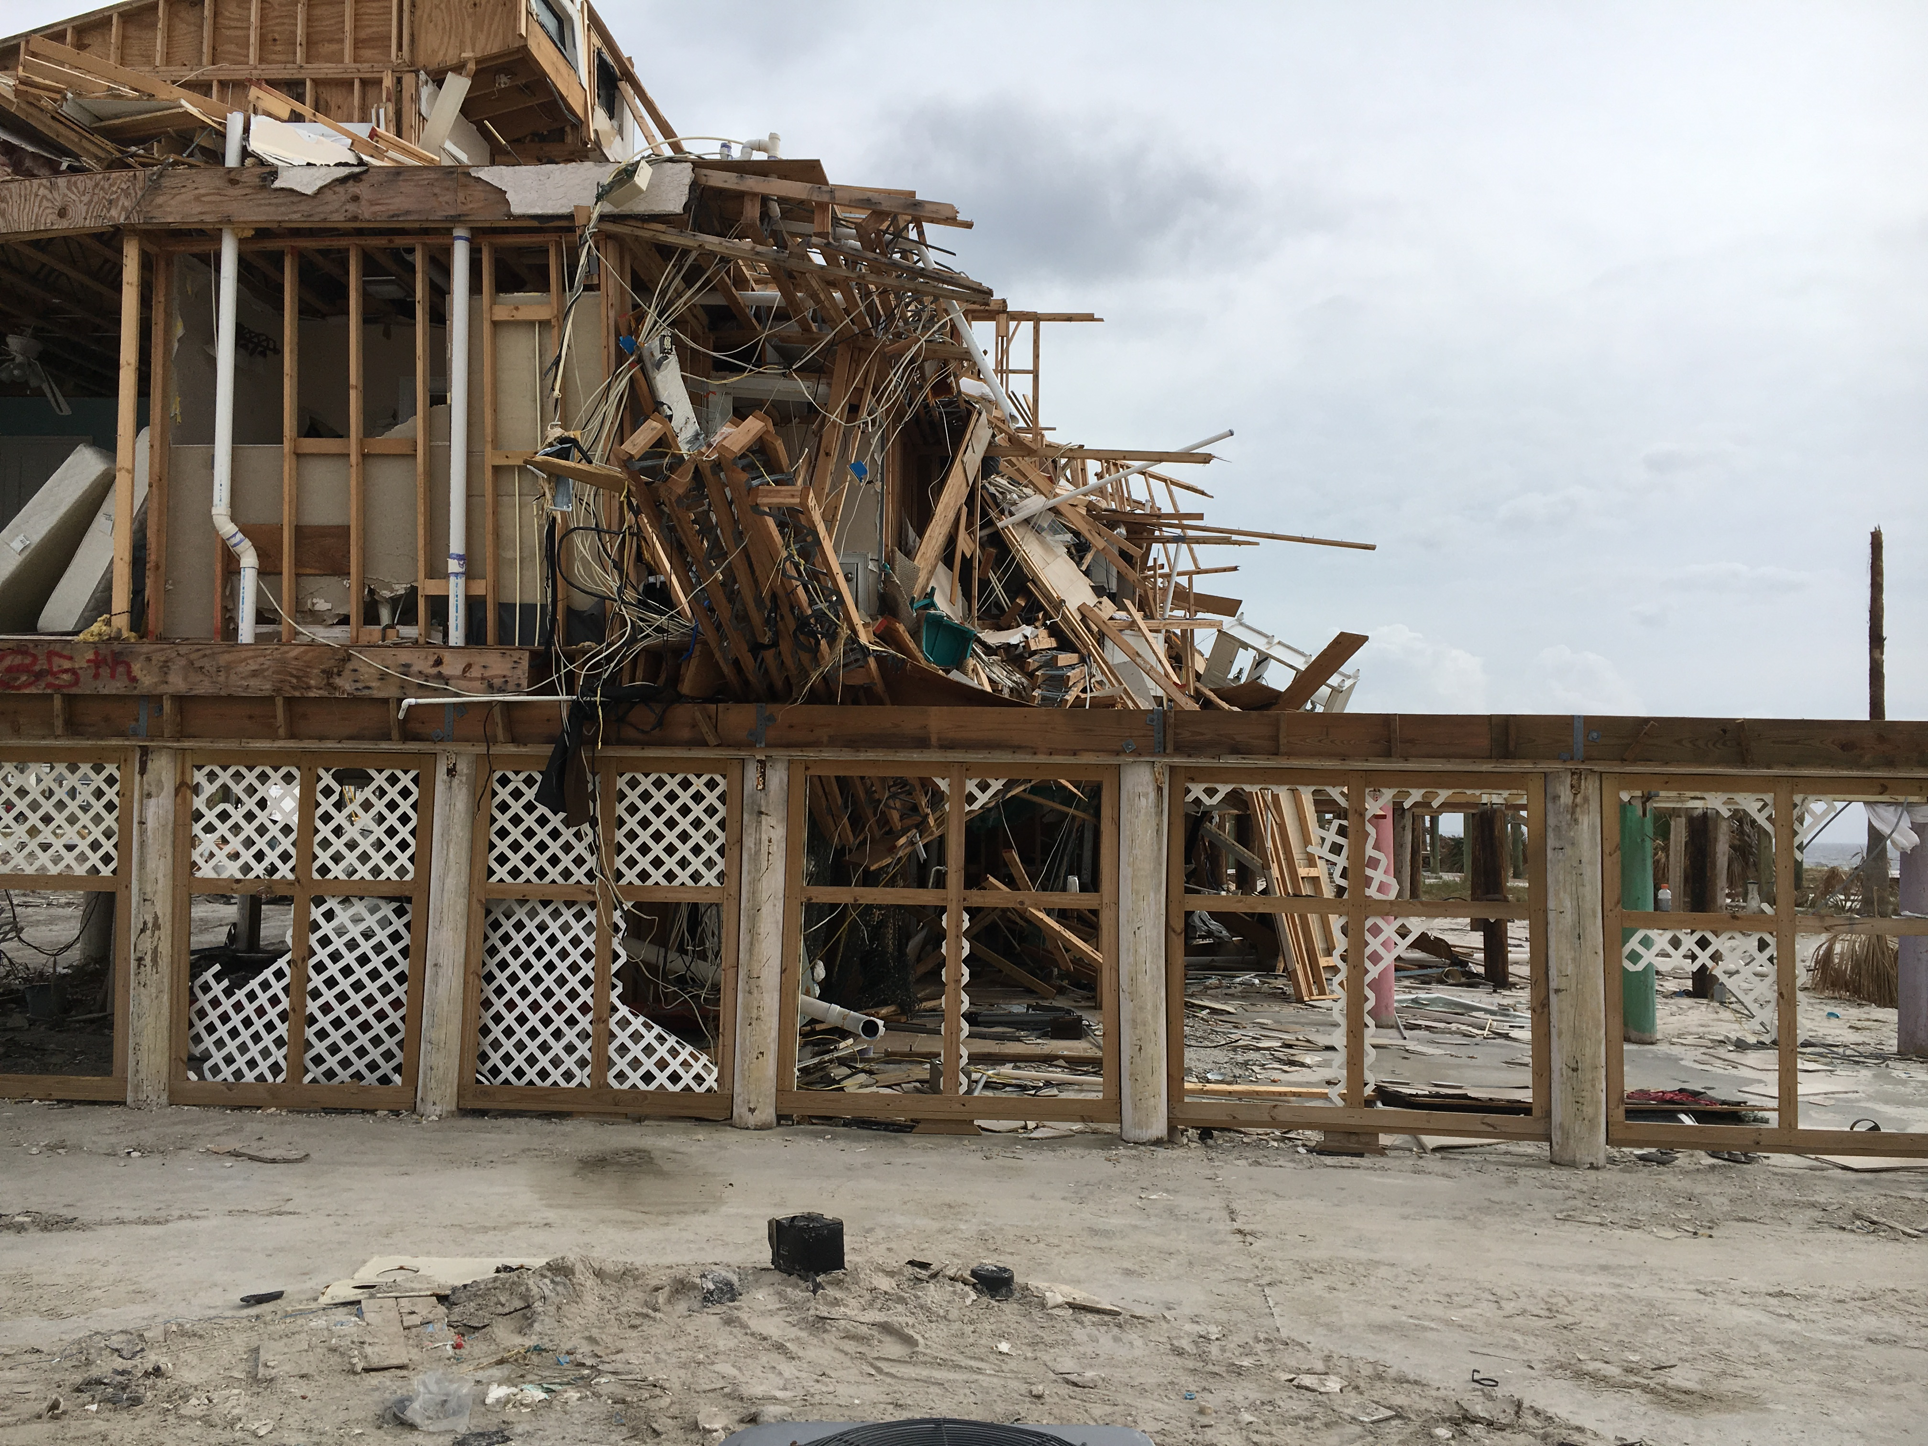
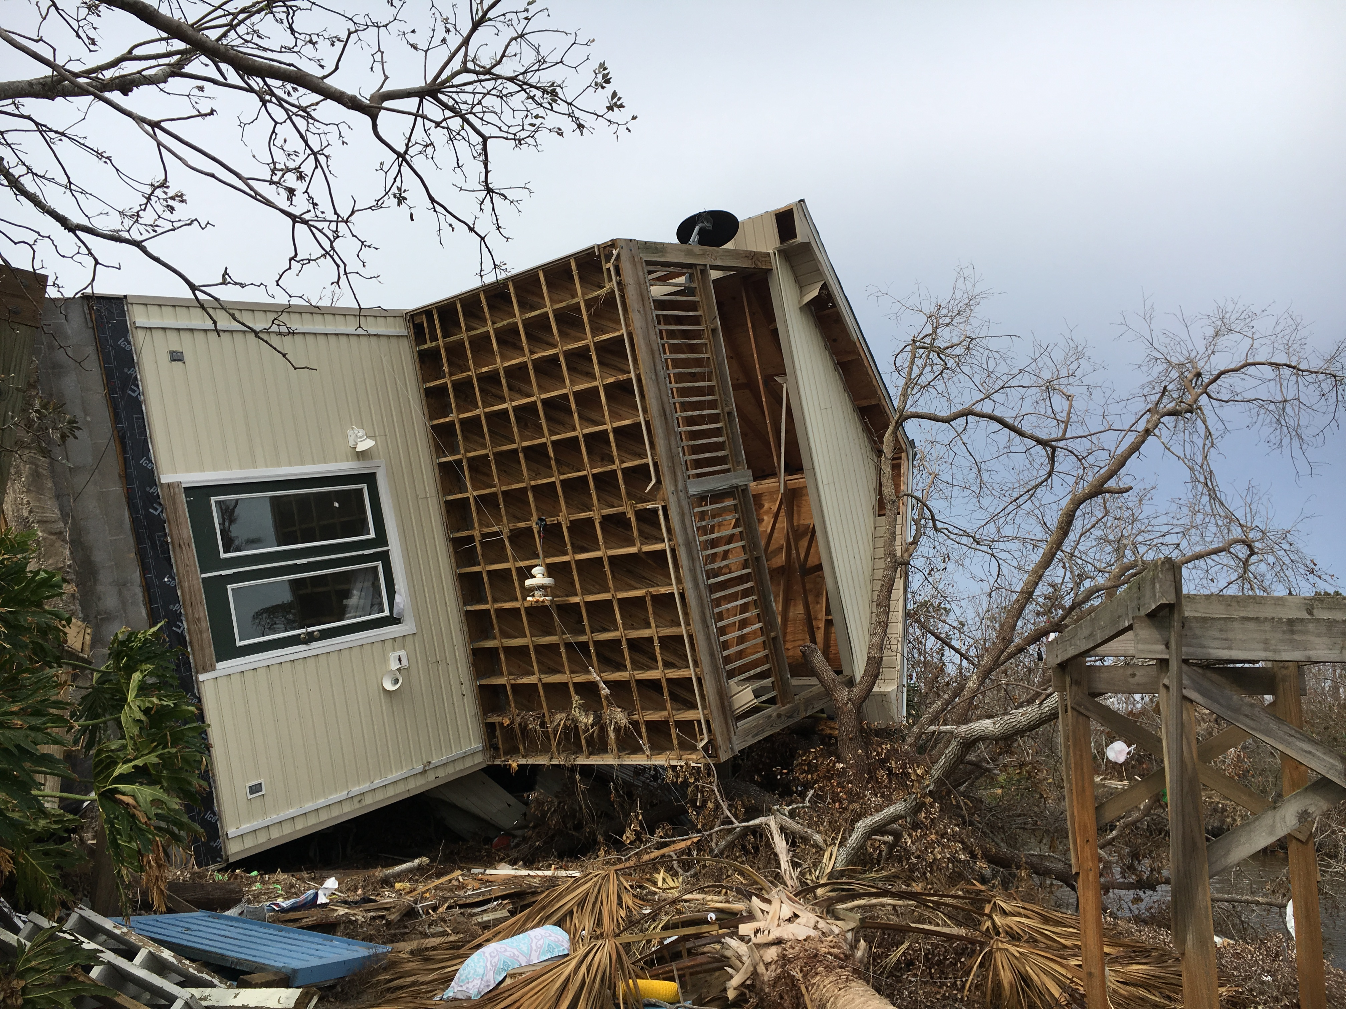
Hurricane Michael
Mix of older structures (weaker codes) and new, stronger structures
Slab on grade beachfront?
Slightly Higher Elevation
Nearby House
Wave Damage
Likely Surge Level
Watertight Modular Home
Failed Prestressed Concrete Piles
Mix of types of construction (wood/concrete)
Notes:
Wave damage

Slide 11
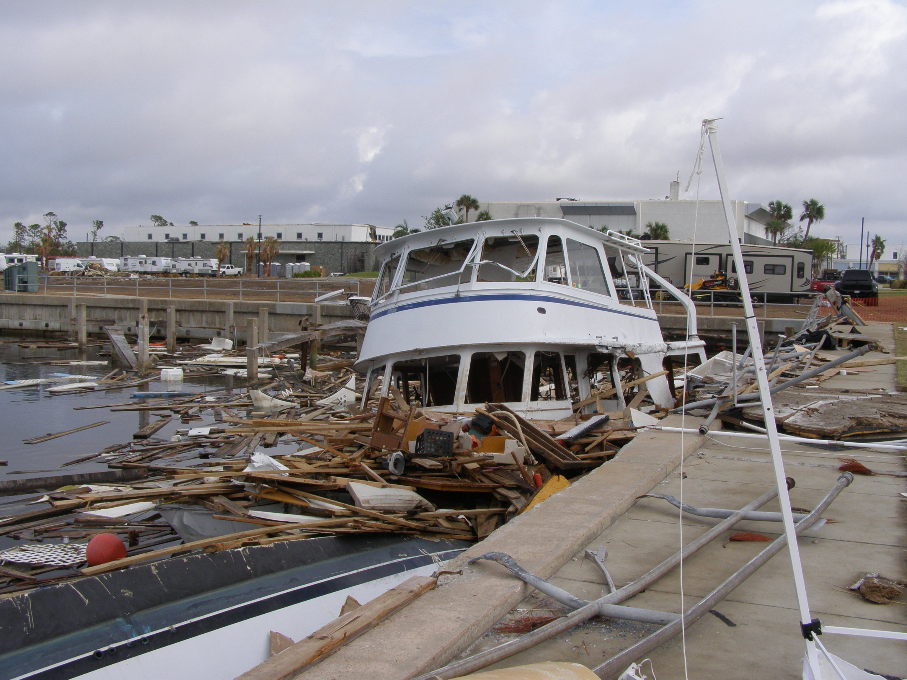
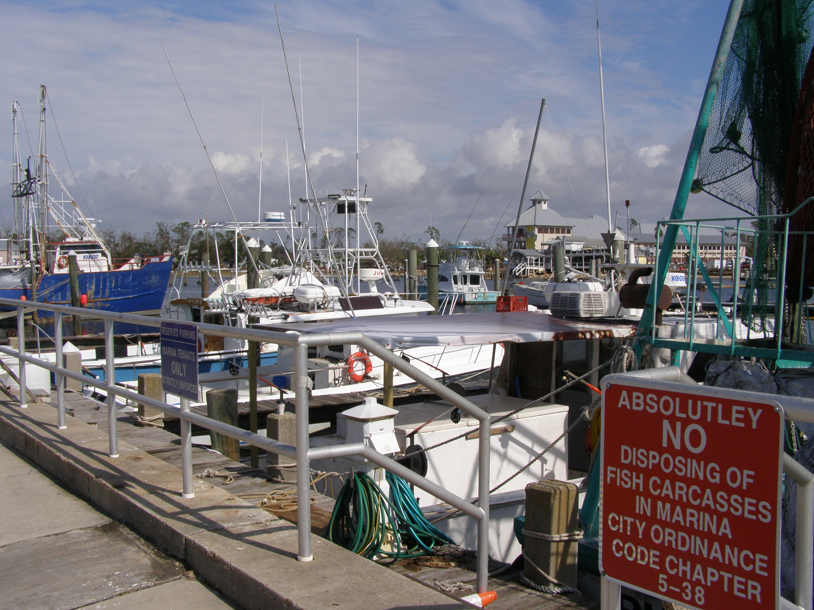
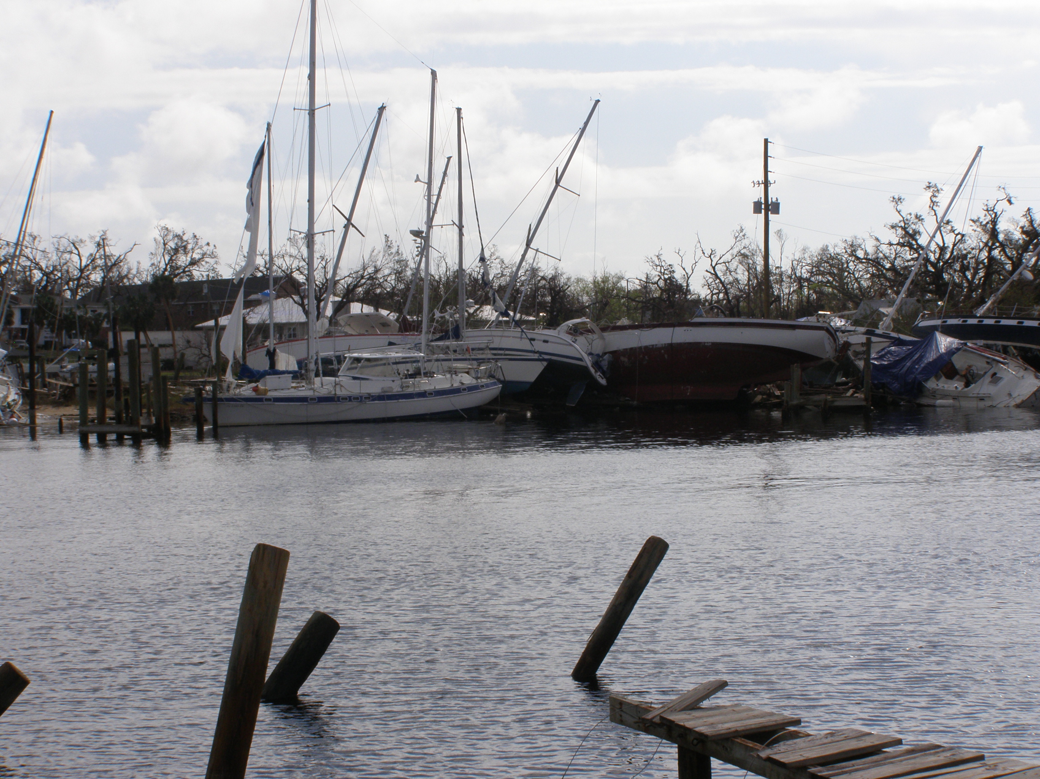
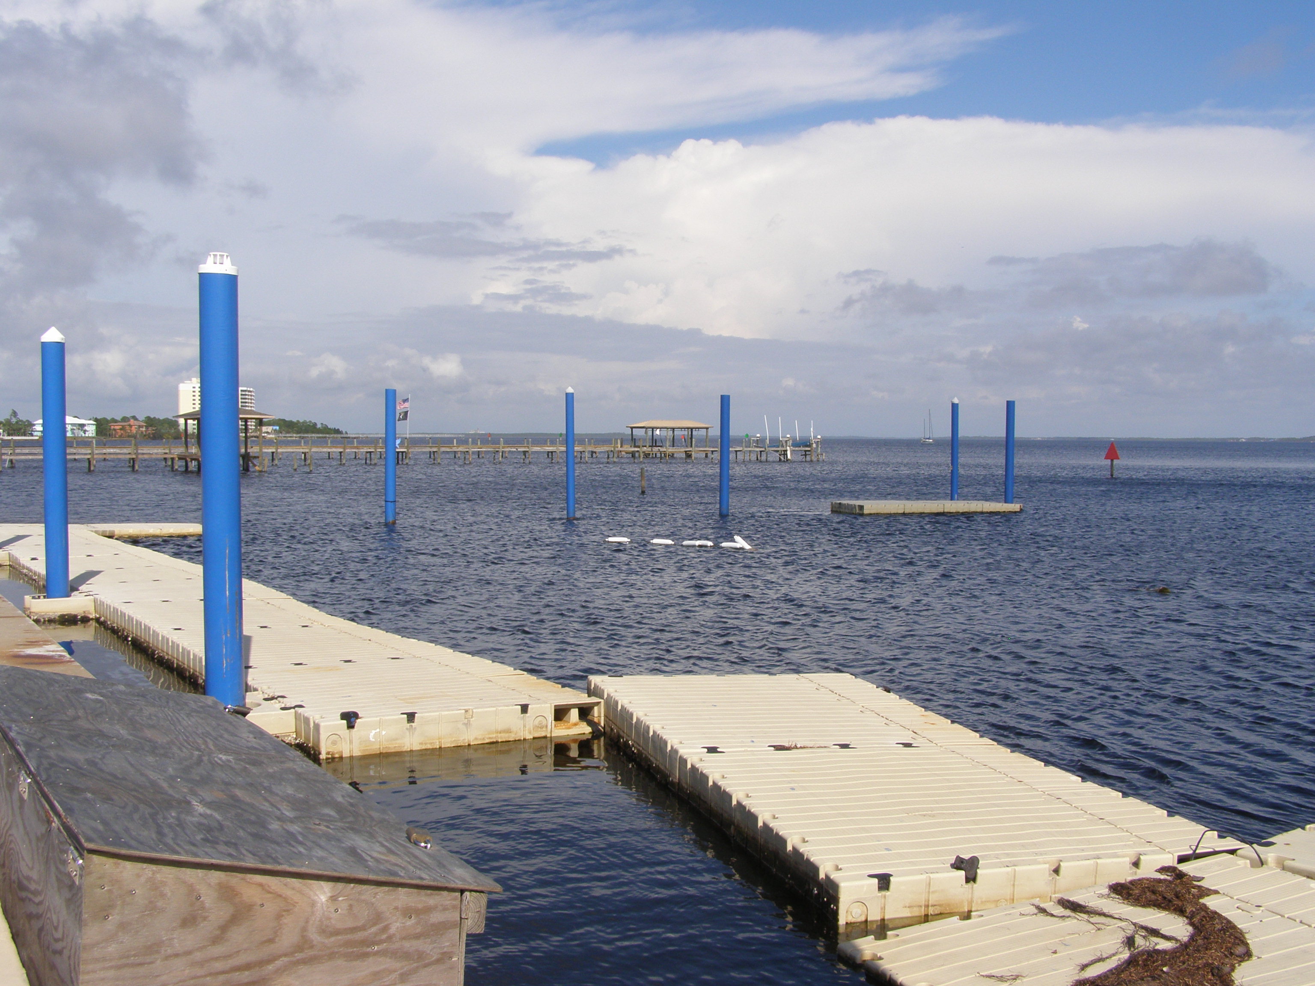
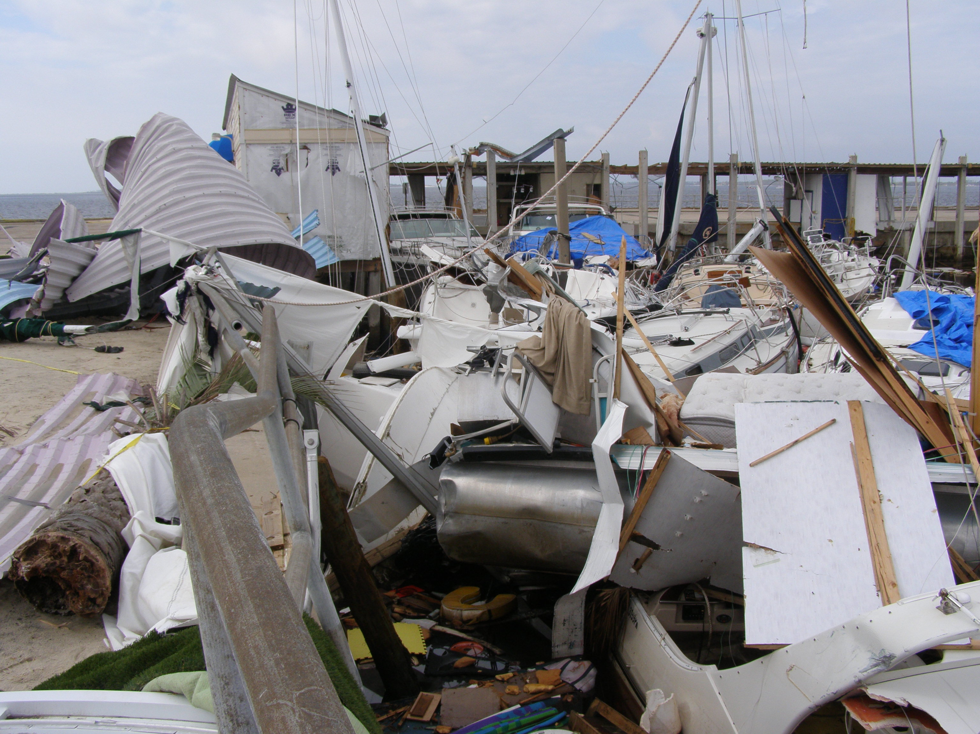
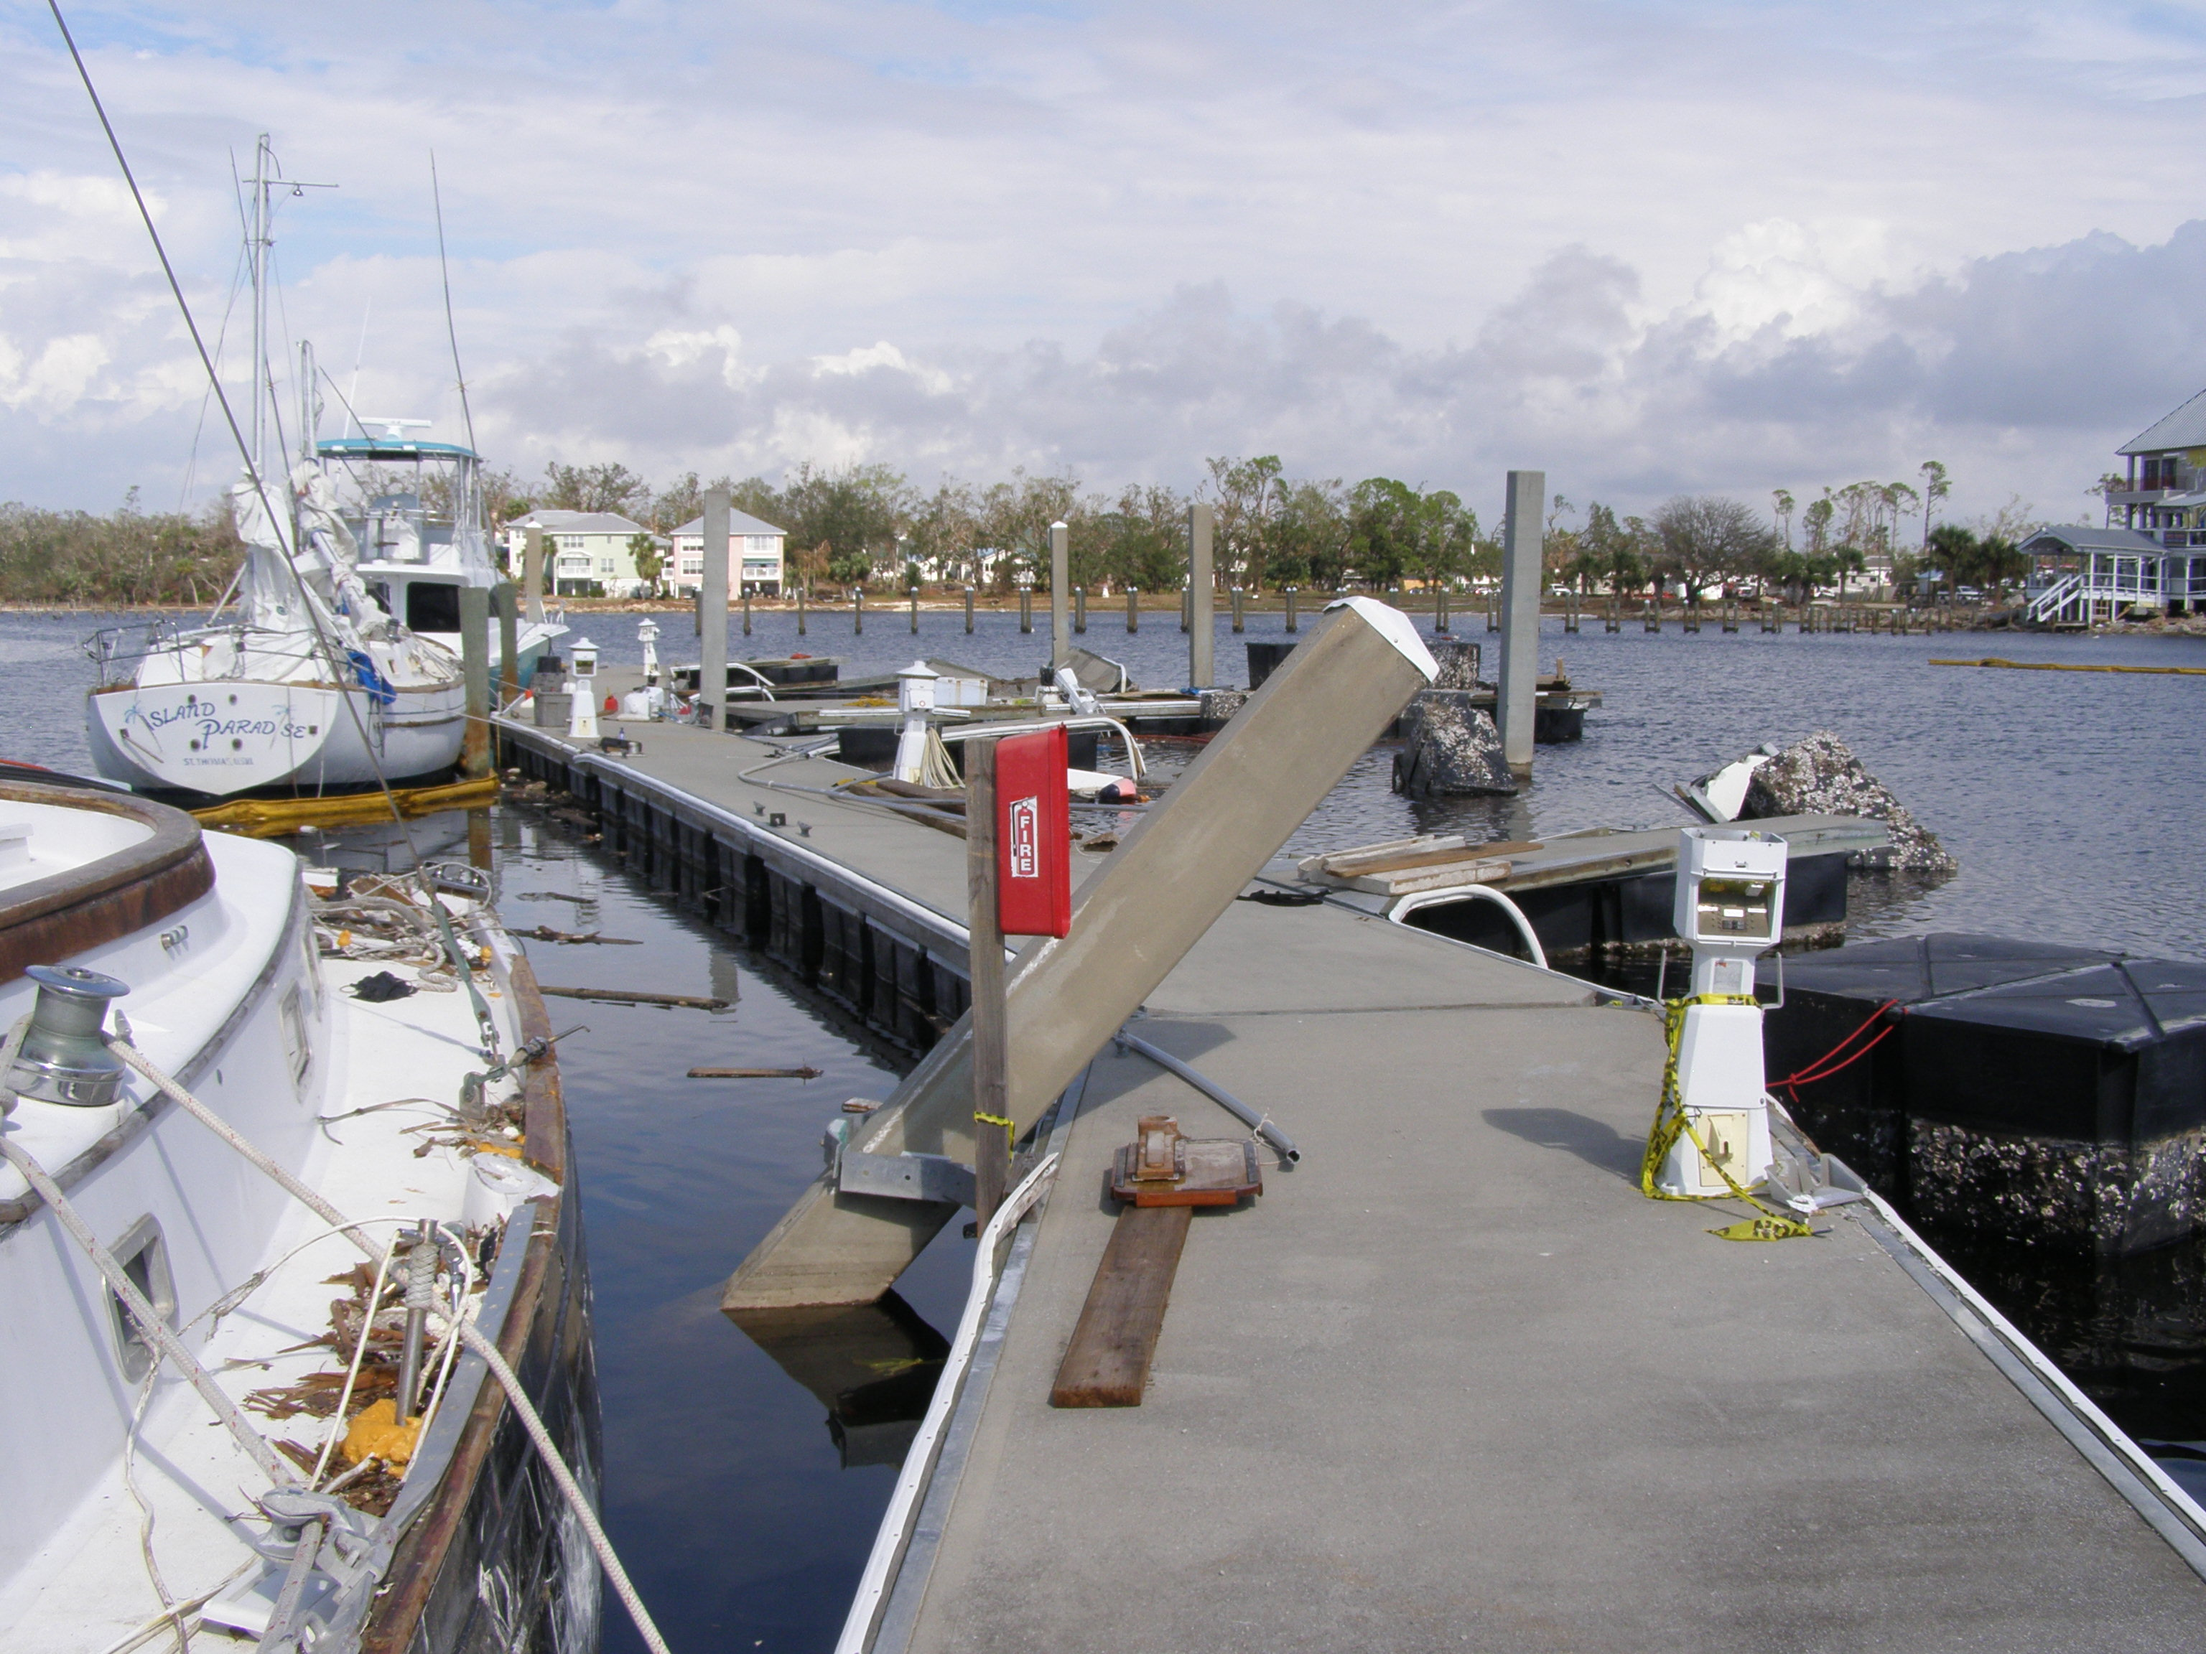
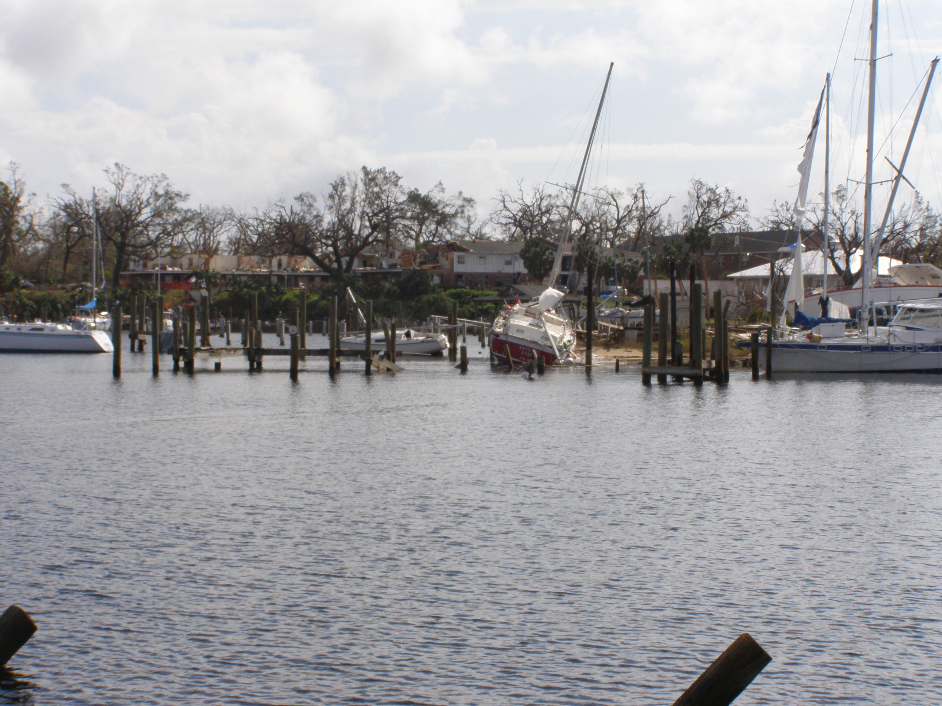
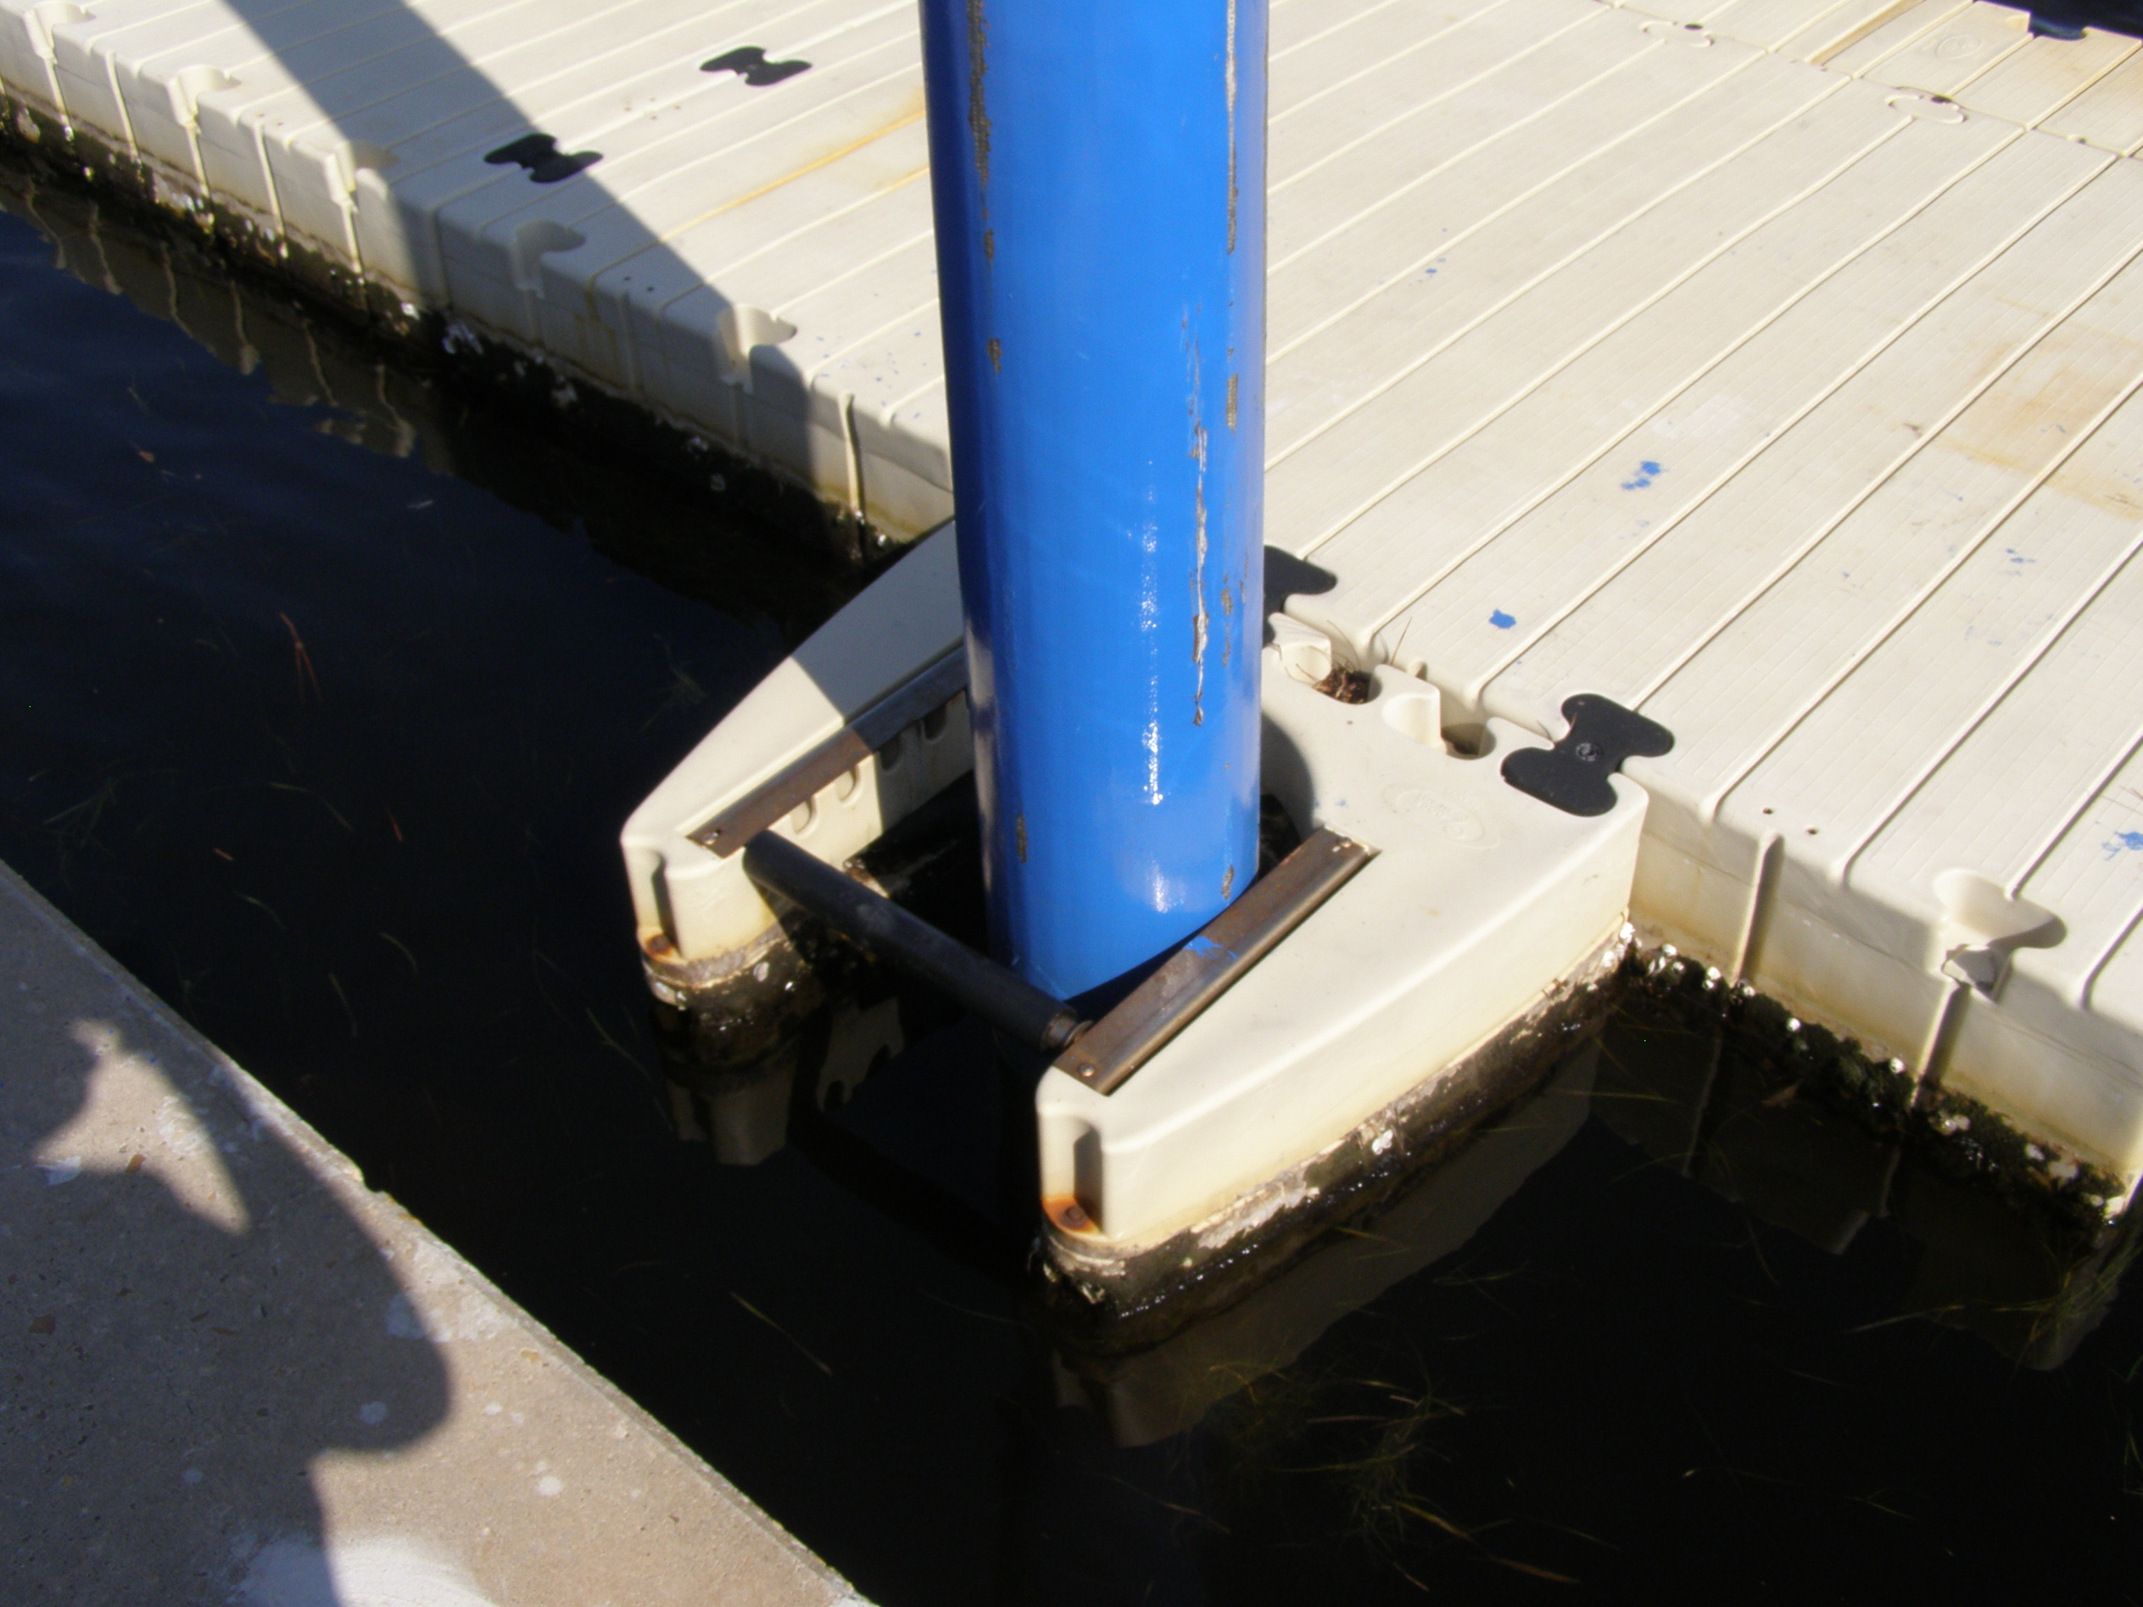
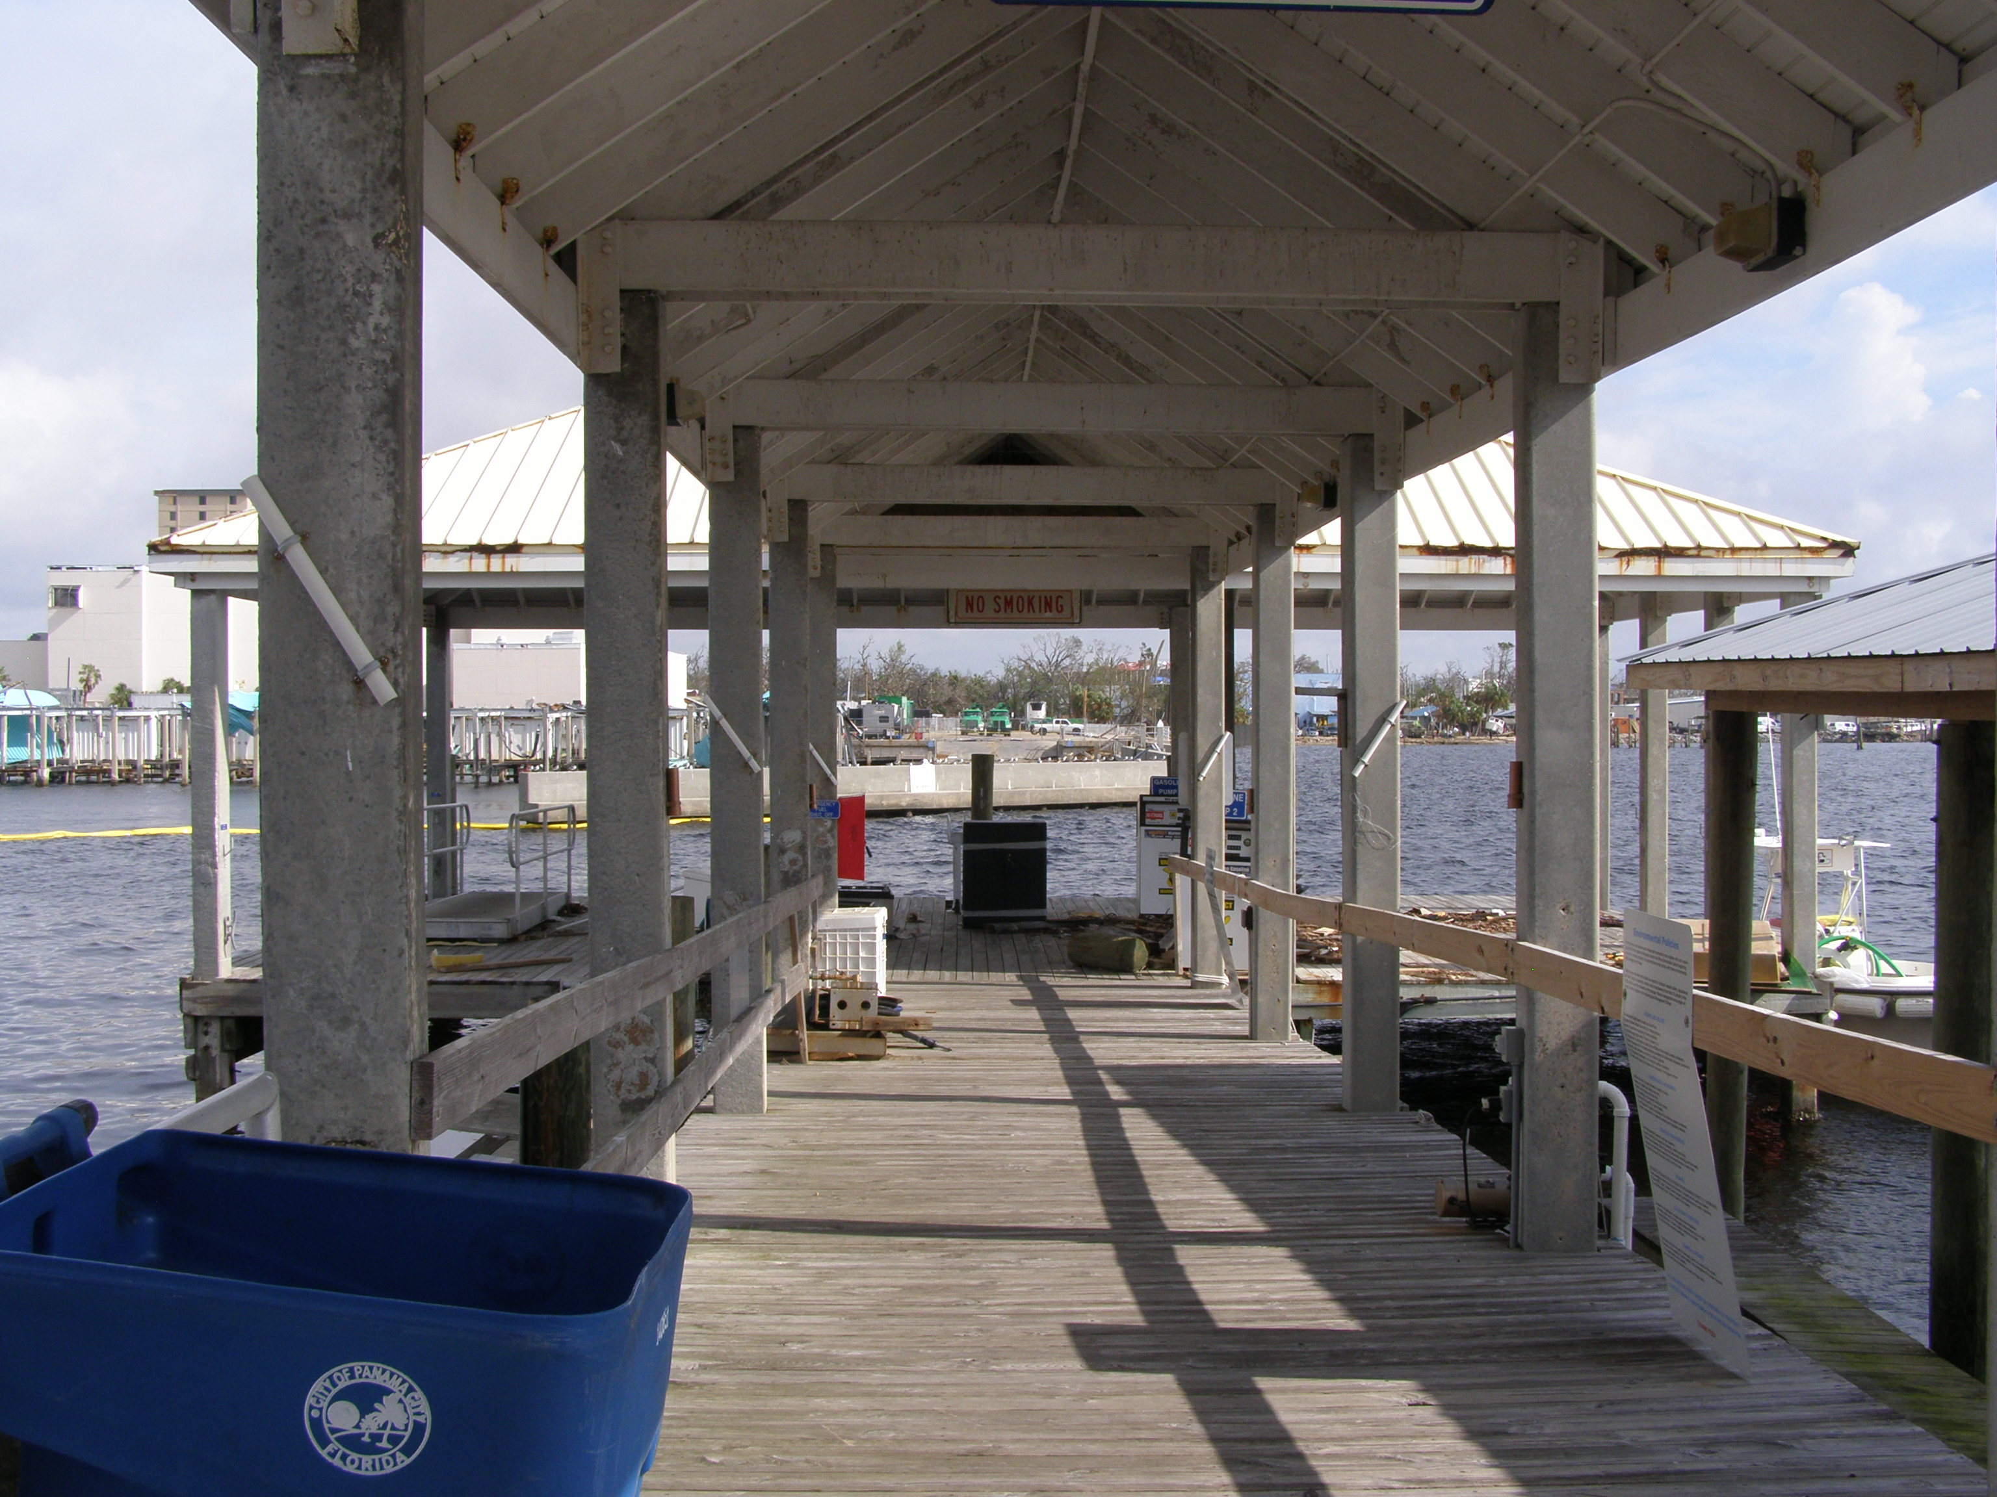
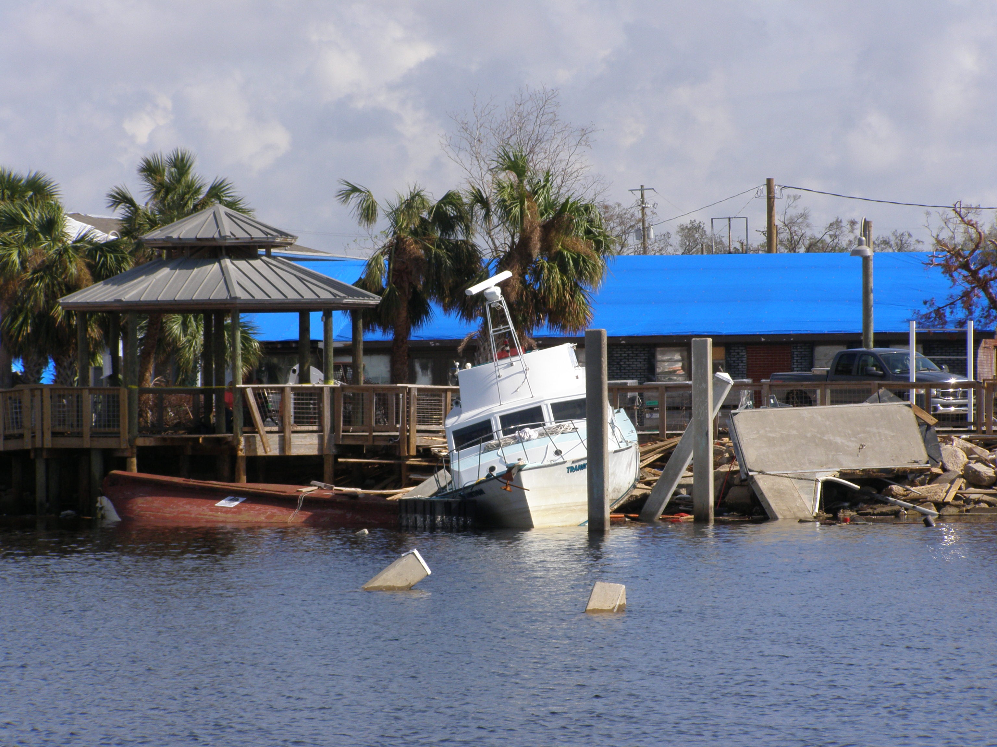
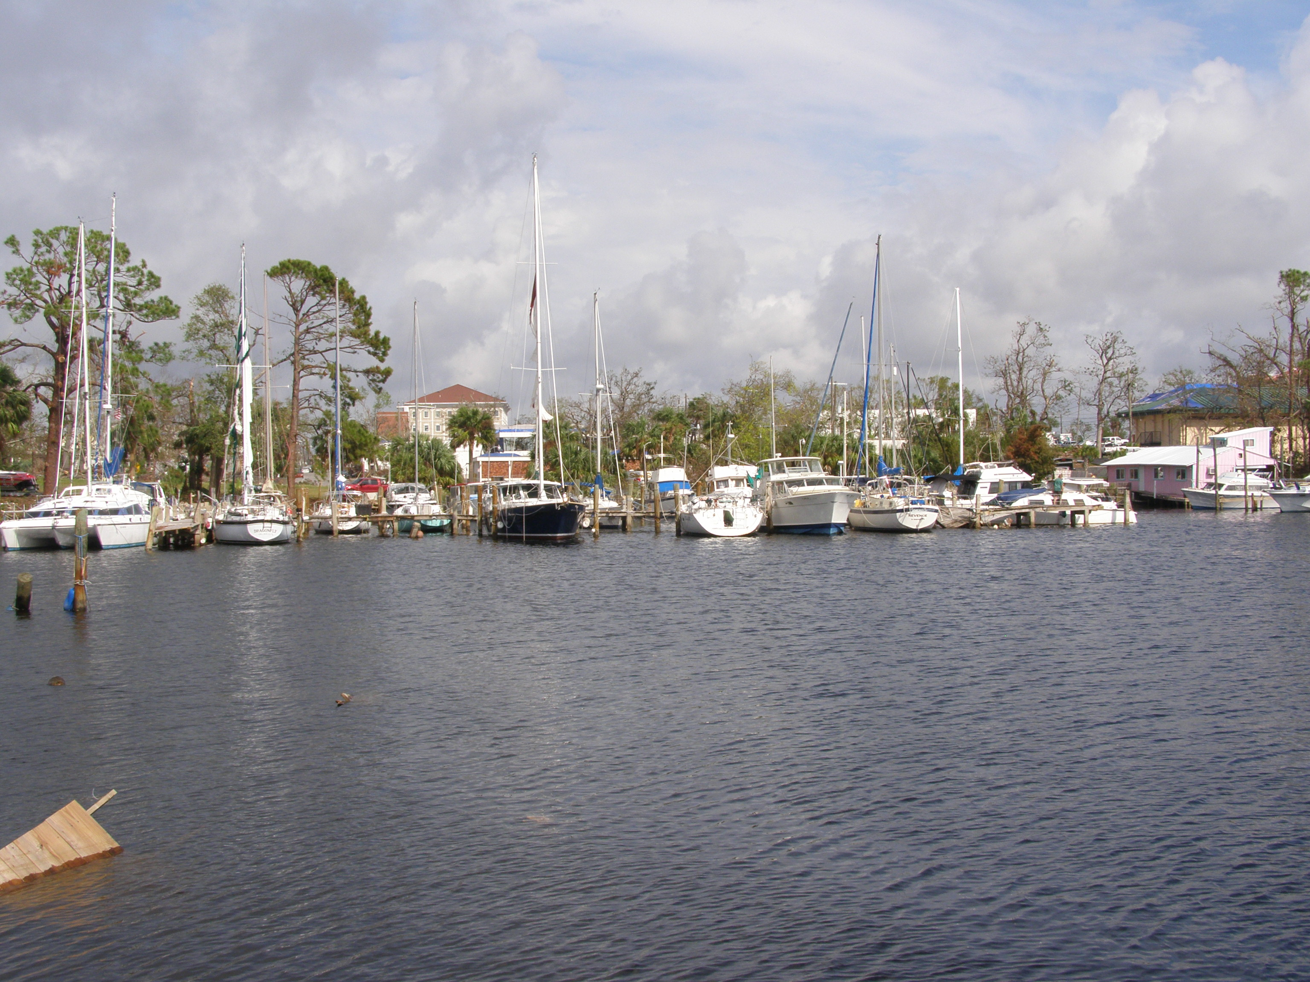
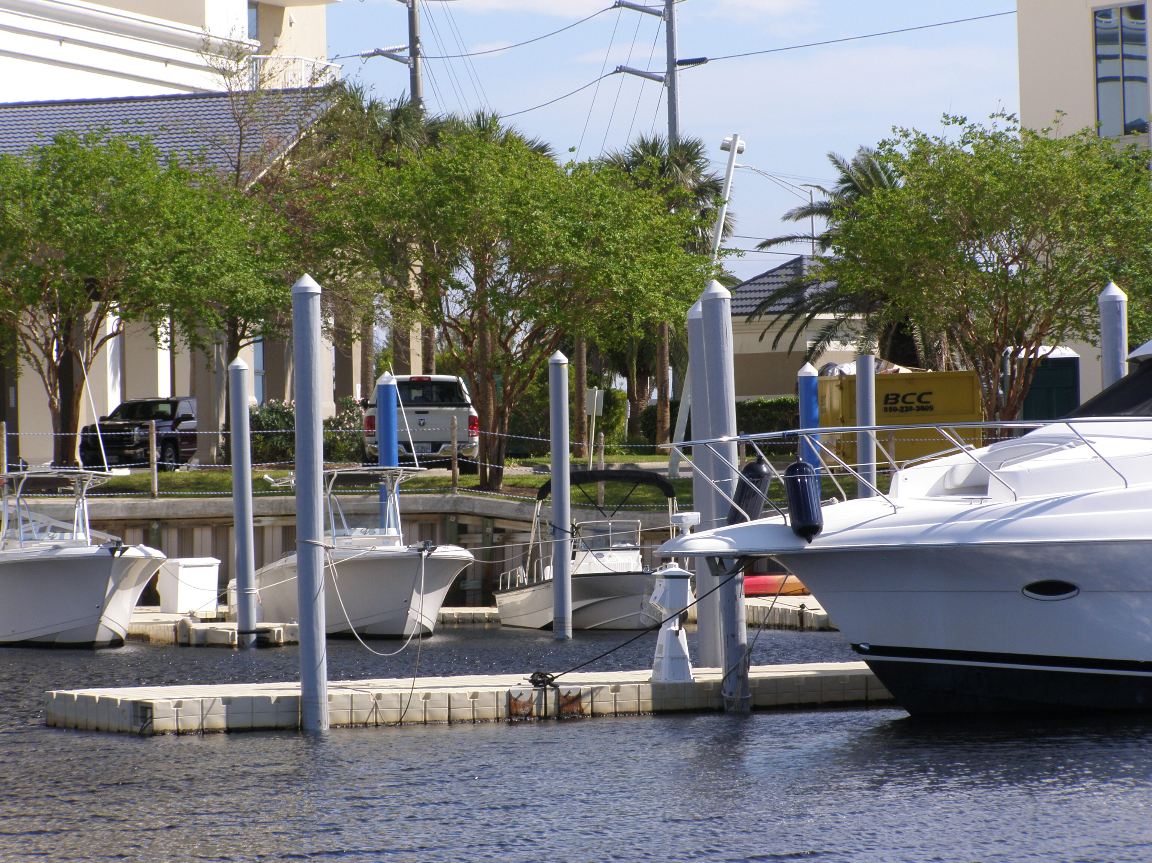
Hurricane Michael
Gulf
Most slips ok
Fiberglass covered steel piles
Large “rogue” ship with bad lines
Boats racked against bridge by return current
Wooden bollards and docks
Sheet metal roofing
Floating docks and concrete piers
Vinyl piers
Several “rogue” ships
Many slips in good shape
Concrete piers and metal roof
Heavy slip damage
Panama City Marina
St. Andrews Marina
Laid Back Boat Marina
Marina Landing Harbor

Slide 12
Lessons Learned
Residential Areas
  Elevation is key
  Concrete >> wood (but may not be enough?)
  Adaptation is key ingredient to resilience
  Uniform code enforcement and retrofitting of old structures essential
  More than a single type of failure for each storm
Marinas
  Design for all phases of a storm
  Concrete >> wood
  Enforce requirements on lines
  Floating docks?
  As much geotechnical issue as structural (pile foundations)

Slide 13
Coastal Engineering Design for Resilience
Gray vs. Green Engineering
Planned Communities for Coastal Resilience
Harbor and Marina Design for Resilience
Probabilistic Design for Multi-Hazards

Slide 14
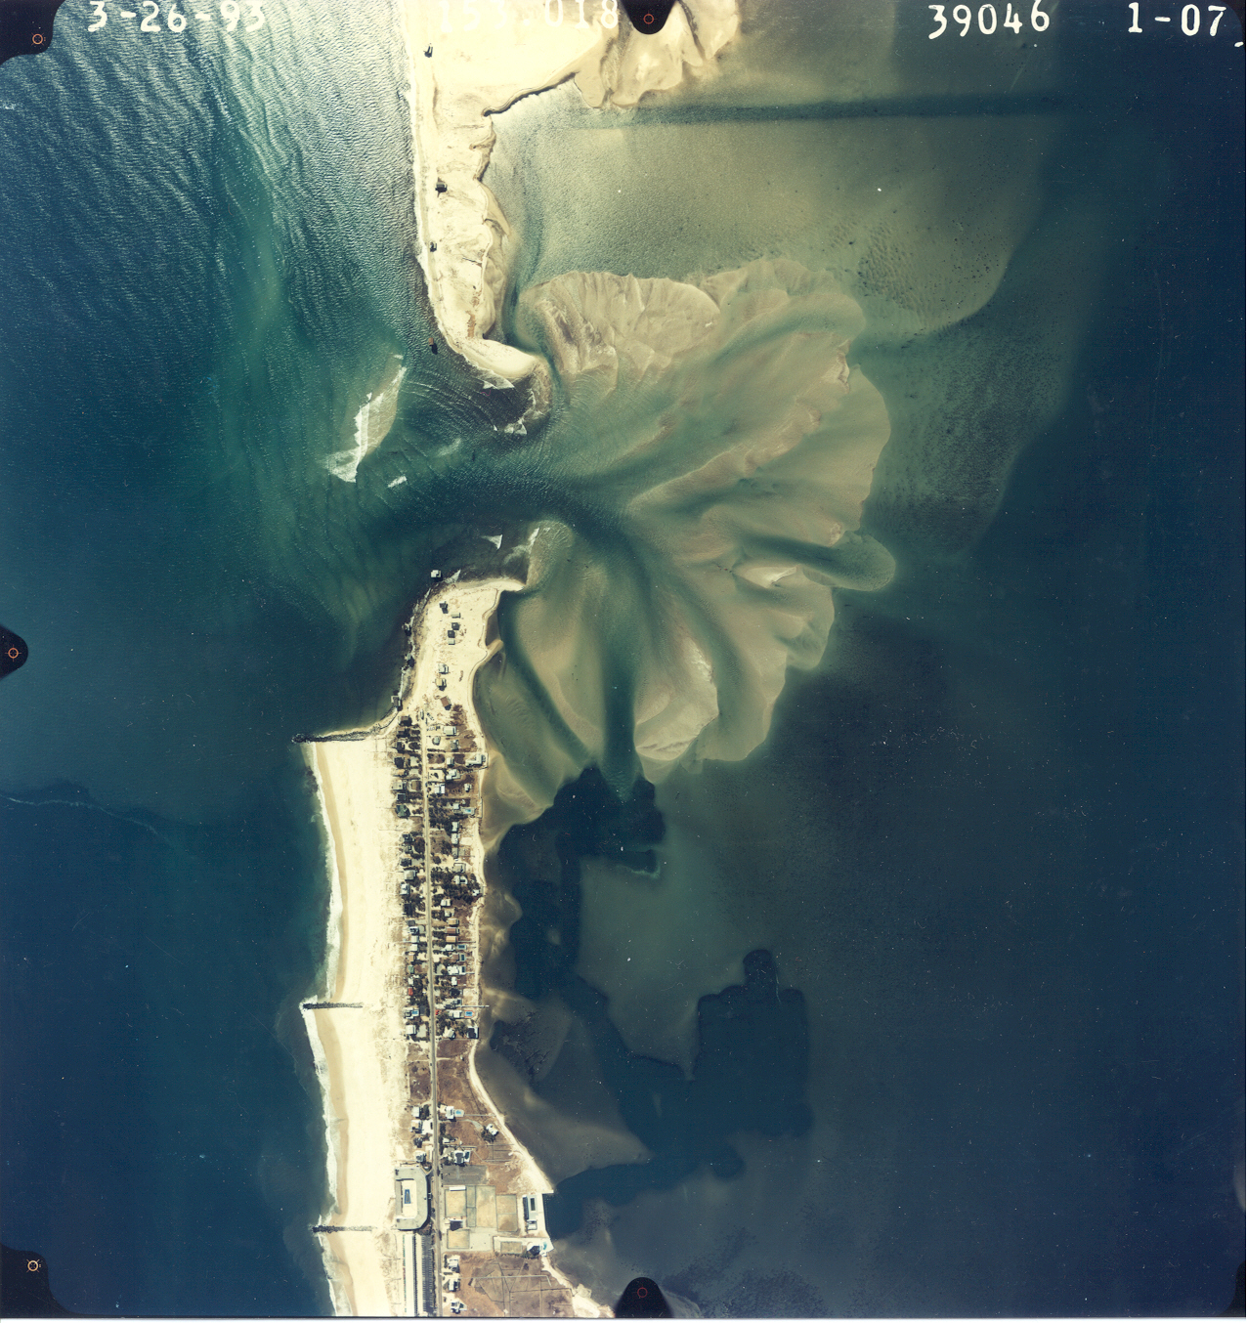
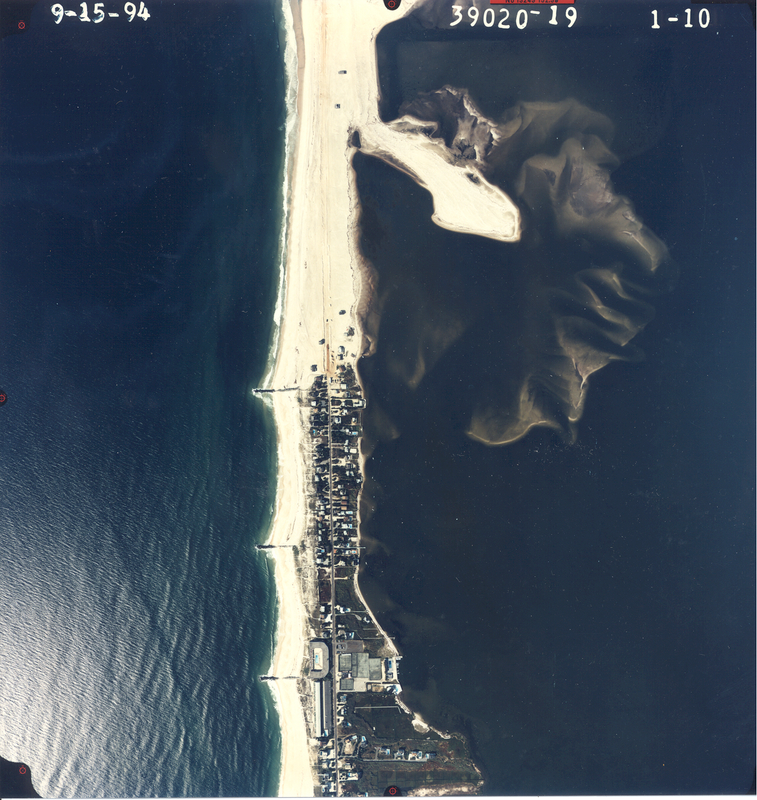
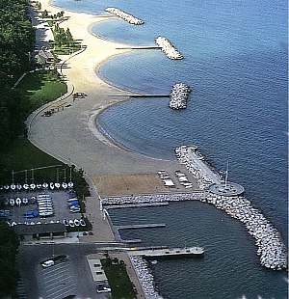
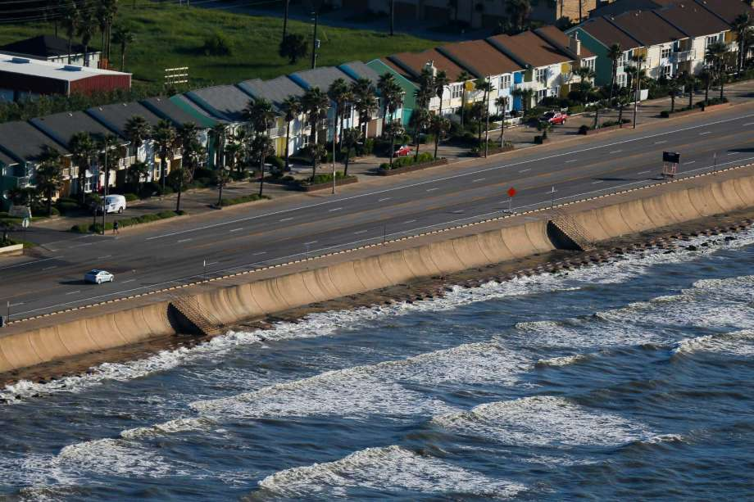
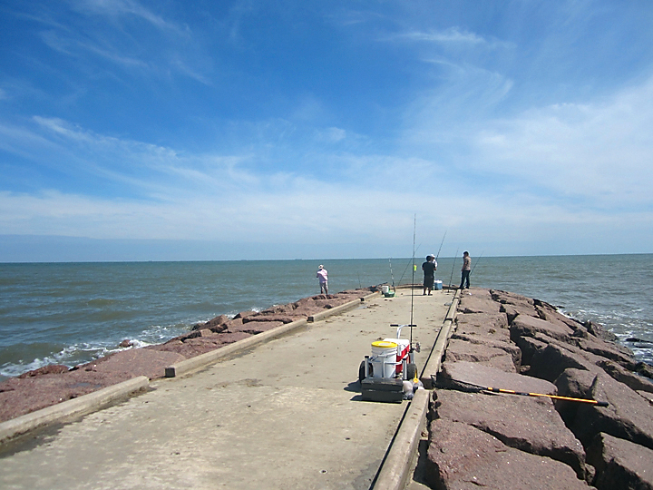
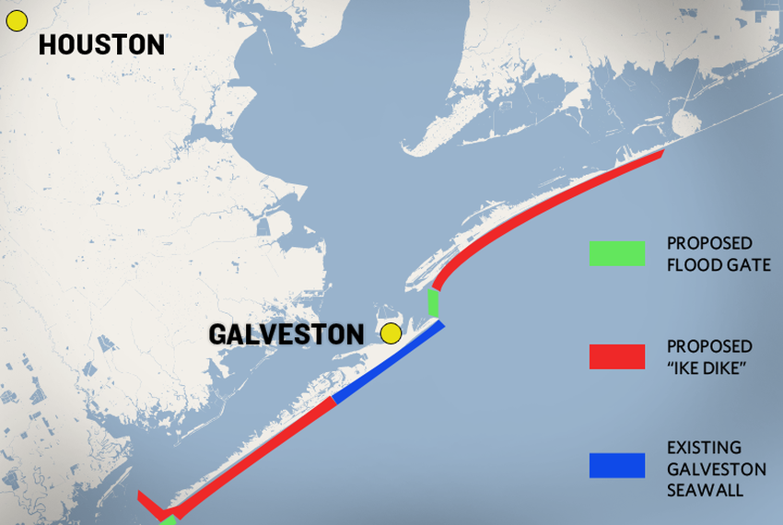
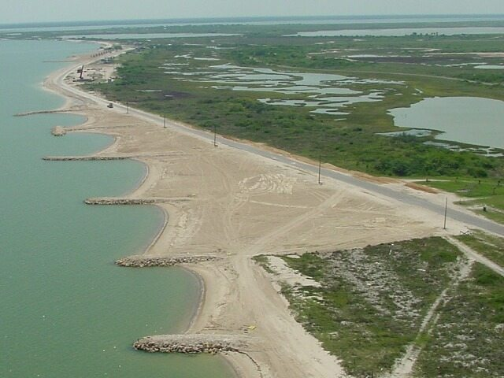
Traditional: Gray Engineering
Sources: Wikipedia, CBI-TAMUCC, Houston Chronicle, USACE
Beach fill placed by USACE
Breach in barrier island
Existing groins
Poorly designed groins
Westchester, New York
Notes:
Galveston Seawall: Gray engineering
Does what it is supposed to
Exacerbates erosion of beaches
Breakwaters

Slide 15
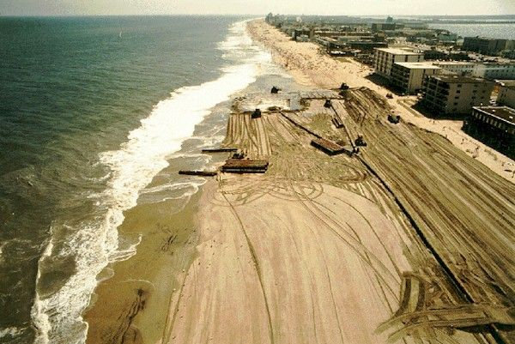
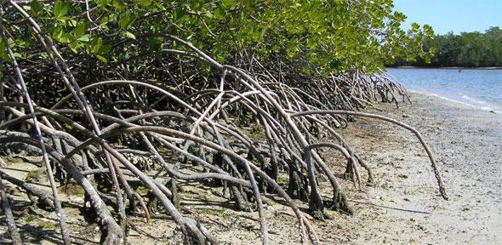
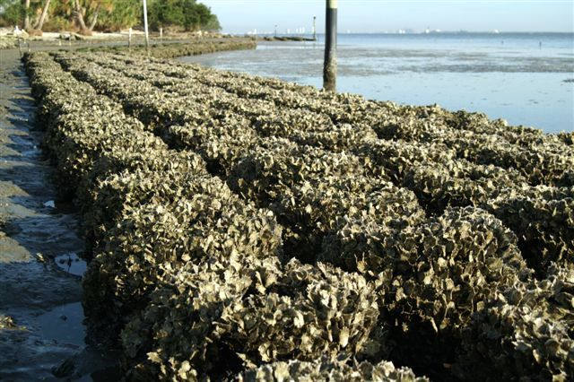

“Green Engineering” – Use Natural Resources Available
“The best nature based solution is one that already exists” – I. Losada
“Going green is difficult as there is little quantitative design information…” – R. Dalrymple, NAE
Careful design and testing required!

Slide 16


“Green Engineering” – Smaller Engineering Footprint
Careful testing required! (some installations problematic for Ike)
Careful testing required! (vulnerable to problems from incomplete analysis)
Beach dunes enforced with sand filled “geotubes”
Construction of dunes anchored by vegetation
Source: New Jersey Sea Grant, coastalcare.org

Slide 17

Planned Communities for Coastal Resilience – Mix of Gray and Green
Hardened structures for surge and wave protection – first line of defense
Optimize for sheltering
Dune construction and vegetation for surge suppression
Reefs or Submerged Structures for wave dissipation
New materials need careful testing and analysis

Slide 18

Harbor and Marina Design for Resilience
Reinforced Concrete piles
Floating concrete docks
Improved Foundation Design
Design for water levels, waves, and current speeds / direction
Careful testing and analysis required!

Slide 19
Probabilistic Design for Multihazards
Keen and Lynett (2018 ICCE)
Single Hazard Condition as Input
Design Procedure
Resulting Design
Run Design Methodology for Many Conditions
Traditional Design Methodology
Risk of Failure from Different Conditions over Design Life
Range of Conditions within Design Life

Slide 20

Community Resilience
Sea Level Rise
Storm Intensity
Hazard
Hazard
Hazard
Hazard
Movement toward “Normal”

Slide 21
Final Thoughts
Bad news
  Hazards are increasing in intensity
  Hazards are complex, eludes “one size fits all” approach
  Sea level rise adds to design uncertainty over design life
Good news
  Judicious mix of green and gray engineering / new materials can help
    Requires careful design and testing / analysis
  More is known about hazards – can help in design
  Probabilistic design: Accounts for hazard type / variability
    Design to the hazard, not just the water level
Caution
  Don’t just rebuild – adapt!
  Community involvement is key

Slide 22




Thanks!
Ike 2008
Adapt!
Post-Ike 2009
New housing, further from shore
Beachfront
Scour
Ike 2008
Mini-dune!!
Adapt??
Post-Ike2009

Slide 23

Further Information
James M. Kaihatu, Ph.D.
Professor
Associate Department Head for Research
Zachry Department of Civil Engineering
Texas A&M University
3136 TAMU
College Station, TX 77843-3136
979-862-3511 / 979-845-1353
jkaihatu@tamu.edu
Web: https://ceprofs.civil.tamu.edu/jkaihatu
Twitter: @TAMU_Coastal
YouTube: James Kaihatu (link, or enter in search field)

