Slide 1
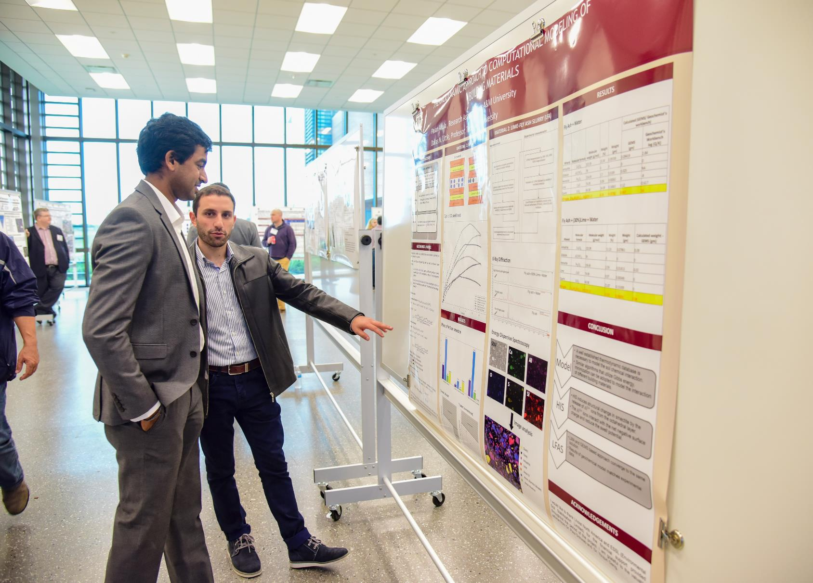
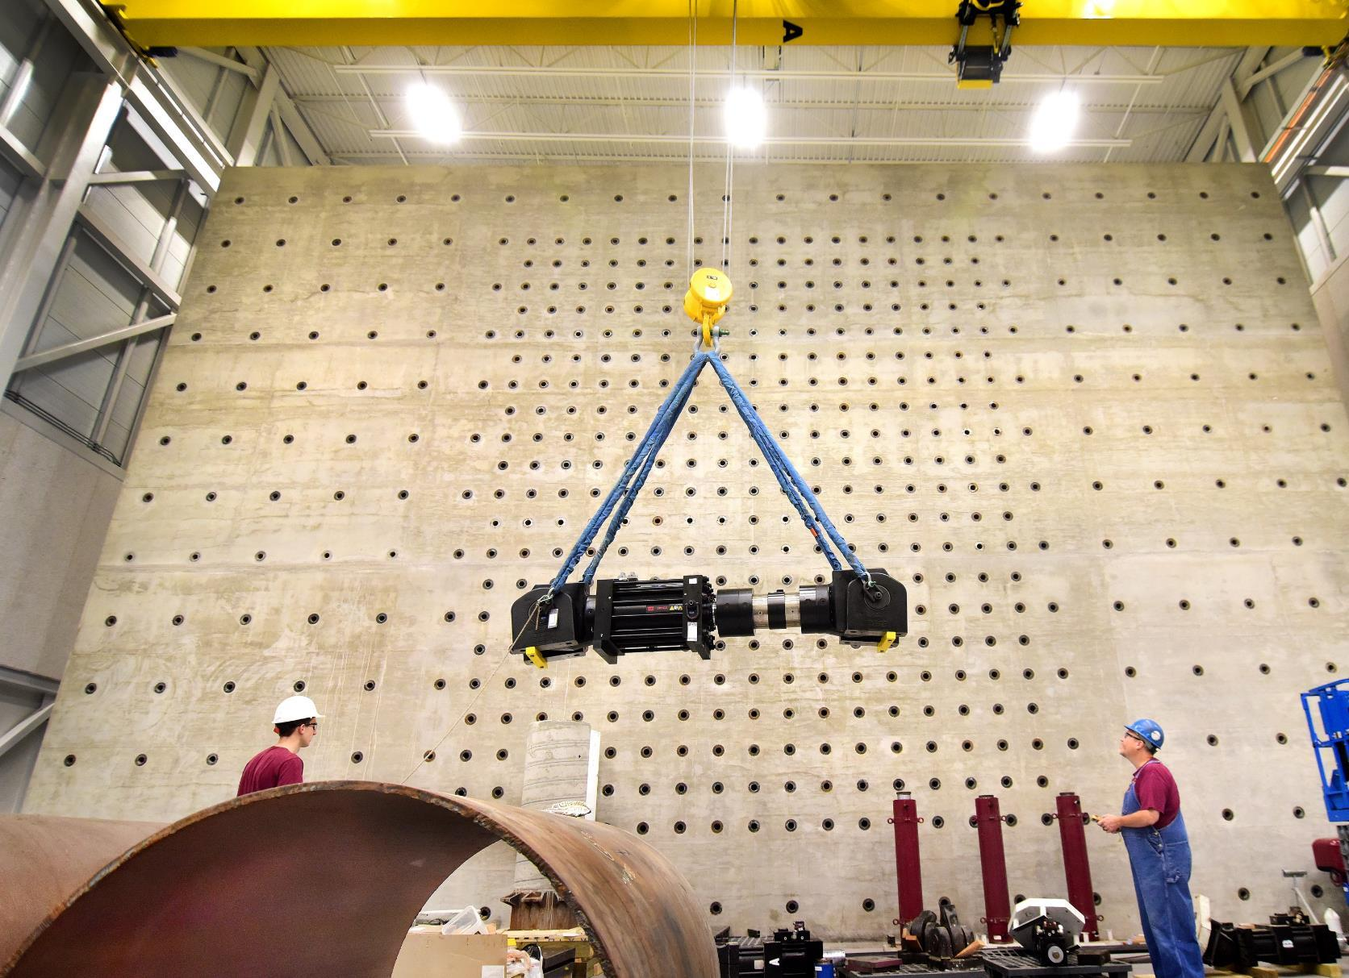
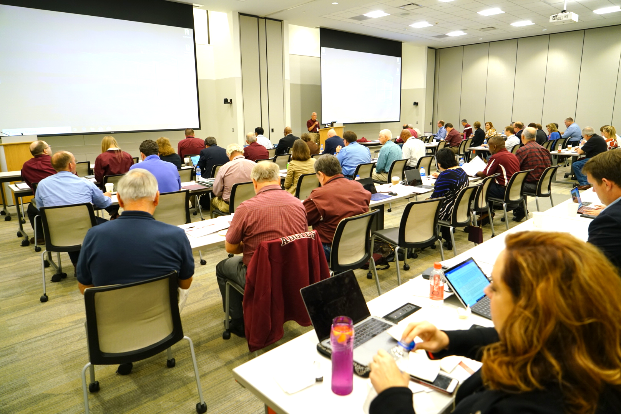
A new asset for maximizing resilience of Texas communities
Zachary Grasley
November 29, 2018

Slide 2
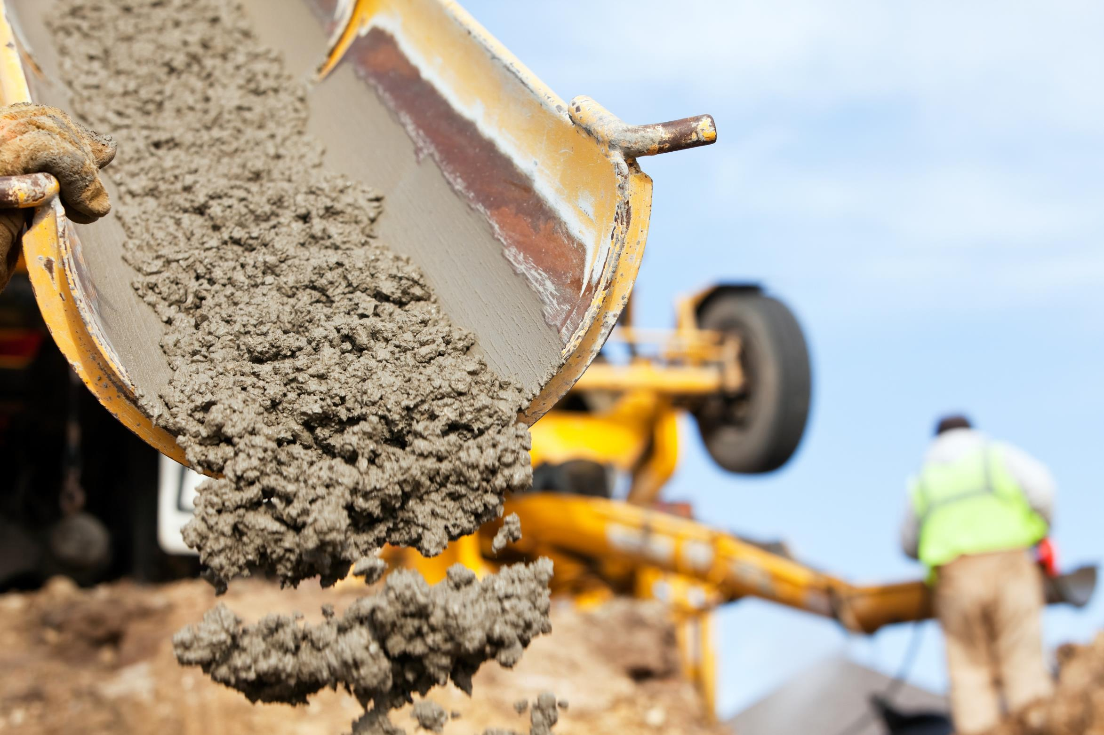
Vision
The CIR is the national leader in the development of transformative infrastructure solutions
CIR innovations lead the way in:
  Longer lasting infrastructure
  Less time and more efficient construction
  Lower cost
Impact measured in $Billions
CIR will serve the State of TX and improve both new and existing infrastructure that supports our way of life

Slide 3
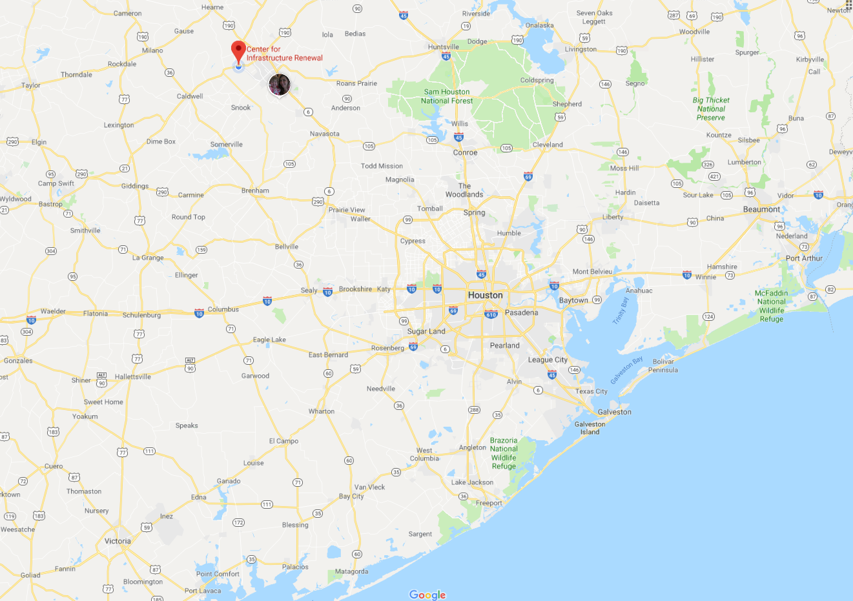
On new RELLIS campus
Notes:
This is a SYSTEM campus to support the State of TX.

Slide 4
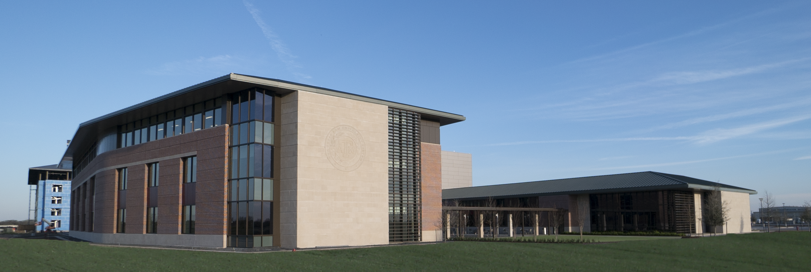
New building
138,000 square feet
High-tech, high-impact multi-disciplinary center for supporting research, innovation and workforce development

Slide 5
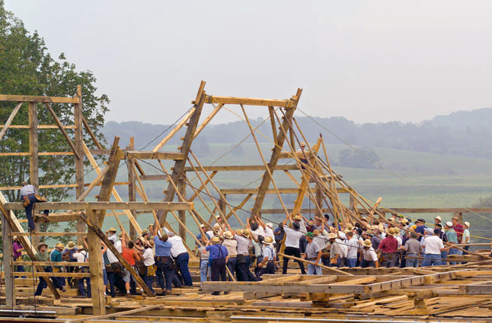
Broad expertise in infrastructure
Many departments
  Civil
  Mechanical
  Materials Science
  Electrical
  Computer Science
  Construction Science
  Architecture
  Industrial
  Chemistry
  Soil Science

Slide 6
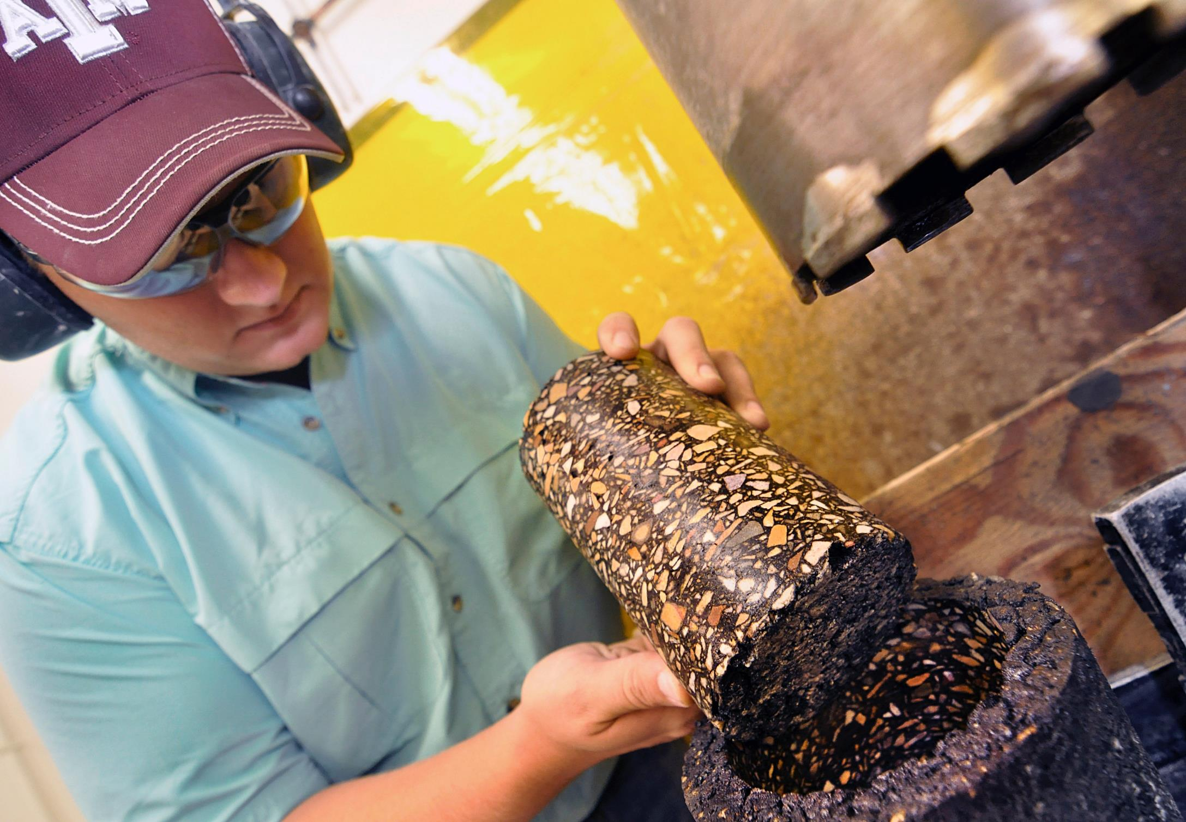
Research
Focused on nine critical infrastructure sectors:
  Chemical
  Communications
  Critical Manufacturing
  Smart Energy
  Information Technology
  Energy Infrastructure
  Materials and Waste
  Transportation Systems
  Water and Wastewater Systems

Slide 7
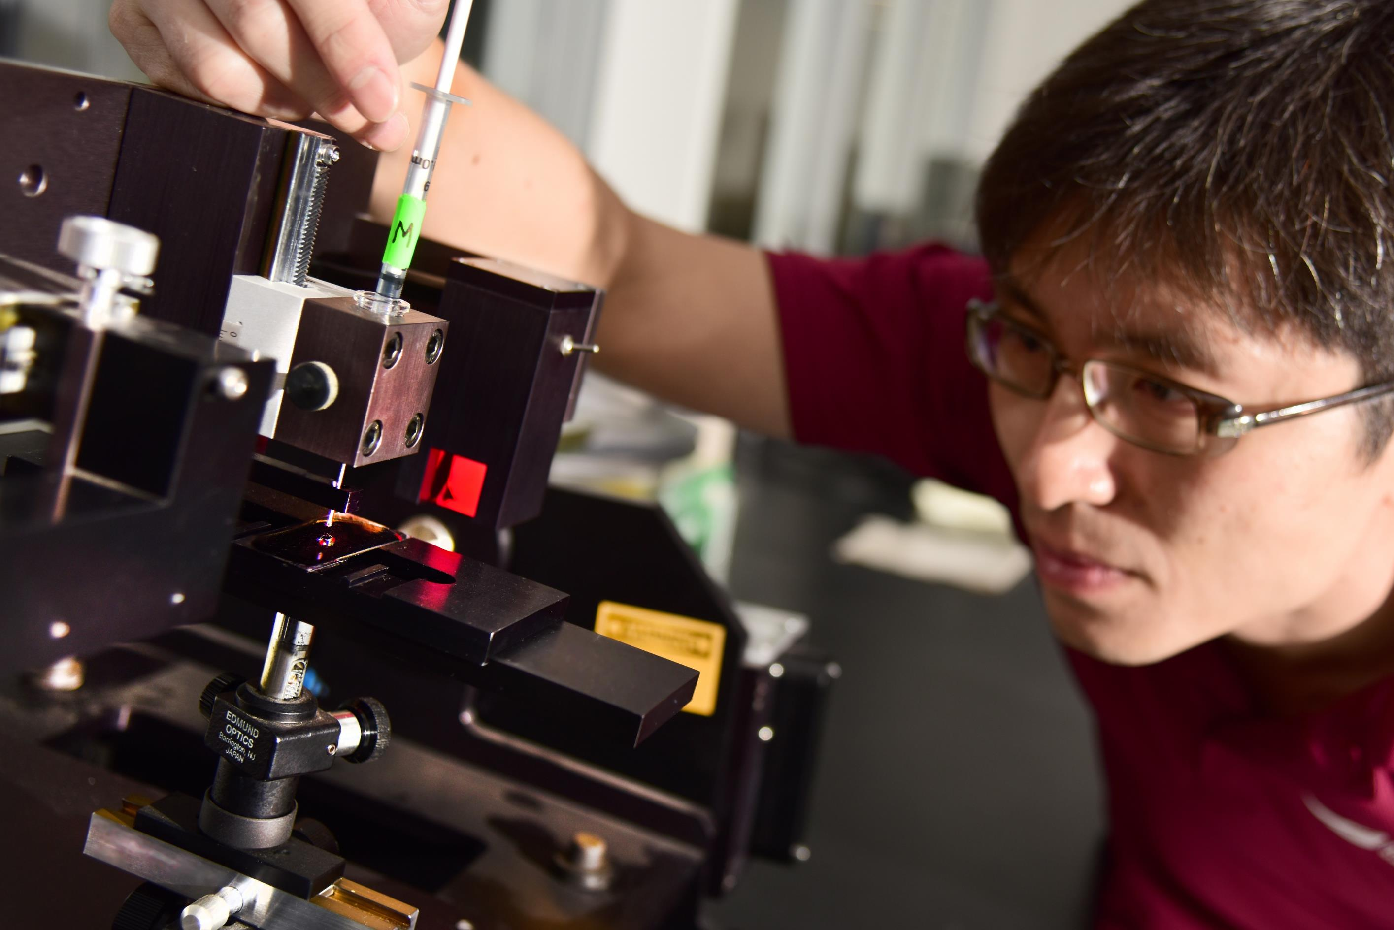

Advanced characterization of infrastructure materials lab
Using advanced micro/nano-analytical techniques and non-destructive evaluation for characterization of:
Aggregates
Bitumen
Cement
Asphalt & cement composites
Soil & other related materials

Slide 8
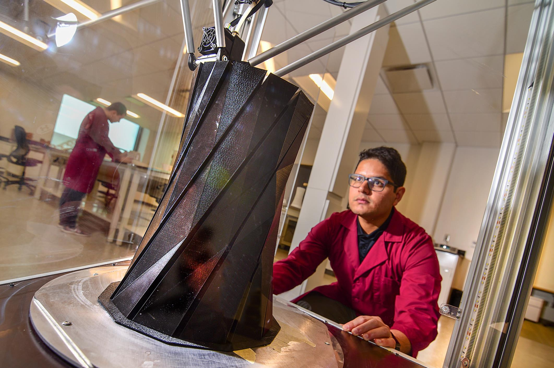
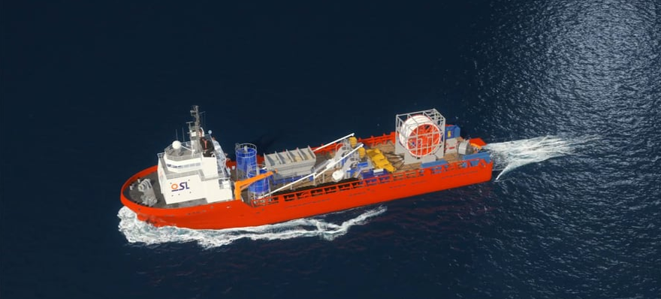
Advanced infrastructure materials & manufacturing lab
Applications of robotics and 3-D printing
Improve construction logistics to ensure cost-effective, higher quality materials

Slide 9
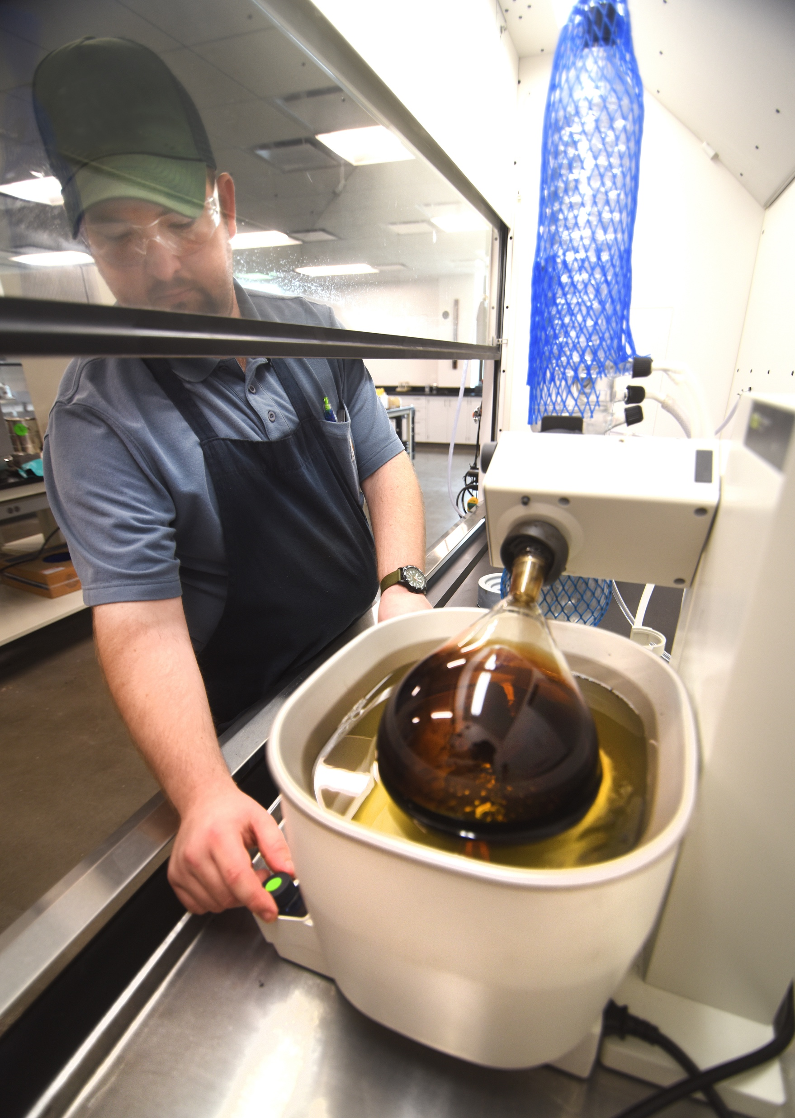
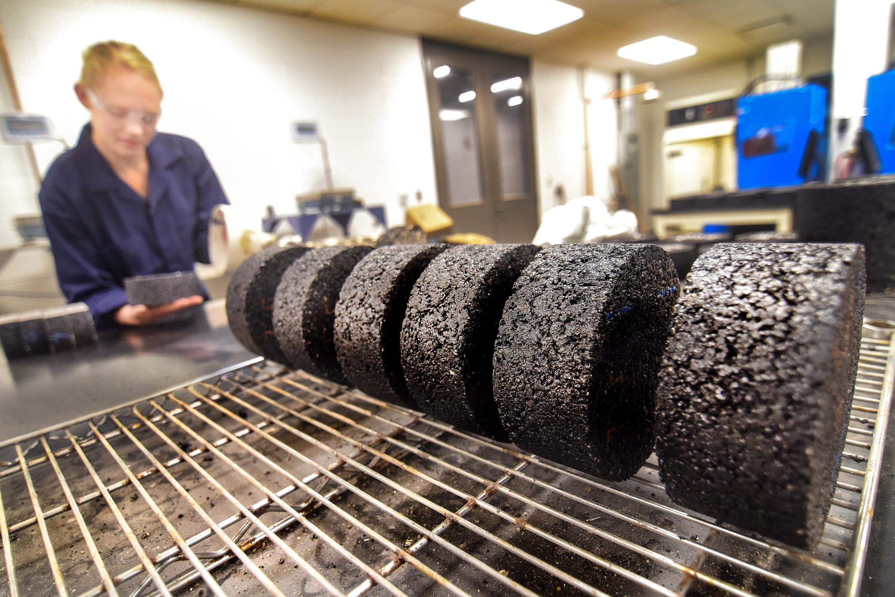
Asphalt innovation lab
Develop next-generation asphalt binders and mixtures that are environmentally friendly
Provide cost effective solutions to the ever expanding need to build resilient roadways

Slide 10
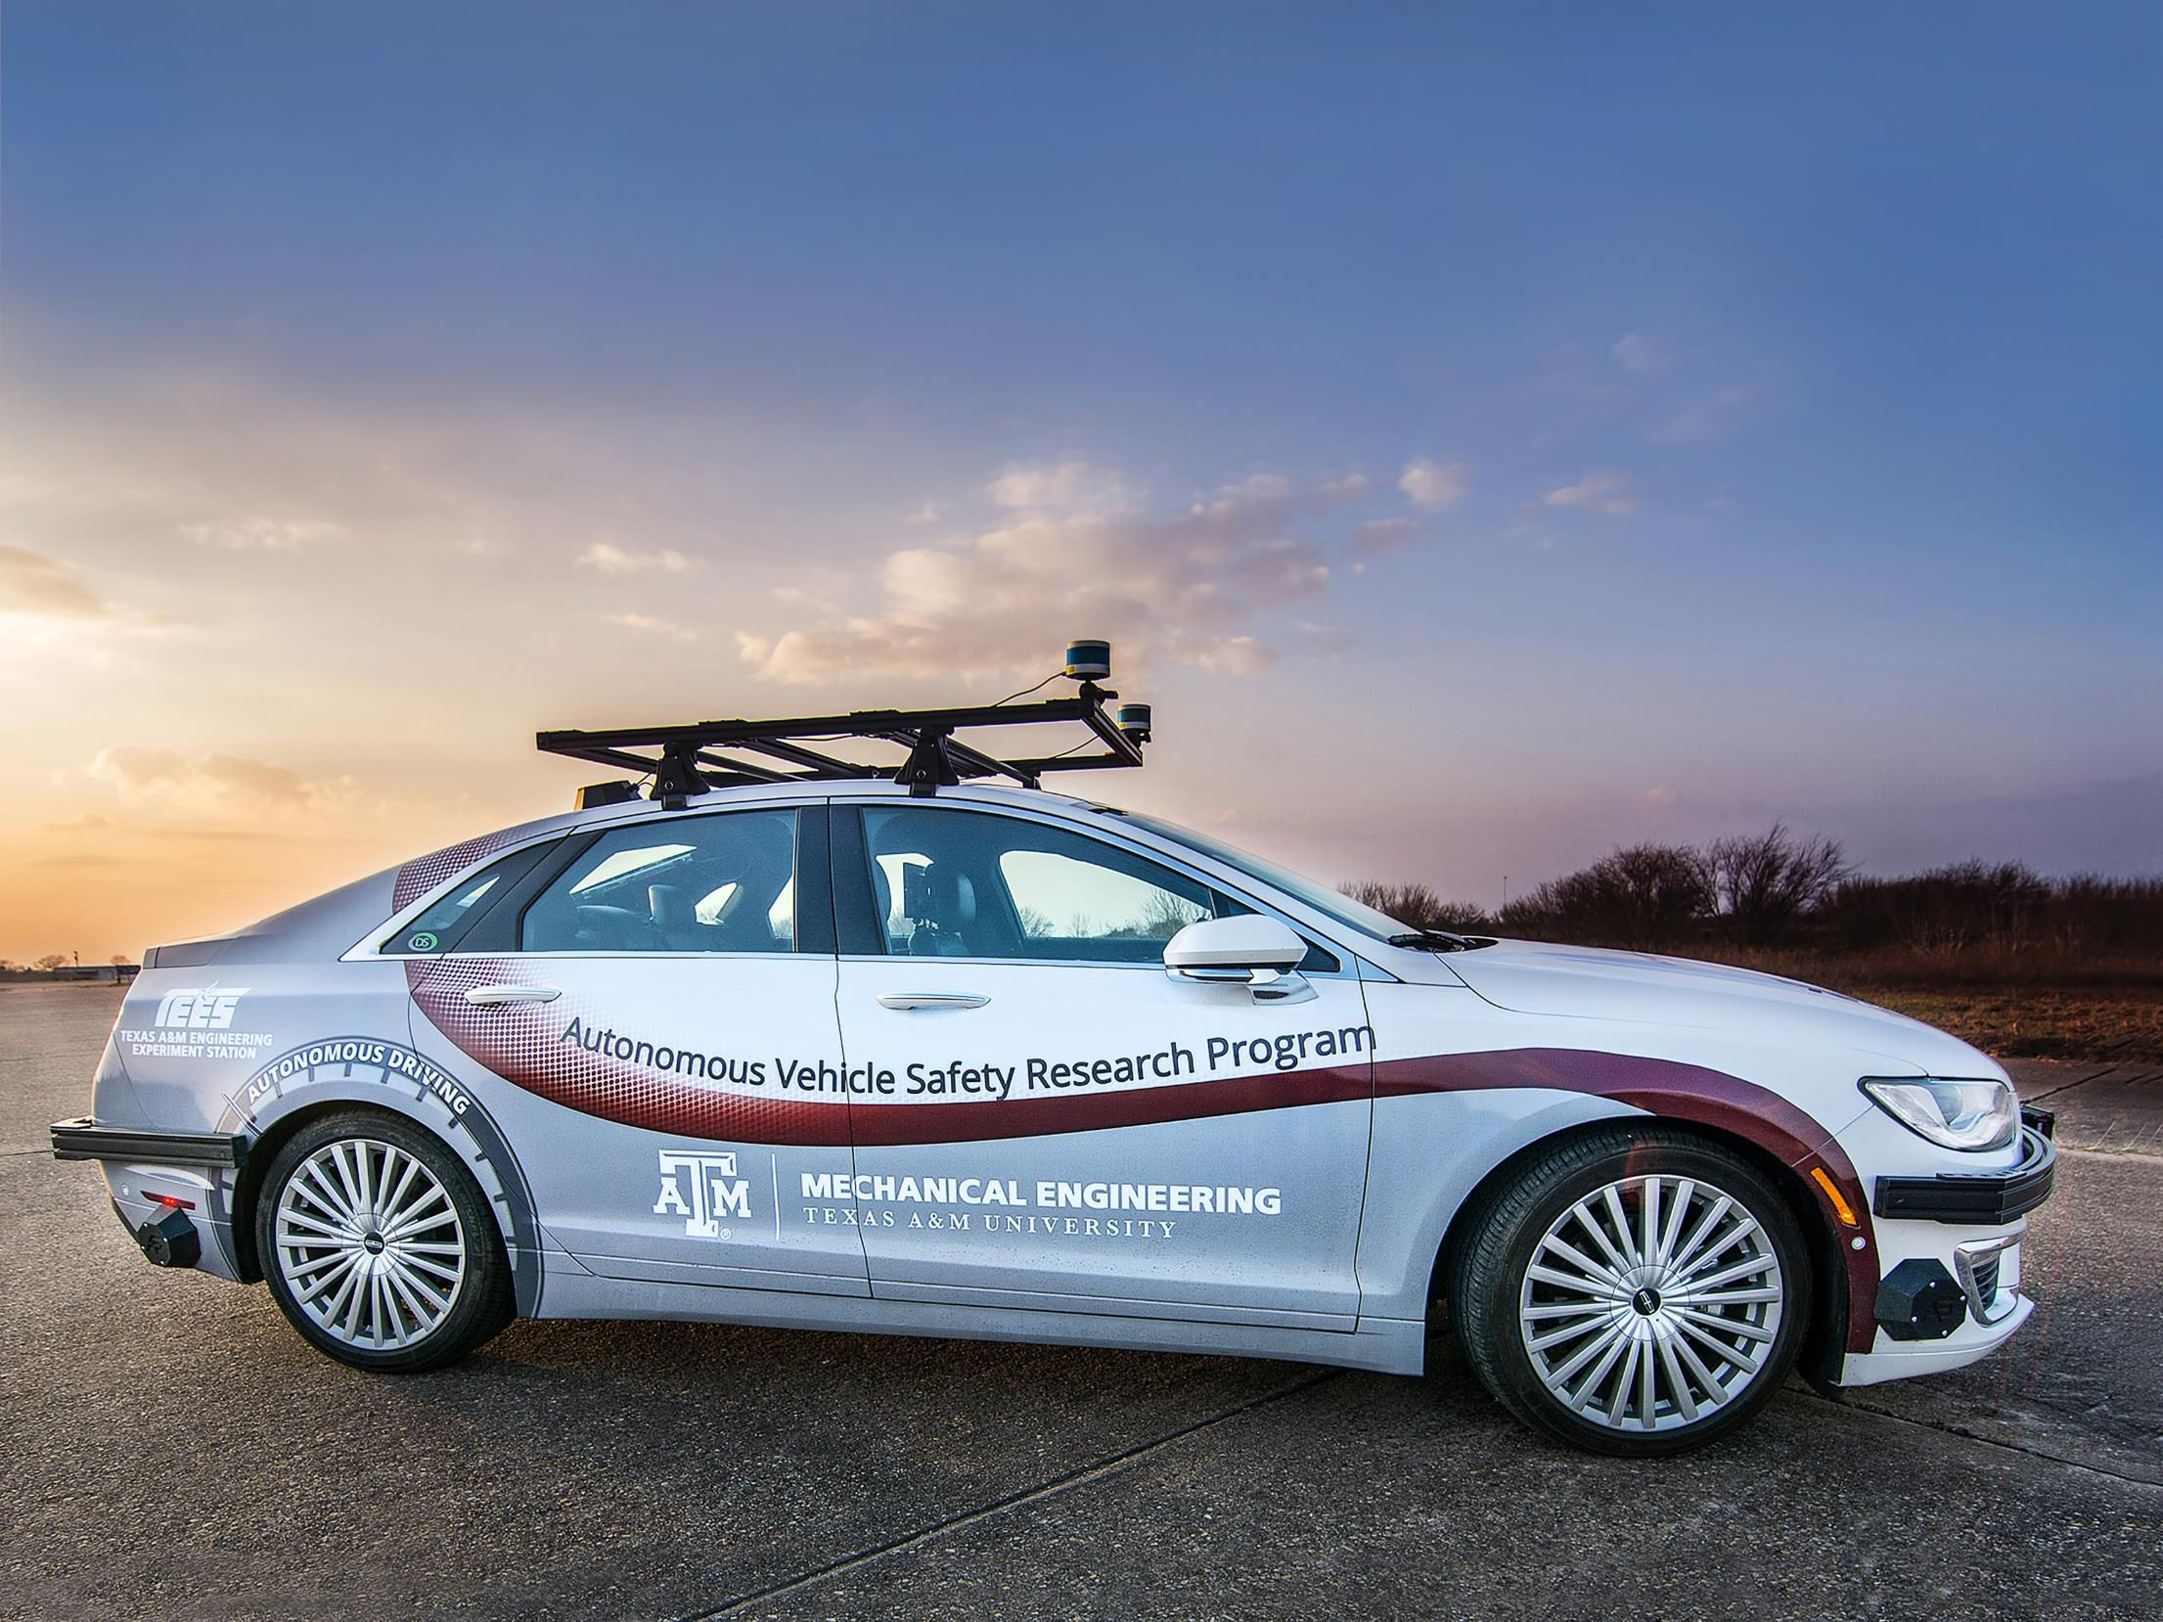
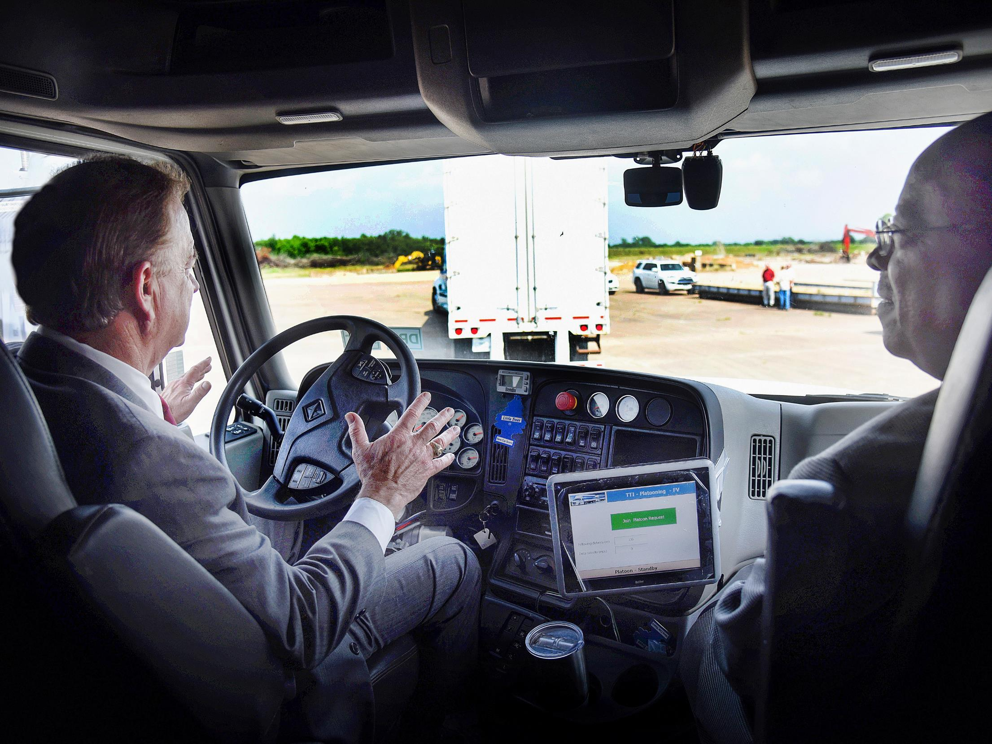
Connected infrastructure lab
Develop, test and deploy next generation sensors and data applications for the connected and automated vehicle environment, allowing vehicles and infrastructure to “talk” to each other and communicate their real-time conditions

Slide 11
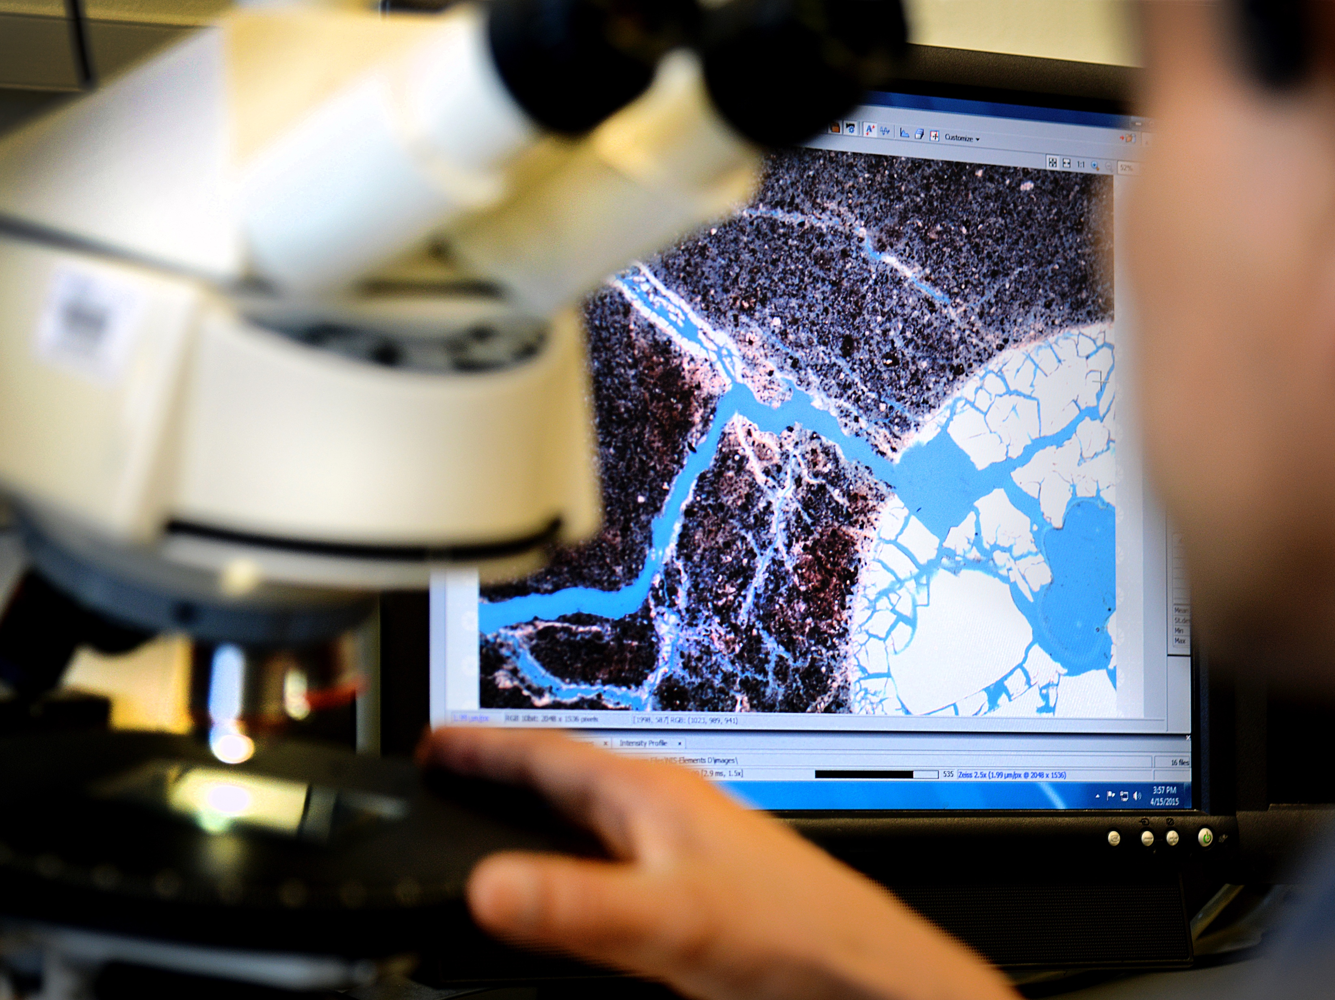
Concrete innovation lab
Develop next generation cements and concrete for more durable and resilient infrastructure

Slide 12
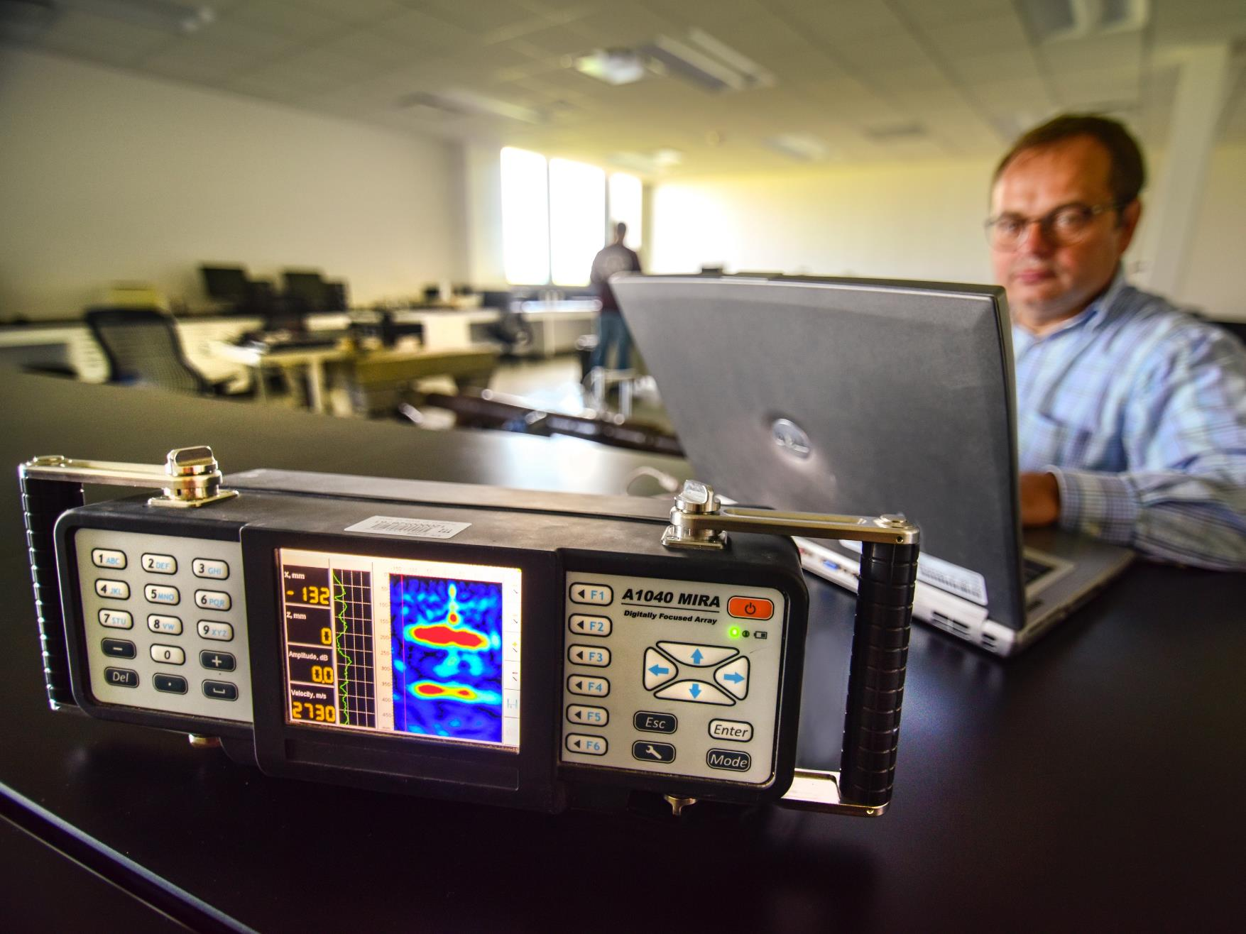
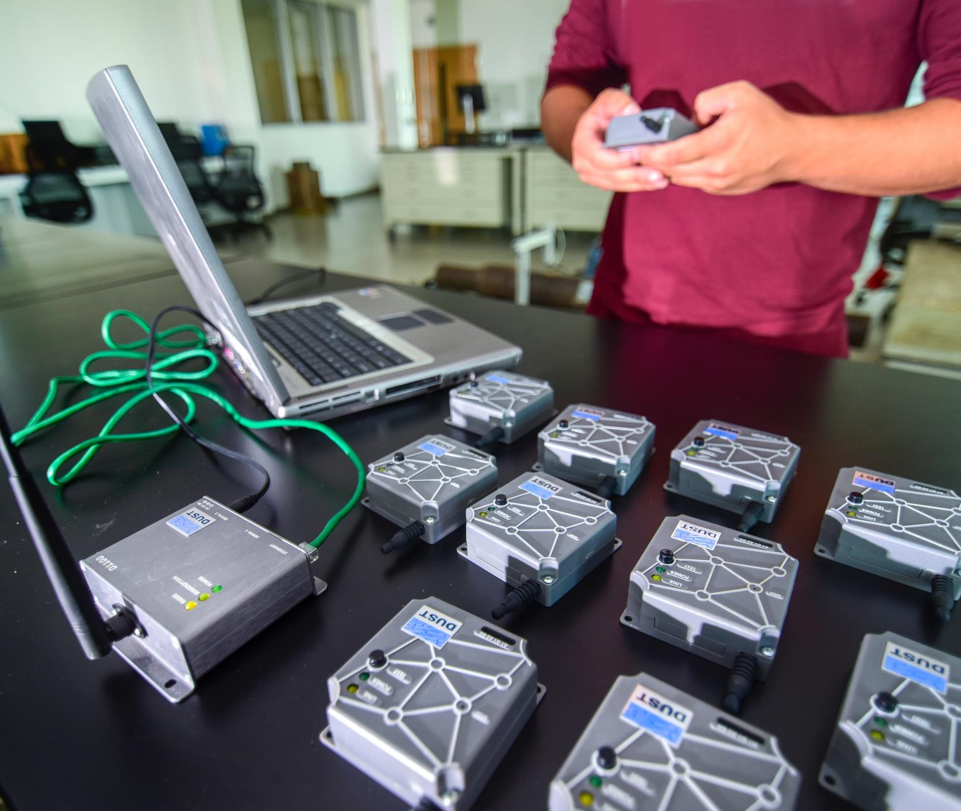
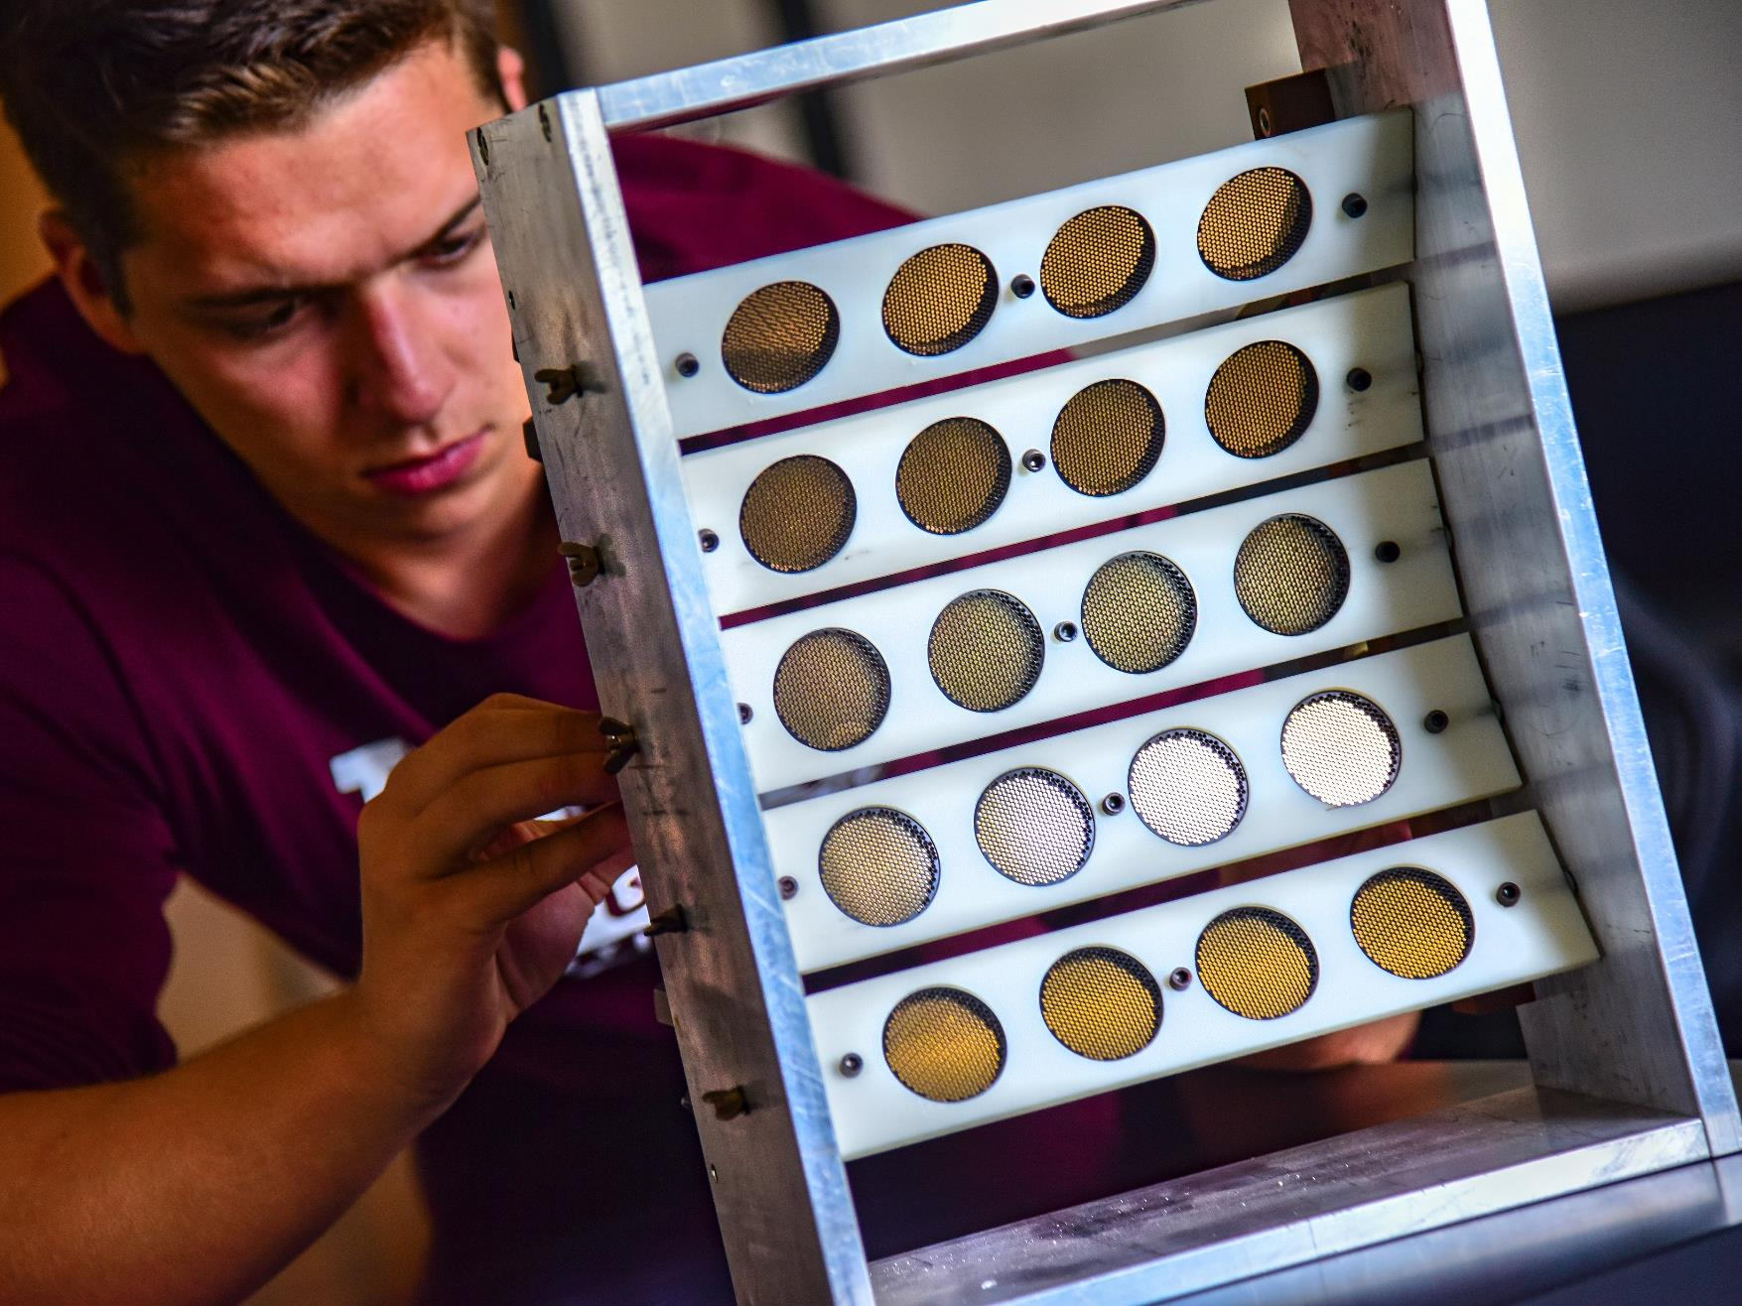
Intelligent infrastructure
Artificial intelligence applied to structures & habitats
Wireless sensor network for infrastructure management
Target-less computer vision, including drone based automated assessment of infrastructure

Slide 13
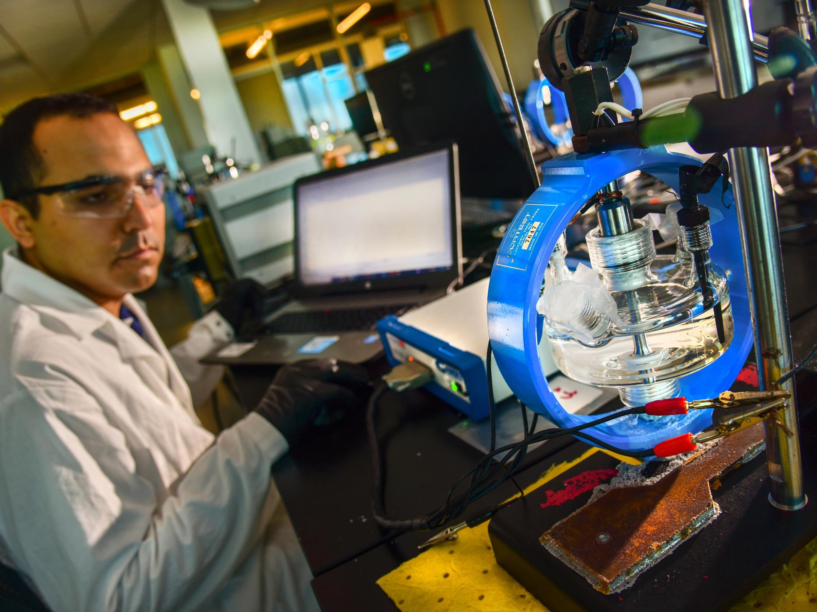
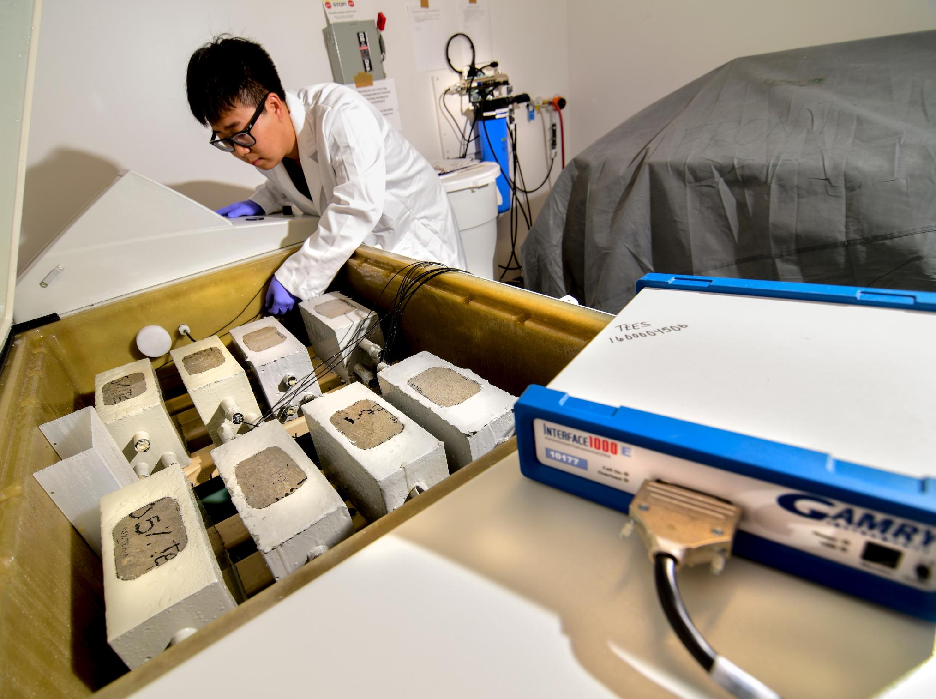
National corrosion & materials reliability lab
Provide solutions to the corrosion needs of industry and government to preserve and extend the integrity of the structures
  Buildings, bridges, pipelines, roads, ports, and off-shore platforms

Slide 14
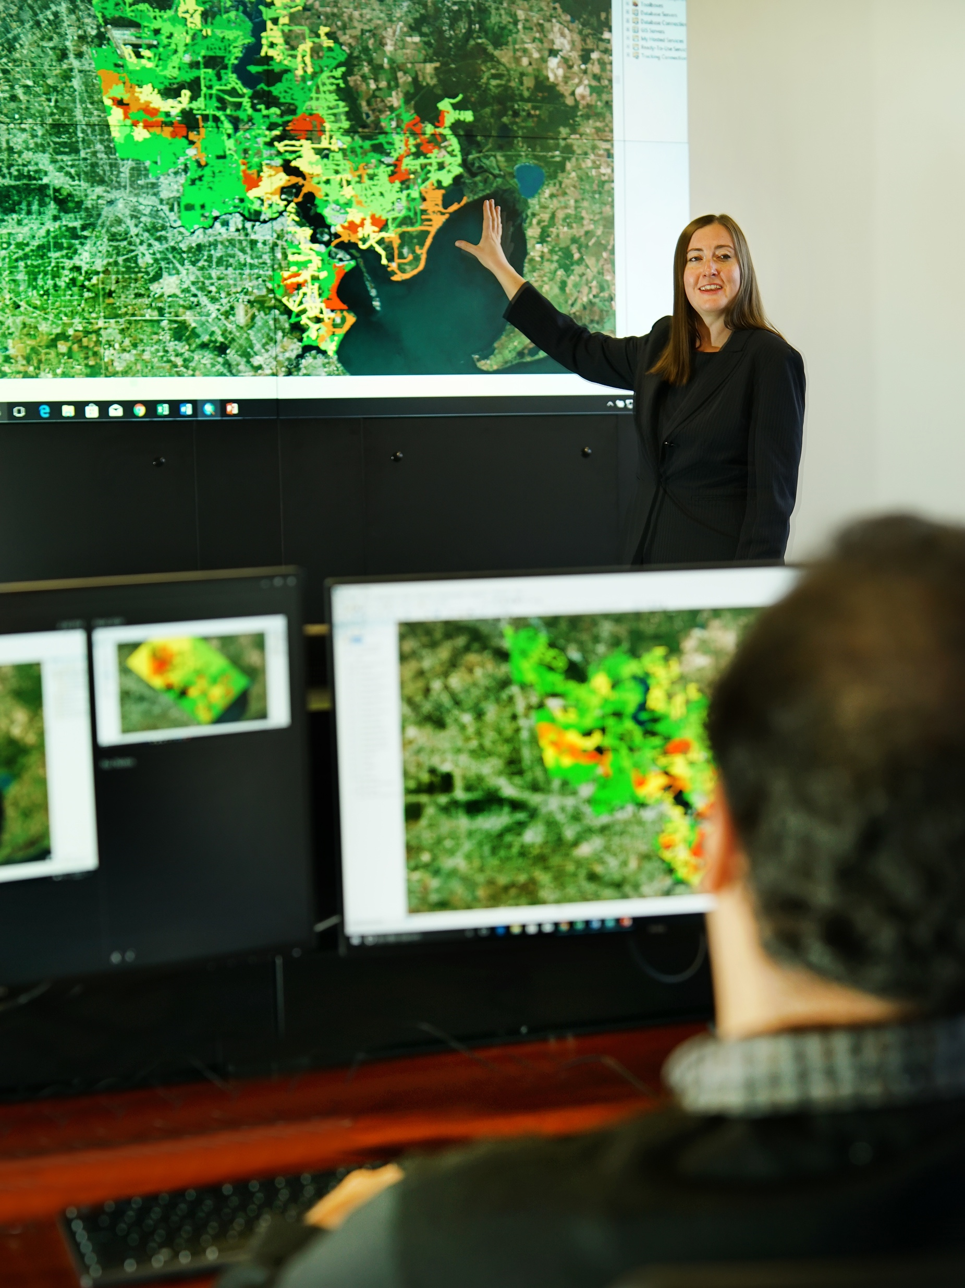
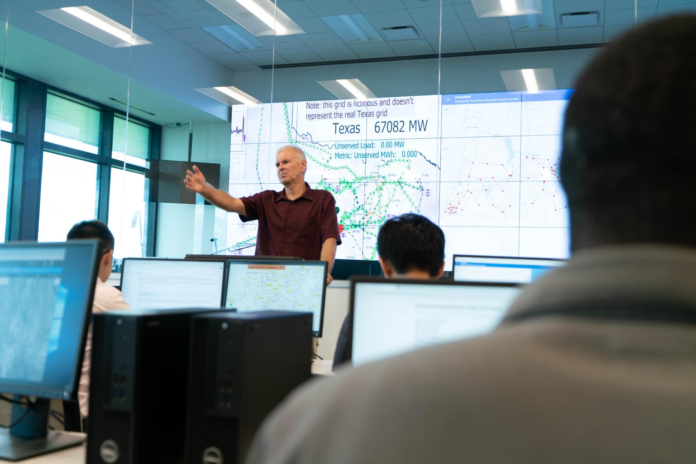
Smart grids control center
Ensure the reliability, sustainability, and security of the electric energy supply via innovative vision of a large-scale, seamlessly integrated Power System Control Center of the future

Slide 15
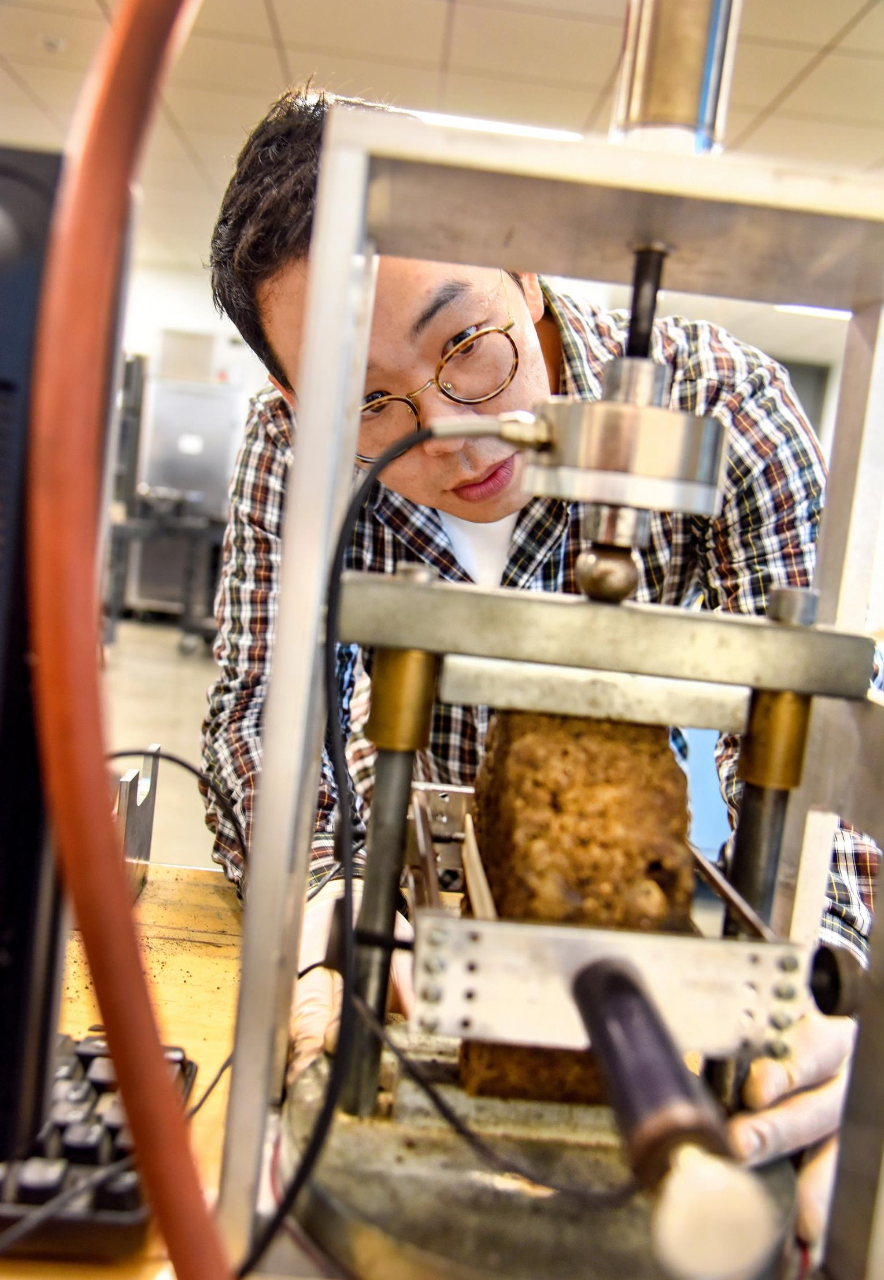
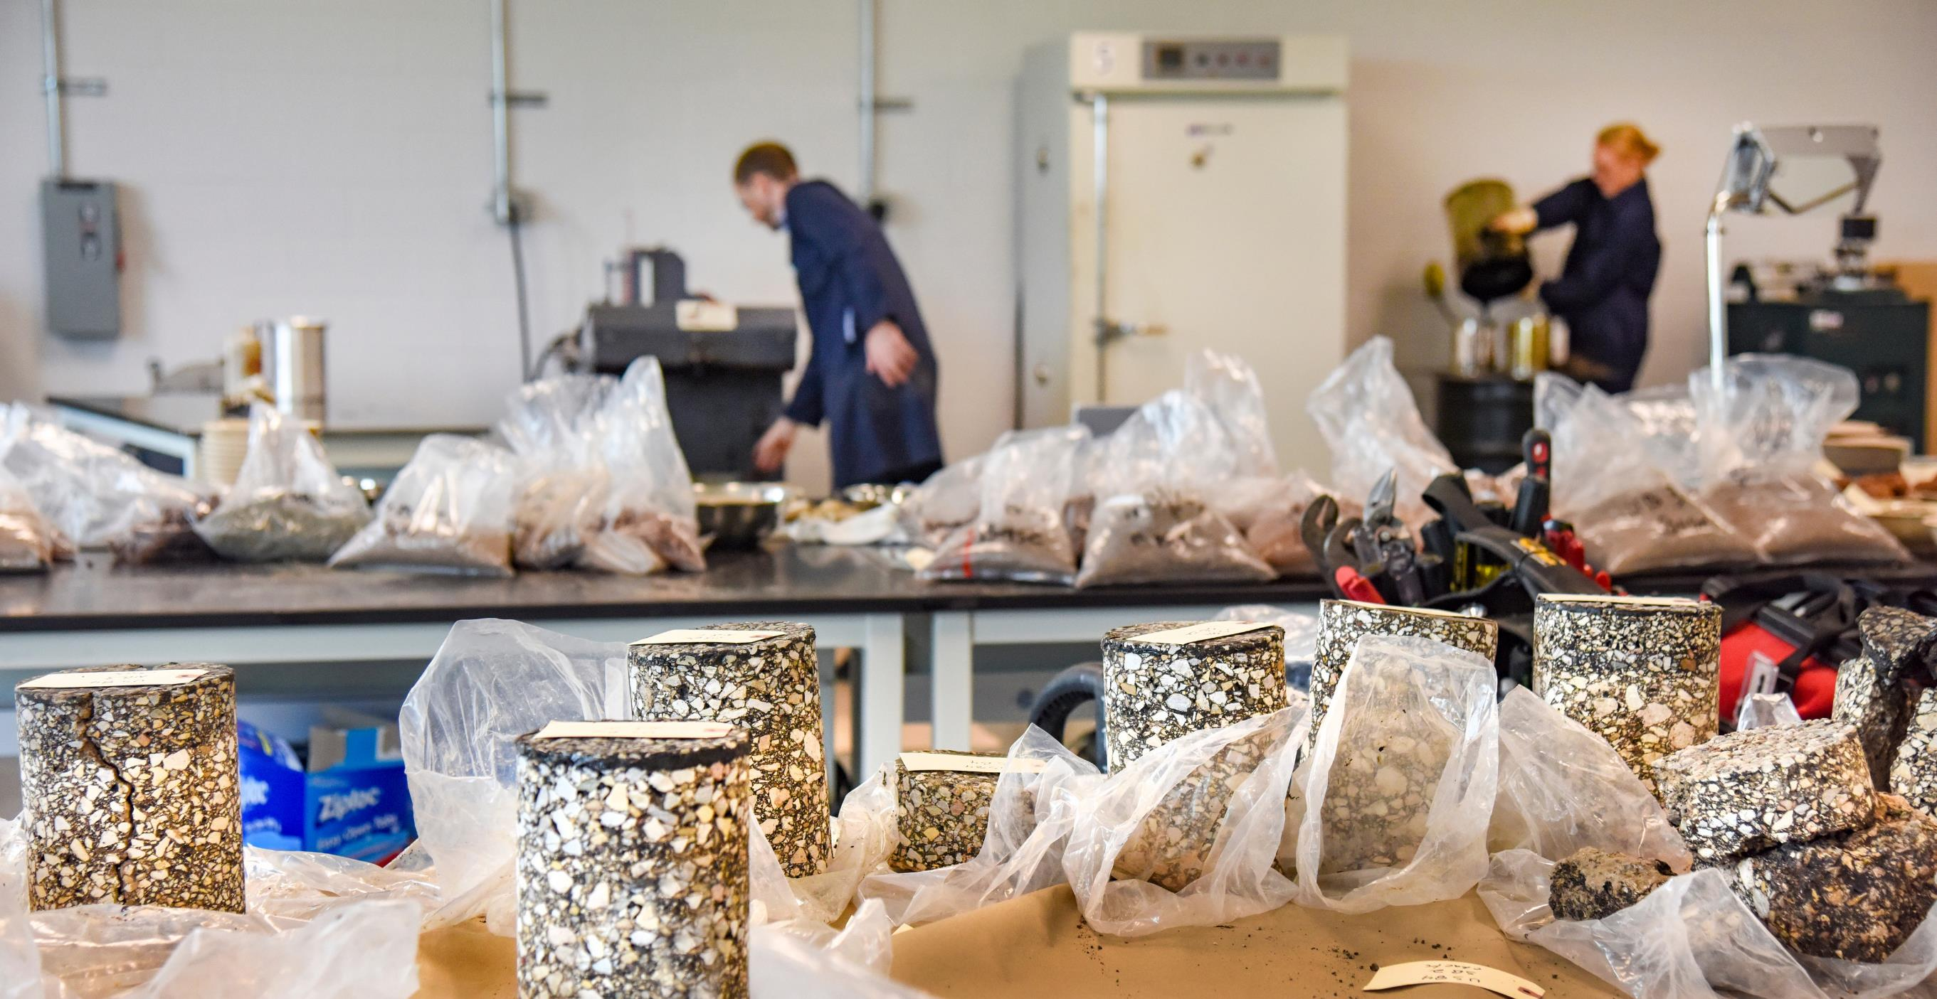
Soil/Unbound materials innovation lab

Slide 16
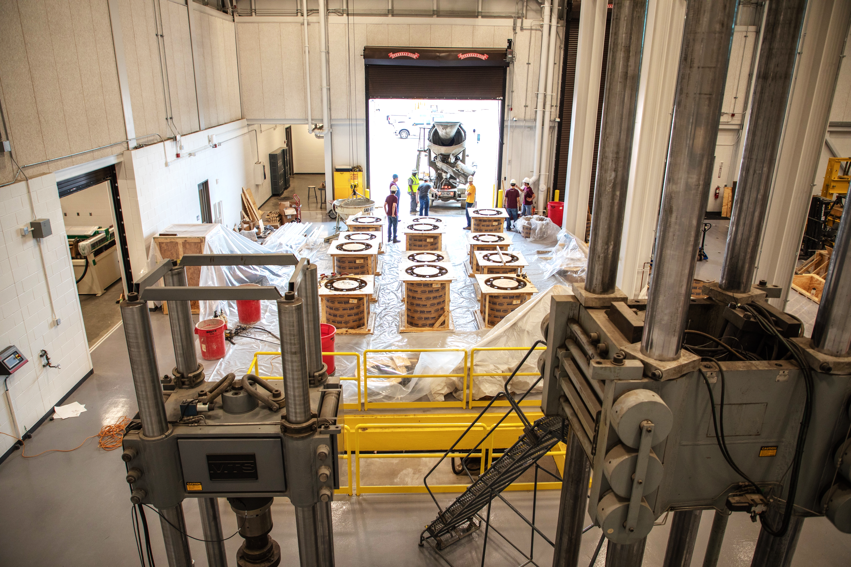
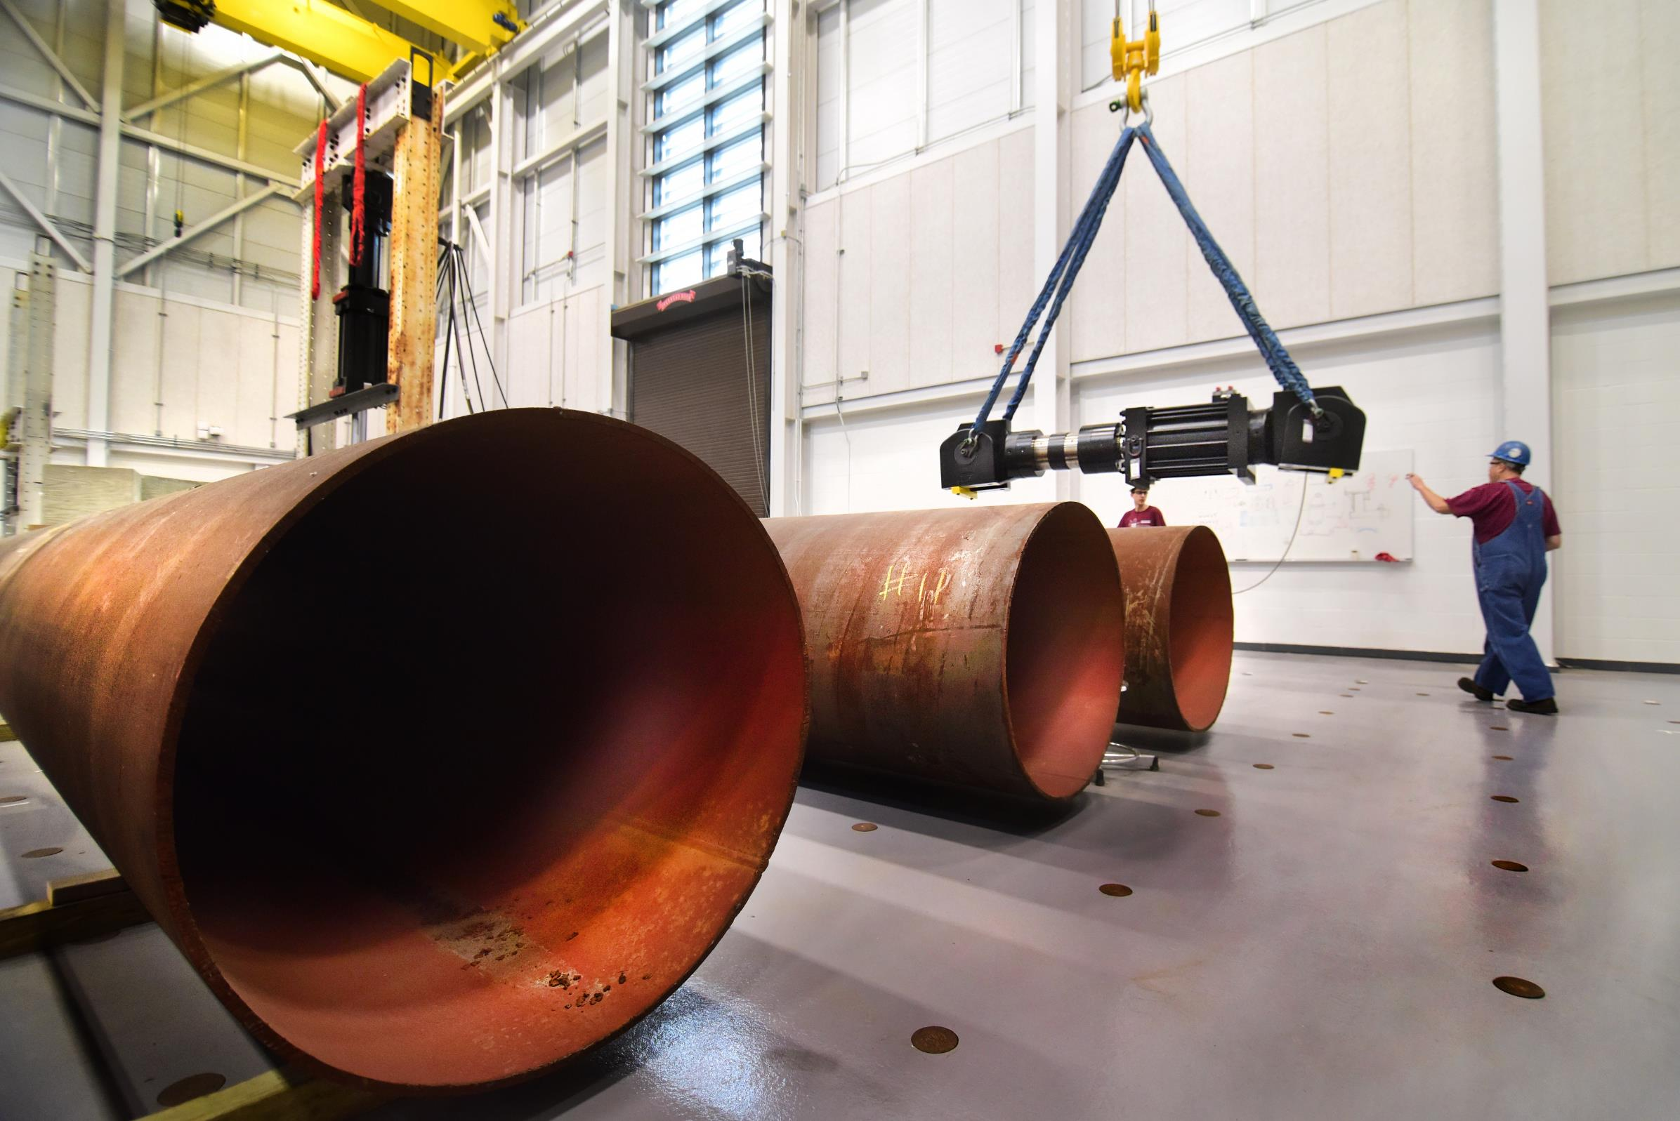
Structural & materials testing lab
Developing advanced assessment techniques for aging infrastructure with a focus on structural systems, evaluation/improvement of current design standards to improve national specifications, and addressing Texas infrastructure problems
Notes:
Strong ties to UF with the wind tunnel, too.

Slide 17
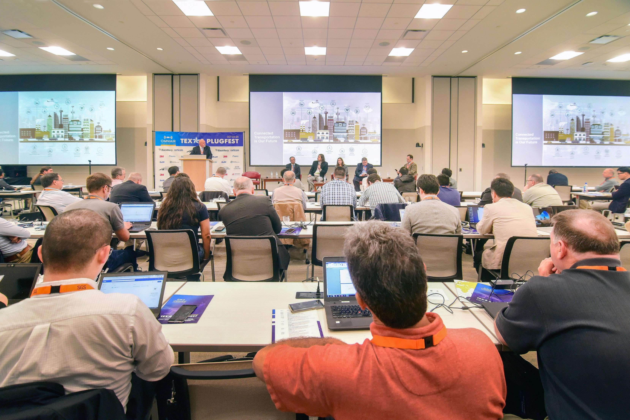
Training & conference space
Notes:
Can seat up to 120 people, 3 rooms, AV, live webstreaming, etc.

Slide 18
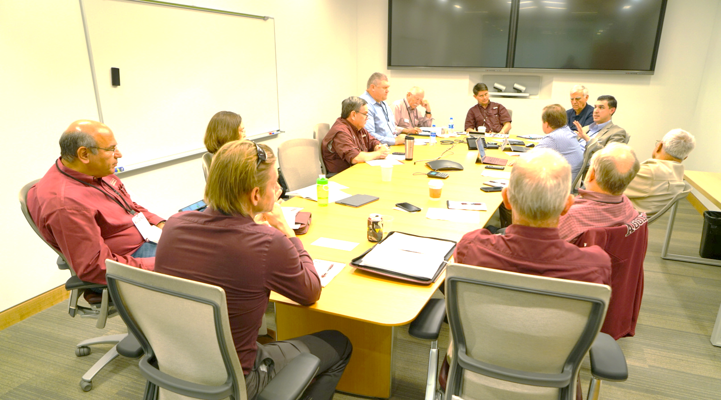
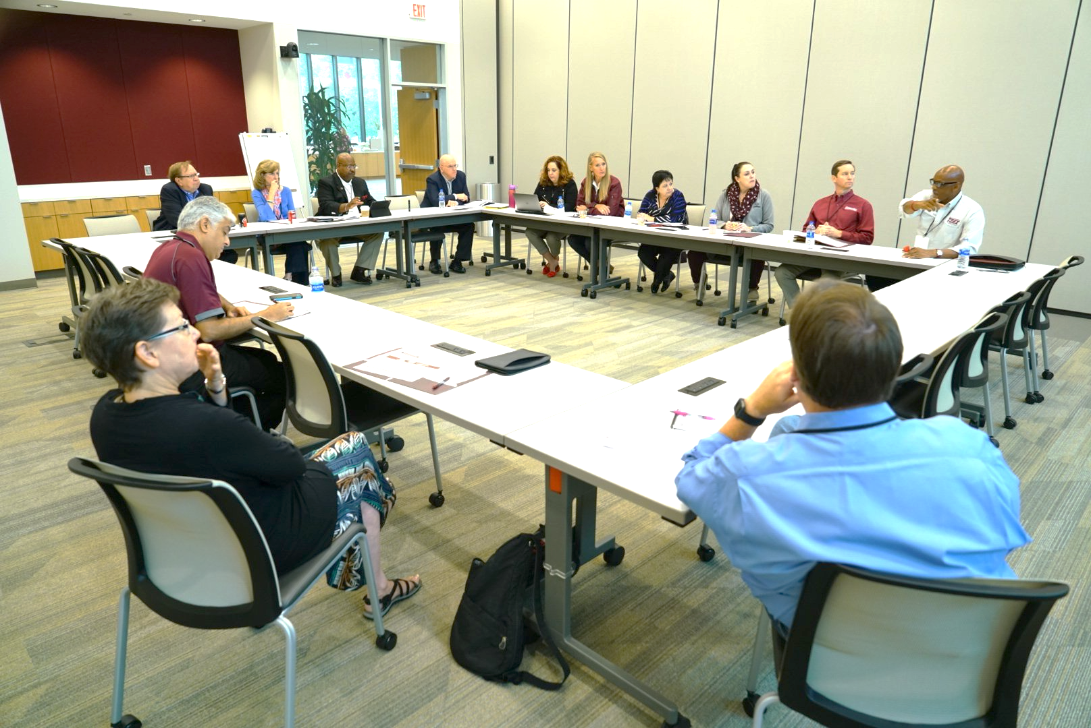
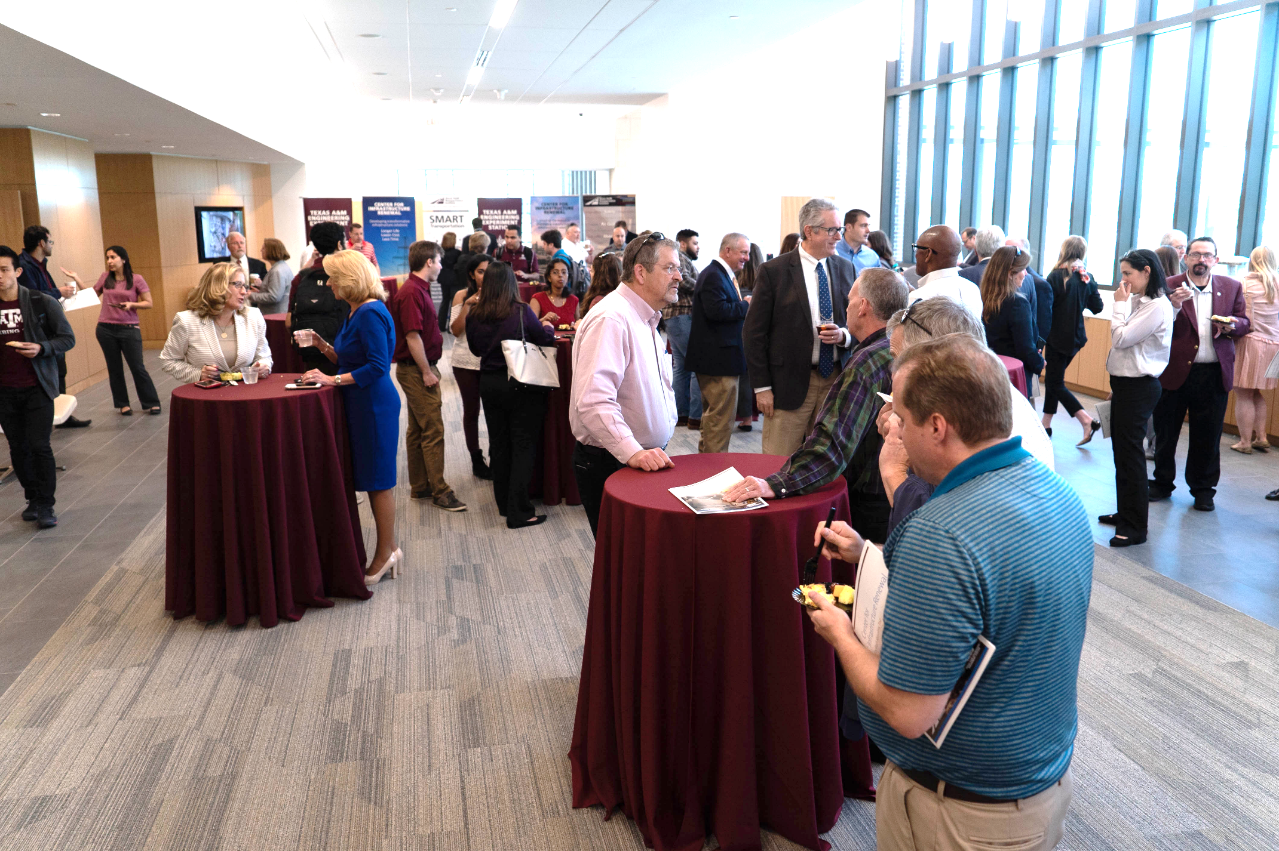
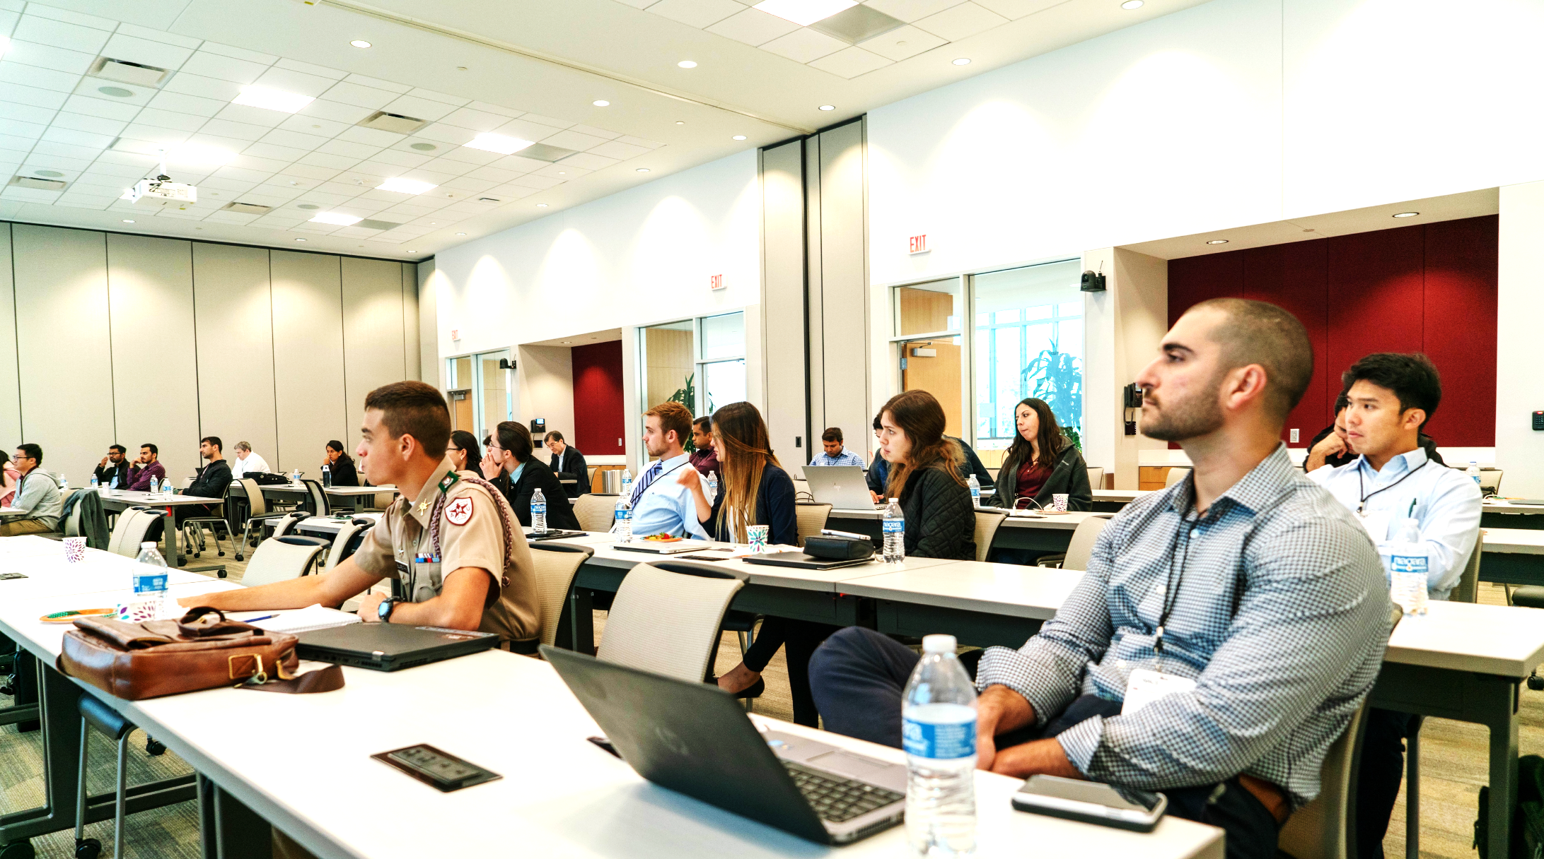
Training & conference space

Slide 19
How do you ensure resilience?
“An ounce of prevention is worth a pound of cure”
Resilience is addressed up front in the design and planning process!
Leverage the CIR – a new, state of the art Texas asset focused on resilience of infrastructure!
  Access to best facilities and researchers, as well as a link to the broader TAMU resources

Slide 20

Current gap
We commonly receive calls from communities needing infrastructure assistance
  Sometimes BIG problems in need of research solution
  Sometimes lack of best practices / updated information
    Small communities often lack “specialists”
  Researchers clock hours
There is a need for support for communities to enable training, consulting, and research to ensure resilient communities and to best leverage the CIR – a new TX asset.
Notes:
Awareness is important – you are getting that from me now. But what about the money?

